Slide 2
Community Engagement in Low- and Moderate-Income Solar
Ari Gerstman, DOEE
Dan Bausch, APPRISE

Slide 3
Outline and Approach
Residential Solar and LMI Households
DC Solar for All
LMI Solar Discussion
3

Slide 4
Residential Solar and lmi households
4

Slide 5
History
Residential solar programs historically targeted the installation of solar systems directly on homes.
E.g. Rooftop solar
Early solar programs did not specifically target LMI households.
As solar programs and markets have matured, costs have decreased. However, solar installations remain unaffordable or unfeasible for a large portion of LMI households.
5

Slide 6
History
In recent years, distributed solar programs have been piloted, launched, and expanded to allow households to participate in solar without installing systems on-site.
E.g. Community solar
21 States and DC have passed legislation supporting community solar (NREL Sharing the Sun, July 2021)
Community solar offers expanded opportunity for LMI households to receive the benefits of solar generation.
6

Slide 7
Current Landscape
Increase in interest and policies to promote participation in solar for LMI households and underserved groups.
Jurisdictions are developing different approaches to:
Determine who to target (Disadvantaged Communities, Environmental Justice Areas, Moderate-Income Definitions)
Identify the best models to deploy and resource (incentives, grants, etc.)
Find and recruit eligible households (rely on vendors, leverage other programs, outreach campaigns)
Engage community partners (stakeholder development process, trainings, etc.)
7

Slide 8
LMI Solar Program Examples
8

Slide 9
NYSERDA NY-Sun (New York)
Solar Energy Equity Framework (enacted in 2020)
A goal of 40% of solar benefits be provided to targeted to disadvantaged communities (DACs) to meet Climate Act requirement.
NYSERDA has developed draft criteria for DACs and is undergoing public comments now.
Recent expansion under new roadmap.
https://www.nyserda.ny.gov/About/Newsroom/2021-Announcements/2021-12-17-Governor-Hochul-Announces-New-Framework
9

Slide 10
NYSERDA NY-Sun (New York) LMI Initiatives
Affordable Solar Rooftop Incentive
Incentive for rooftop systems for income-qualifying households
Multifamily Affordable Housing Incentive
Incentives for systems on affordably housing buildings
Affordable Solar and Storage Predevelopment and Technical Assistance
Grants for community-based planning and preparation work
Inclusive Community Solar Adder
Incentives for community solar projects serving LMI households
Solar for All / Expanded Solar for All
Small utility bill discount to qualifying households
Expanded program jointly run with National Grid to enroll customers from bill discount program
Community-led Solar (Co-Design In Progress)
Working to create program for community-developed projects in underserved areas
10

Slide 11
Illinois’ Solar For All
Established in 2016 by Public Act 99-0906 Future Energy Jobs Act
Four Sub-Programs:
Low-Income Distributed Generation
Systems for homes/multifamily buildings
Low-Income Community Solar
Subscriptions to PV system
Non-Profits and Public Facilities
Systems for non-profits or public buildings in Environmental Justice or low-income communities
Low-Income Community Solar Pilot Programs
Projects funded using competitive procurement approach
11

Slide 12
Illinois’ Solar For All Low-Income Community Solar Sub-Program
Subscribers receive bill credits for their subscription share
Projects must show partnerships with community stakeholders in the area where the project will be located.
Incentives are provided for low-income subscription portion.
http://www.appriseinc.org/wp-content/uploads/2020/02/ILSFA-Phase-II-First-Interim-Report-Presentation-12-13-19.pdf
12

Slide 13
DC Solar For all
13

Slide 14
Origins
Established in 2016 by the Renewable Portfolio Standard Expansion Act
Statutory Language
“The Program shall provide the long-term financial benefits of solar energy production to at least 100,000 District low-income households in an amount equivalent to at least 50% of the District's average residential electric bills for calendar year 2016 by December 31, 2032. The Department shall, to the extent feasible, meet this goal by reducing low-income households' electric or gas bills by at least 50%.”
Administered by DC Department of Energy and Environment (DOEE)
14

Slide 15
Phased Approach
Phase 1 (FY 2017-2019)
Fund grantees to test models of deployment
Establish community partnerships
Work through initial barriers / challenges
Identify strategies to furnish benefits to those without electric bills
Phase 2 (FY 2020-FY 2022)
Increase solar deployment (scale up)
Refine / develop strategies for large-scale community solar deployment
Identify ways to increase enrollment
Assess progress and conclusions from efforts
15

Slide 16
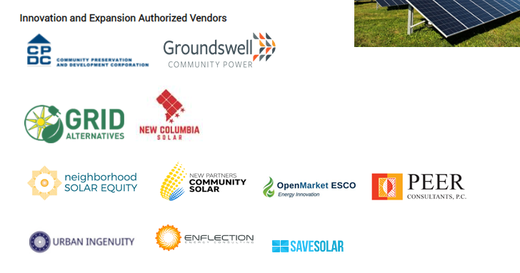
Program Partners
16

Slide 17
Solar Types
Single Family Installations
Install on rooftops
Multifamily Affordable/Low-Income Housing
Sized so savings are 50% of usage (when feasible)
Direct and indirect benefits to residents in buildings under affordable housing covenant
Rooftop repair allowable
Community Solar
Installations on land / facilities
Residents at the location, in area, or in District when receive virtual net metering credits.
Subscribers guaranteed benefits for minimum of 15 years.
17

Slide 18
Solar Benefits to Households
Direct Bill Credits
Benefits targeted to 50% of bill or $500 annual value.
Indirect Benefits
Reductions in homeowner’s association (HOA) fees
Resident services / amenities
Building improvements
Net metering credits on electric bill
18

Slide 19
Results So Far
Provided Innovation & Expansion Grants to 9 organizations.
Established multiple partnerships / Program Components
Deployed approximately 20 MW serving 8,000 households
Effective use of LIHEAP information/system to target and confirm qualifying households
Over 250 residents received job training via Solar Works DC
Fiscal Year | Megawatts Deployed | Households Targeted | Expenditures (Millions)
2017 | <1 | 20 | $3.04
2018 | <1 | 364 | $19.08
2019 | 7 | Approximately 8,600 | $22.18
2020 | 11 | 3,100 | $27.73
TOTAL Through 2020 | ~20 | ~12,000 | $72.03
19

Slide 20
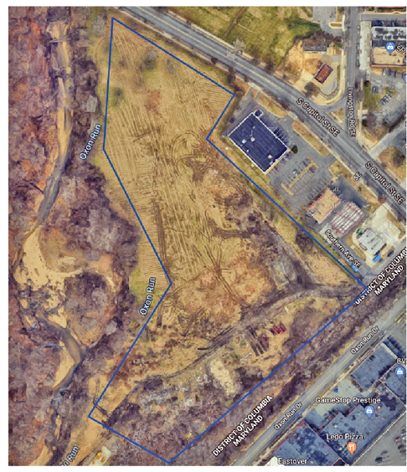
Example: Oxon Run
Brownfield site owned by government
Contract awarded to GRID Alternatives Mid-Atlantic to complete solar installation at site.
2.65 MW to benefit ~780 LMI households in immediate vicinity.
Area land restoration for solar installation
Construction completed in Dec. 2020.
20

Slide 21
Community Engagement Challenges
To reach the 2032 goal, the program needs to serve several thousand new households per year.
The LMI population in DC is…
58% LIHEAP-eligible / 42% not
72% pay electric bill / 28% have no electric bill
Continued effort needed for increasing participation
21

Slide 22
Community Engagement Challenges
Expanding relationships with trusted community partners and groups
Communicating solar benefits to LMI households
Reducing barriers to applying/recertification
Coordination with partners and utility
Recruitment of building owners and sites
22

Slide 23
LMI Solar DISCUSSION
23

Slide 24
Getting Started with LMI Solar
There are so many options, so many steps, so many voices.
How do you identify where to start with developing effective LMI solar initiatives?

Slide 25
Solar Deployment / Business Models
Which models worked well in your jurisdiction? Why?
Which models haven’t worked for your jurisdiction? Why not?

Slide 26
Partners and Stakeholders
How do you identify potential partners?
How do you build and maintain partnerships?
What are the challenges?

Slide 27
Targeting LMI Households
How do you identify or find LMI households?
How do you recruit them?
What are the challenges with reaching low-income households? Moderate-income?
How do you retain them?

Slide 28
LMI Solar Challenges
What are the main hurdles you are facing with LMI solar?
How are you working to overcome those problems?

Slide 29
Equity Considerations
How do you make sure programs are serving LMI households with different characteristics and that initiatives are as inclusive as possible?
Are we systematically missing any segments?

Slide 30
Recommendations
Where else would models that worked for your jurisdiction work well?
What should other policymakers and program advocates consider and plan for to make programs more successful?

Slide 31
Contact
Ari Gerstman
Associate Director for Policy and Compliance
Energy Administration
Department of Energy & Environment
Government of the District of Columbia
1200 First Street NE, 5th Floor
Washington, DC 20002
202-499-2015
Dan Bausch
Project Director, APPRISE
609-252-9050
Daniel-Bausch@appriseinc.org
31

