Slide 2
LIHEAP Clearinghouse Website – Finding what you need when you need it!
Marisa Larson, LIHEAP Clearinghouse Manager, NCAT
Daniel Bausch, Project Director, APPRISE
David Carroll, Managing Director, APPRISE

Slide 3
Section #1 – Understanding LIHEAP Websites

Slide 4
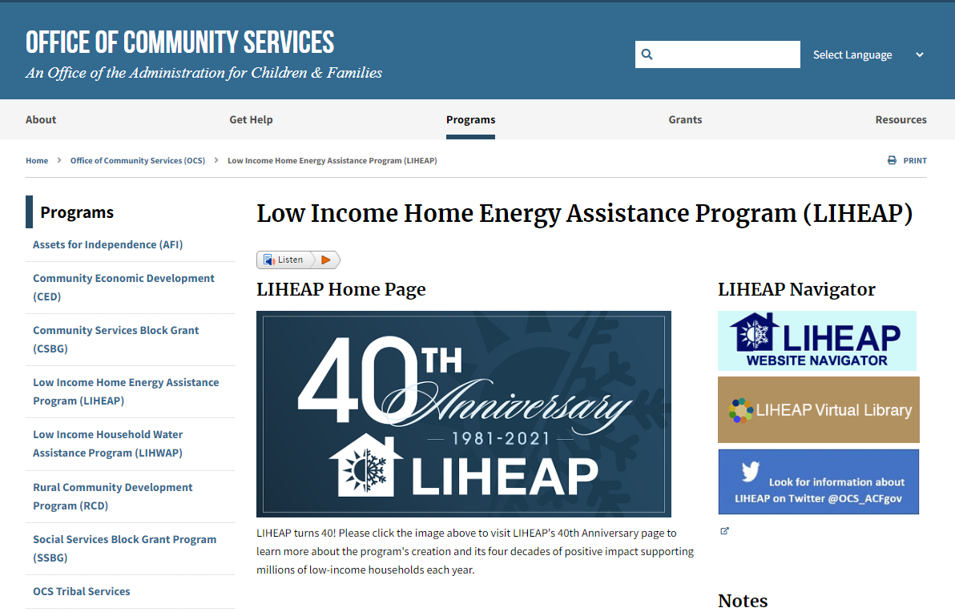
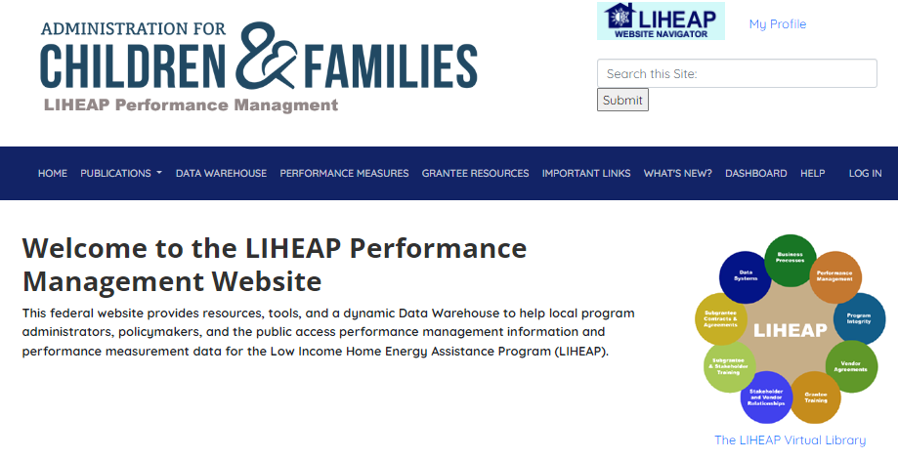
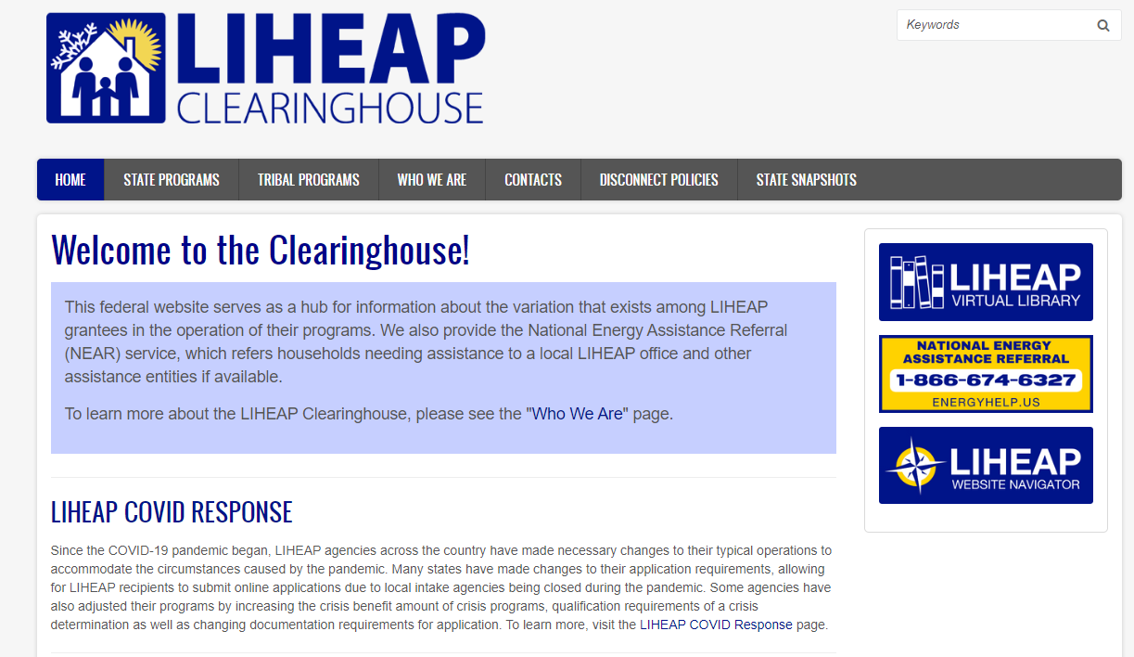
LIHEAP Websites Supported by HHS Office of Community Services (OCS)
HHS LIHEAP Website
LIHEAP Clearinghouse
Performance Management Website
Notes:
Another resource available on our website are the State Snapshots. Each snapshot provides a quick picture of what is going on in each state. Those snapshots are divided into subsections related to Energy Assistance [click], Energy Efficiency [click], and Utility Assistance [click]. To the left I’ve linked to a few examples of what that looks like. The Energy Assistance subsection will include information on LIHEAP and state-funded energy assistance efforts. We provide contact information for those seeking energy and weatherization assistance as well as a snapshot of funding levels for the current fiscal year, income eligibility, benefit amounts, the number of households served based on the most recently available household reports, as well as program dates. Further down, if available, we provide information on low-income energy efficiency assistance available from each grantee as well as information on utility-funded energy assistance programs and also information on assistance through charitable organizations, when available.

Slide 5
HHS LIHEAP Website – Federal LIHEAP Policy
https://www.acf.hhs.gov/ocs/low-income-home-energy-assistance-program-liheap
Notes:
Another resource available on our website are the State Snapshots. Each snapshot provides a quick picture of what is going on in each state. Those snapshots are divided into subsections related to Energy Assistance [click], Energy Efficiency [click], and Utility Assistance [click]. To the left I’ve linked to a few examples of what that looks like. The Energy Assistance subsection will include information on LIHEAP and state-funded energy assistance efforts. We provide contact information for those seeking energy and weatherization assistance as well as a snapshot of funding levels for the current fiscal year, income eligibility, benefit amounts, the number of households served based on the most recently available household reports, as well as program dates. Further down, if available, we provide information on low-income energy efficiency assistance available from each grantee as well as information on utility-funded energy assistance programs and also information on assistance through charitable organizations, when available.

Slide 6
LIHEAP Clearinghouse Website – State, Tribal, and Territorial Data
https://liheapch.acf.hhs.gov/
Notes:
Another resource available on our website are the State Snapshots. Each snapshot provides a quick picture of what is going on in each state. Those snapshots are divided into subsections related to Energy Assistance [click], Energy Efficiency [click], and Utility Assistance [click]. To the left I’ve linked to a few examples of what that looks like. The Energy Assistance subsection will include information on LIHEAP and state-funded energy assistance efforts. We provide contact information for those seeking energy and weatherization assistance as well as a snapshot of funding levels for the current fiscal year, income eligibility, benefit amounts, the number of households served based on the most recently available household reports, as well as program dates. Further down, if available, we provide information on low-income energy efficiency assistance available from each grantee as well as information on utility-funded energy assistance programs and also information on assistance through charitable organizations, when available.

Slide 7
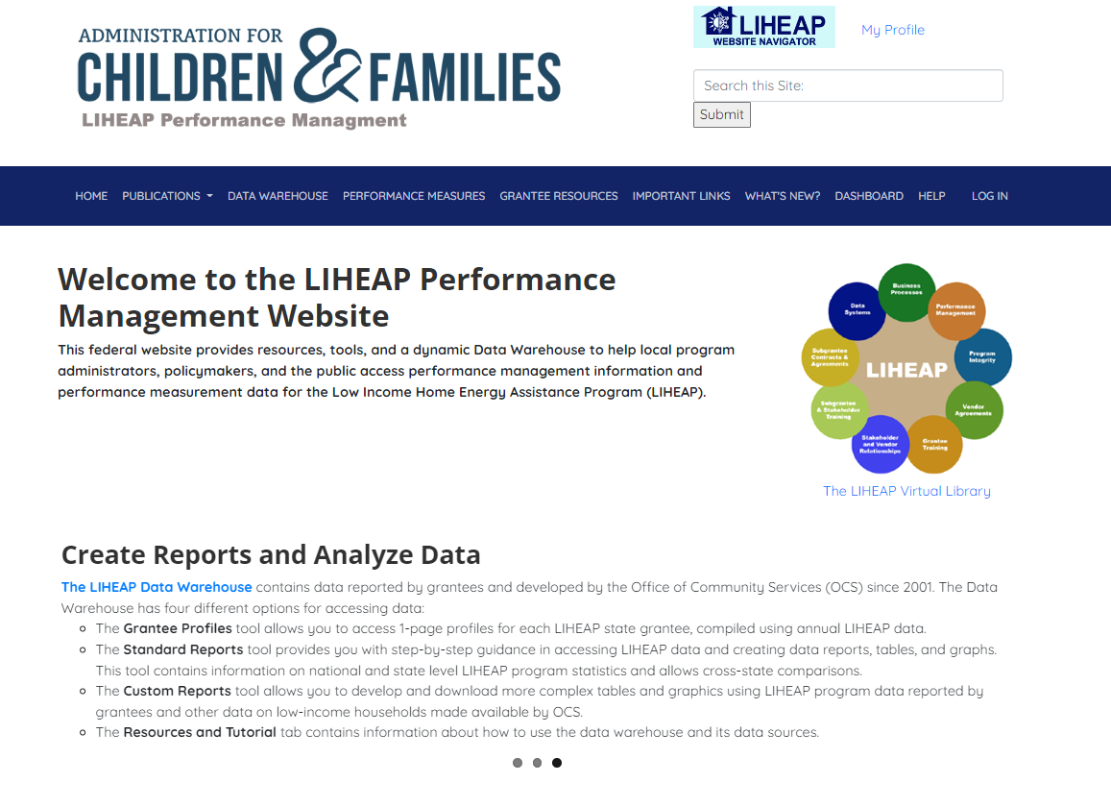
LIHEAP Performance Management Website – LIHEAP Performance Statistics
https://liheappm.acf.hhs.gov/
Notes:
Another resource available on our website are the State Snapshots. Each snapshot provides a quick picture of what is going on in each state. Those snapshots are divided into subsections related to Energy Assistance [click], Energy Efficiency [click], and Utility Assistance [click]. To the left I’ve linked to a few examples of what that looks like. The Energy Assistance subsection will include information on LIHEAP and state-funded energy assistance efforts. We provide contact information for those seeking energy and weatherization assistance as well as a snapshot of funding levels for the current fiscal year, income eligibility, benefit amounts, the number of households served based on the most recently available household reports, as well as program dates. Further down, if available, we provide information on low-income energy efficiency assistance available from each grantee as well as information on utility-funded energy assistance programs and also information on assistance through charitable organizations, when available.

Slide 8
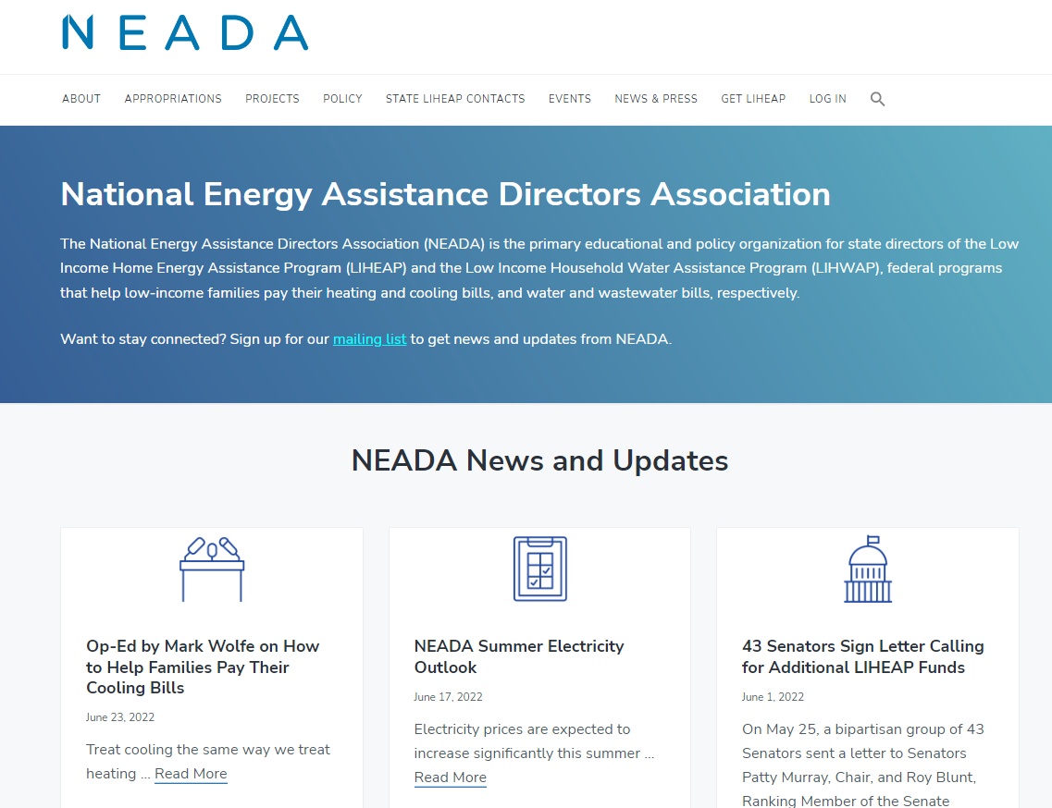
National Energy Assistance Directors Association – LIHEAP Grantee Organization/ Not OCS
https://neada.org/

Slide 9
Section #2 – LIHEAP Clearinghouse State Snapshots

Slide 10
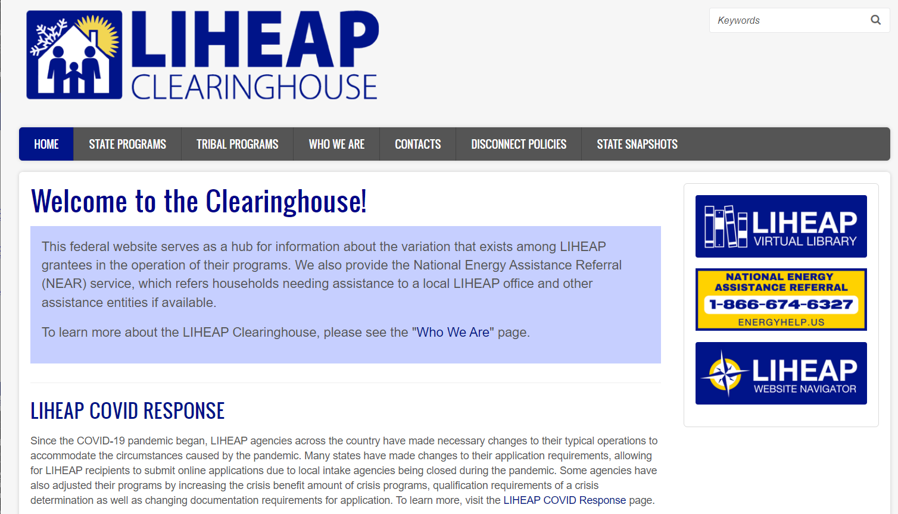
LIHEAP Clearinghouse Website – State Snapshots
https://liheapch.acf.hhs.gov/snapshots.htm

Slide 11
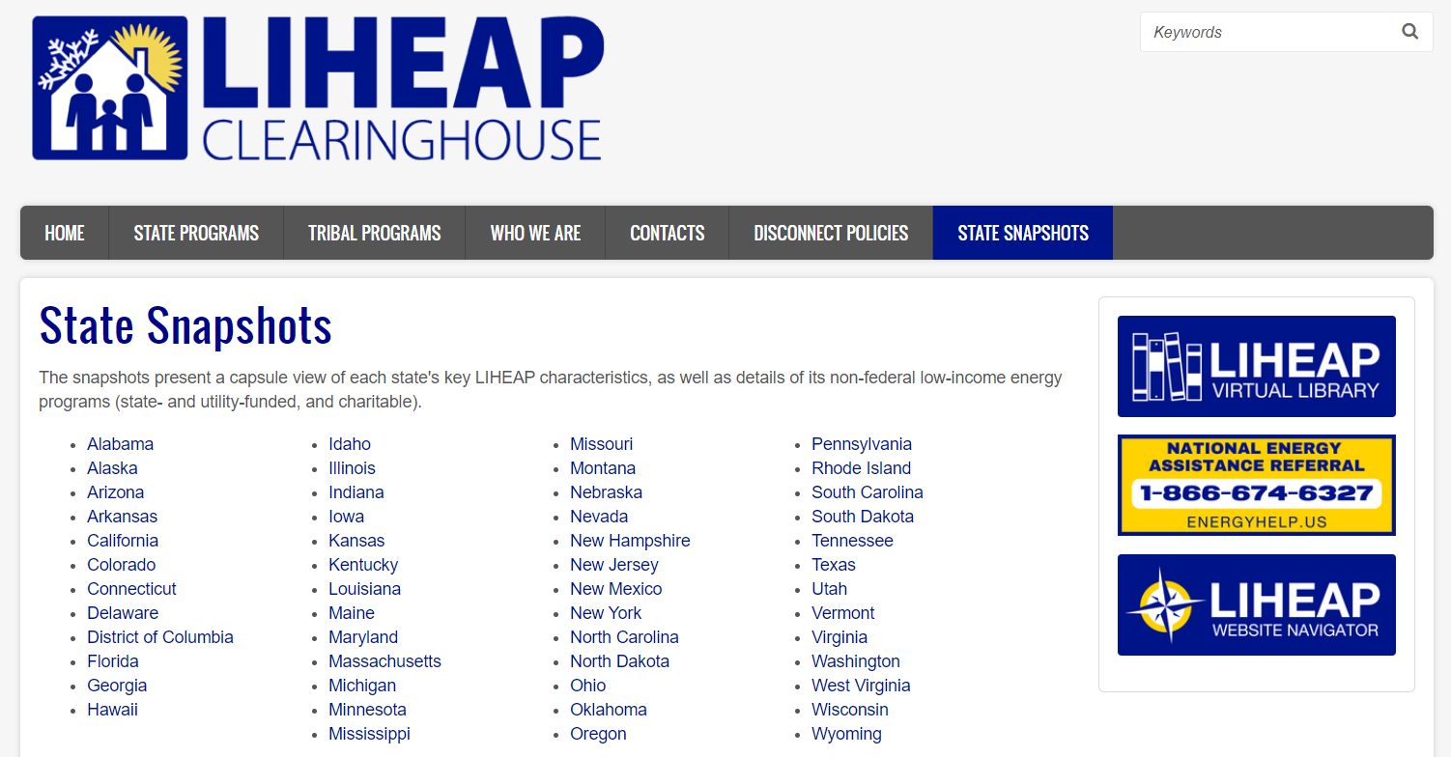
Selecting a State
https://liheapch.acf.hhs.gov/snapshots.htm

Slide 12
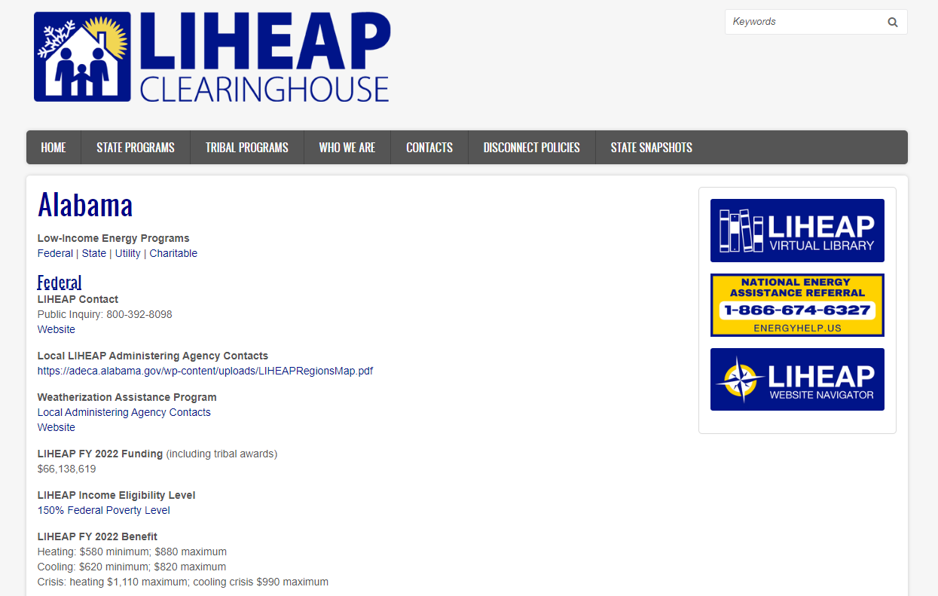
State Information
https://liheapch.acf.hhs.gov/profiles/Alabama.htm

Slide 13
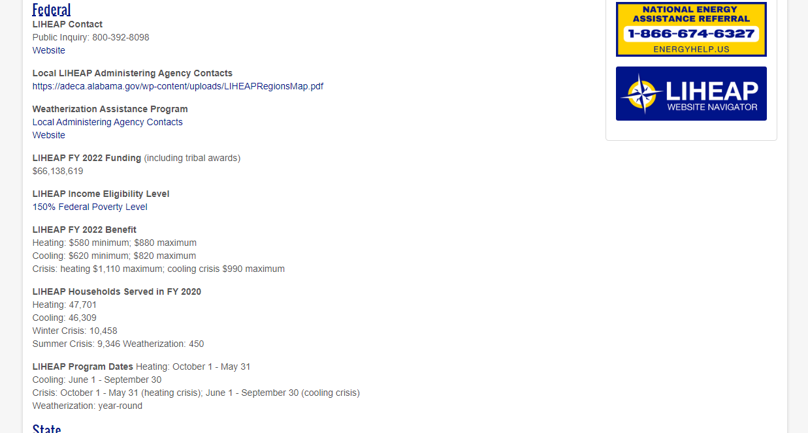
LIHEAP Data Federal
https://liheapch.acf.hhs.gov/profiles/Alabama.htm#federal

Slide 14
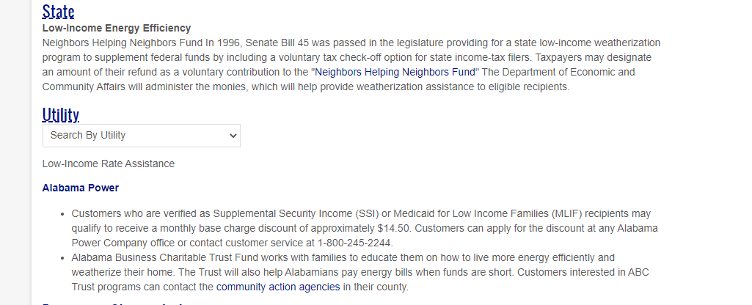
State Energy Assistance and Energy Efficiency
https://liheapch.acf.hhs.gov/profiles/Alabama.htm#state

Slide 15
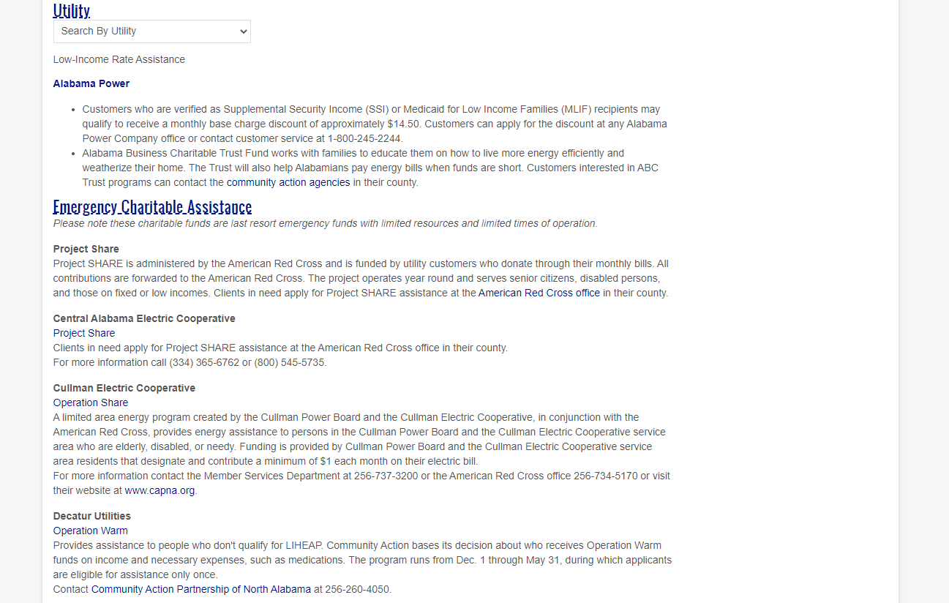
Utility Energy Assistance and Energy Efficiency
https://liheapch.acf.hhs.gov/profiles/Alabama.htm#utility

Slide 16
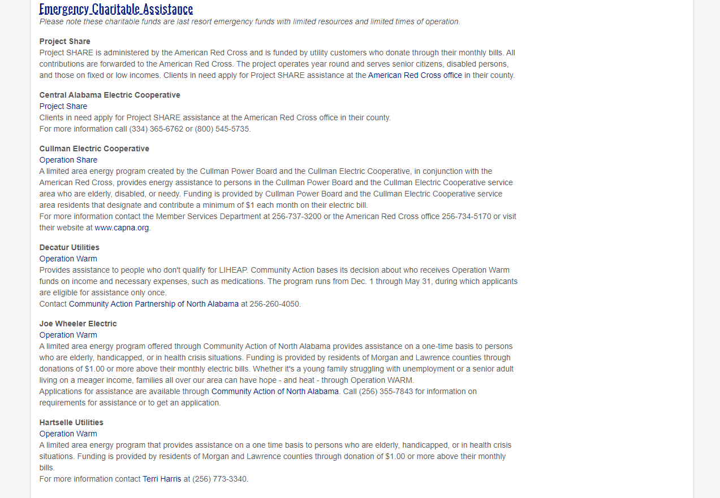
Charitable Assistance
https://liheapch.acf.hhs.gov/profiles/Alabama.htm#charitable

Slide 17
Summary of Information
State LIHEAP Program Data
State Administered Programs
Utility Administered Programs
Charitable Programs
We want this to be a partnership. Please review the data we have recorded for your state and tell us if you see anything that needs to be updated.

Slide 18
Information Sources
LIHEAP State Plan – FY 2022 data
LIHEAP Grantee Reports – FY 2020 data (FY 2021 soon)
Information from state and utility websites

Slide 19
Section #2 – LIHEAP Clearinghouse State Snapshots Q&A

Slide 20
Section #3 – State Programs

Slide 21
LIHEAP Clearinghouse Website – State Programs
https://liheapch.acf.hhs.gov/

Slide 22
Resources on State Programs Tab
https://liheapch.acf.hhs.gov/state

Slide 23
State Program Administration
Statutes & Regulations
Plans, Manuals & Delegation Letters
Costs & Definitions
Administering Agencies
Energy Vendor & Local Agency Contacts
Fiscal Management
Oversight & Monitoring
Program Integrity

Slide 24
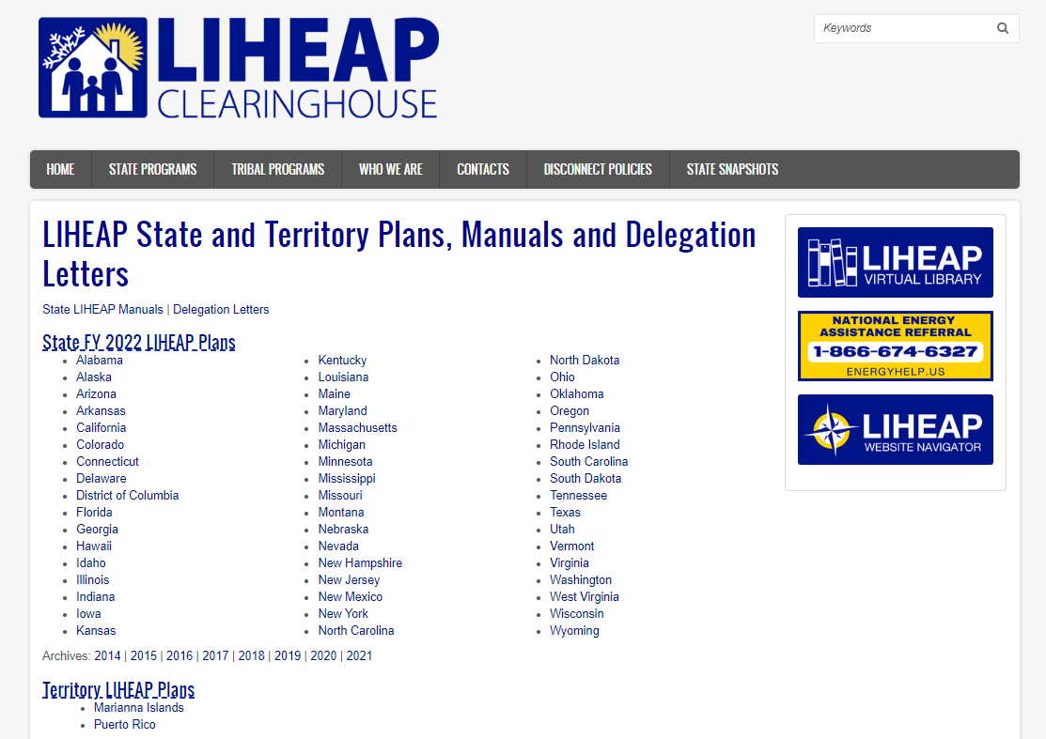
Plans, Manuals & Delegation Letters
https://liheapch.acf.hhs.gov/stateplans.htm

Slide 25
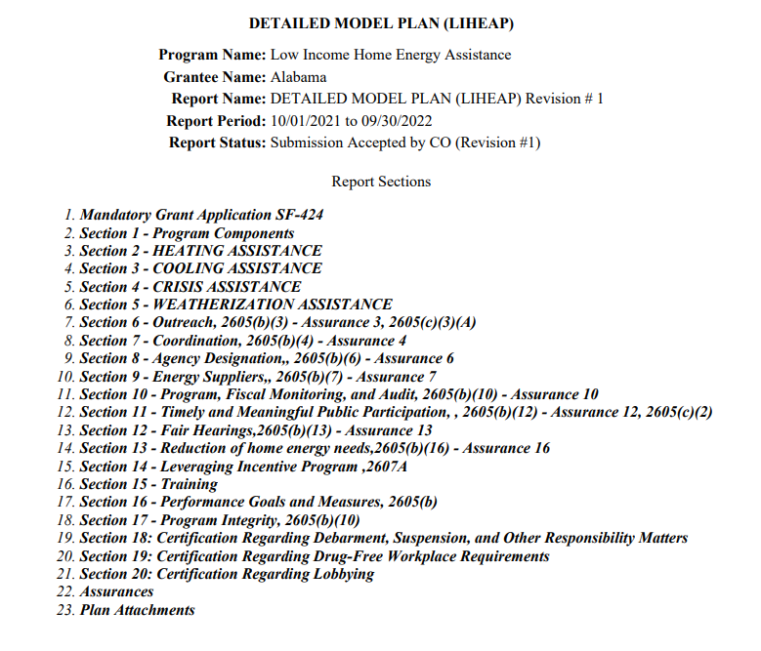
Alabama State Plan
https://liheapch.acf.hhs.gov/sites/default/files//webfiles/docs/AL_Plan_2022.pdf

Slide 26
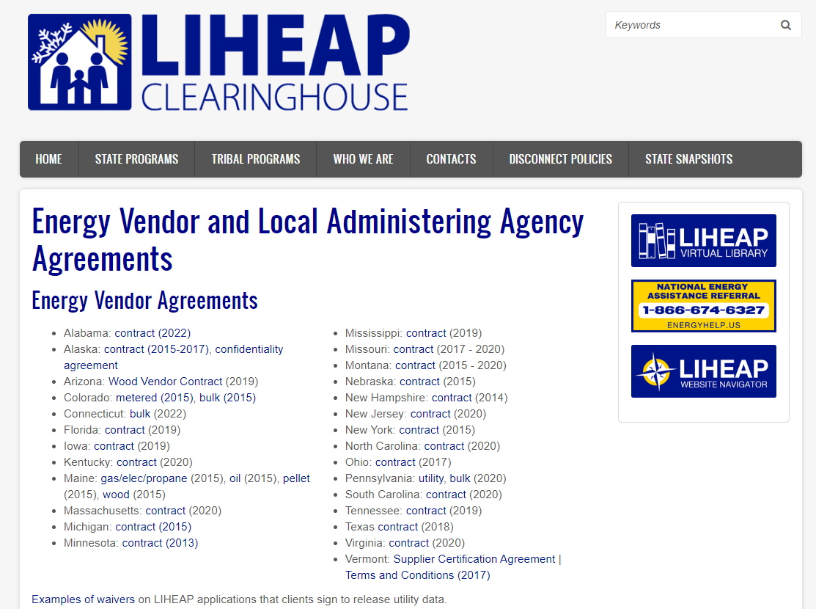
Energy Vendor and Local Agency Contracts
https://liheapch.acf.hhs.gov/admin/contracts.htm

Slide 27
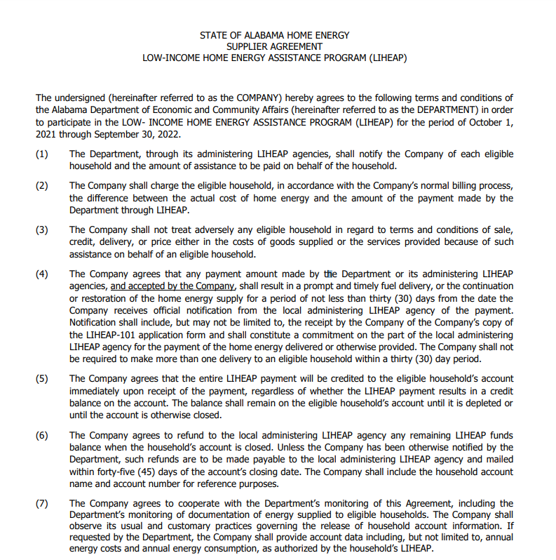
Alabama Vendor Contract
https://liheapch.acf.hhs.gov/sites/default/files/webfiles/docs/AL_VendorAgreement_2022.pdf

Slide 28
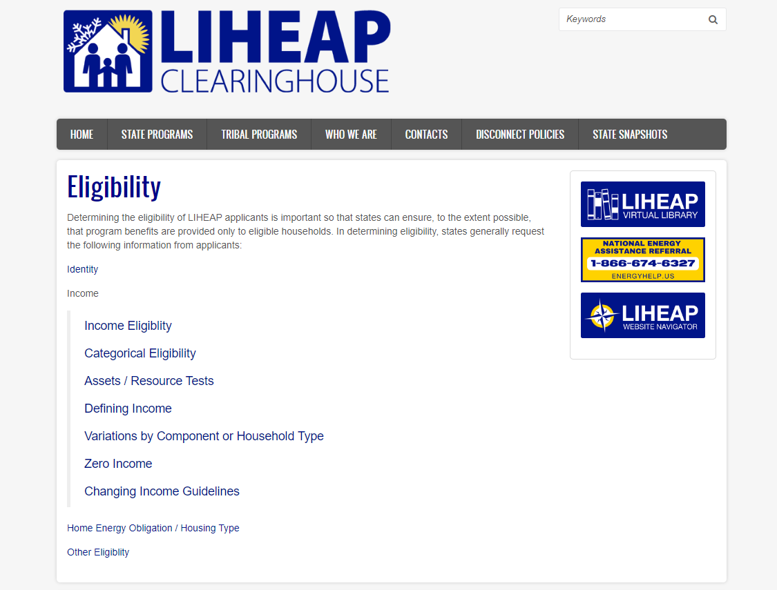
State Program Analysis - Eligibility
https://liheapch.acf.hhs.gov/delivery/eligibility.htm

Slide 29
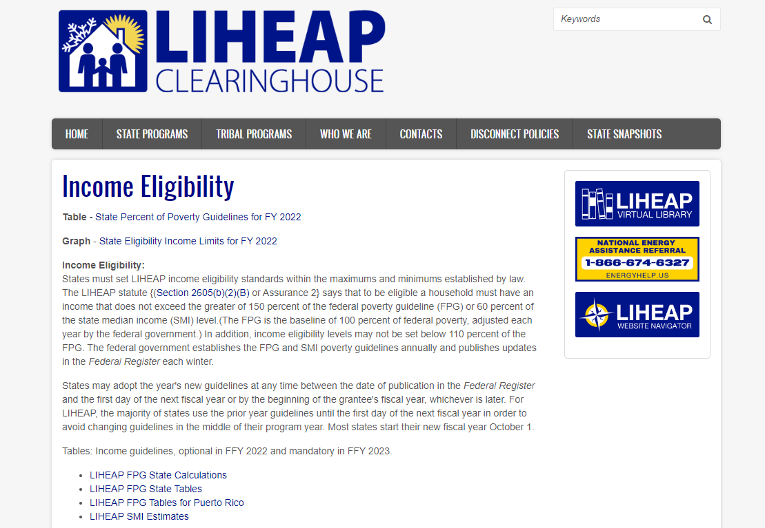
State Program Analysis – Income Eligibility
https://liheapch.acf.hhs.gov/delivery/income_eligibility.htm

Slide 30
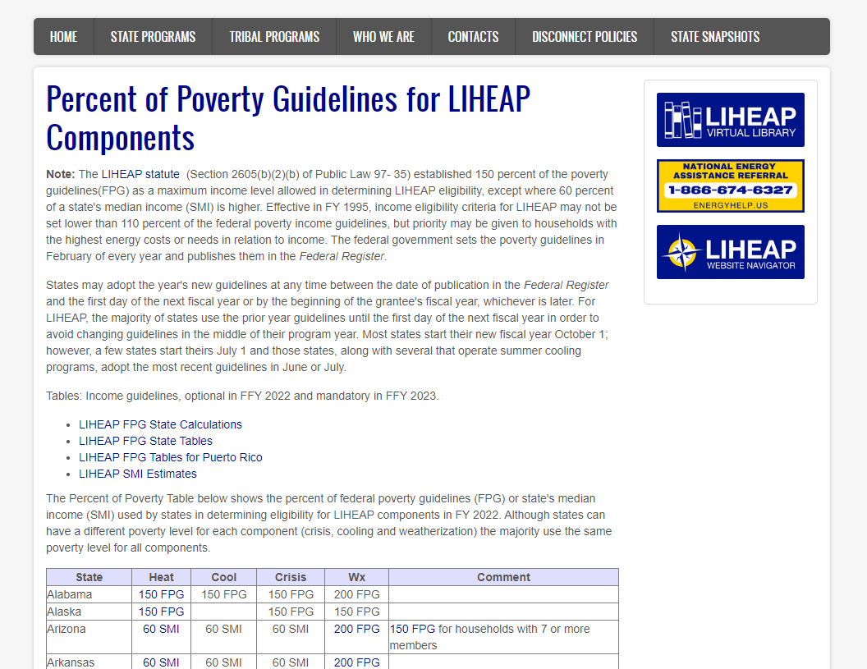
State Program Analysis – State Percent of Poverty Guidelines
https://liheapch.acf.hhs.gov/delivery/income_eligibility.htm

Slide 31
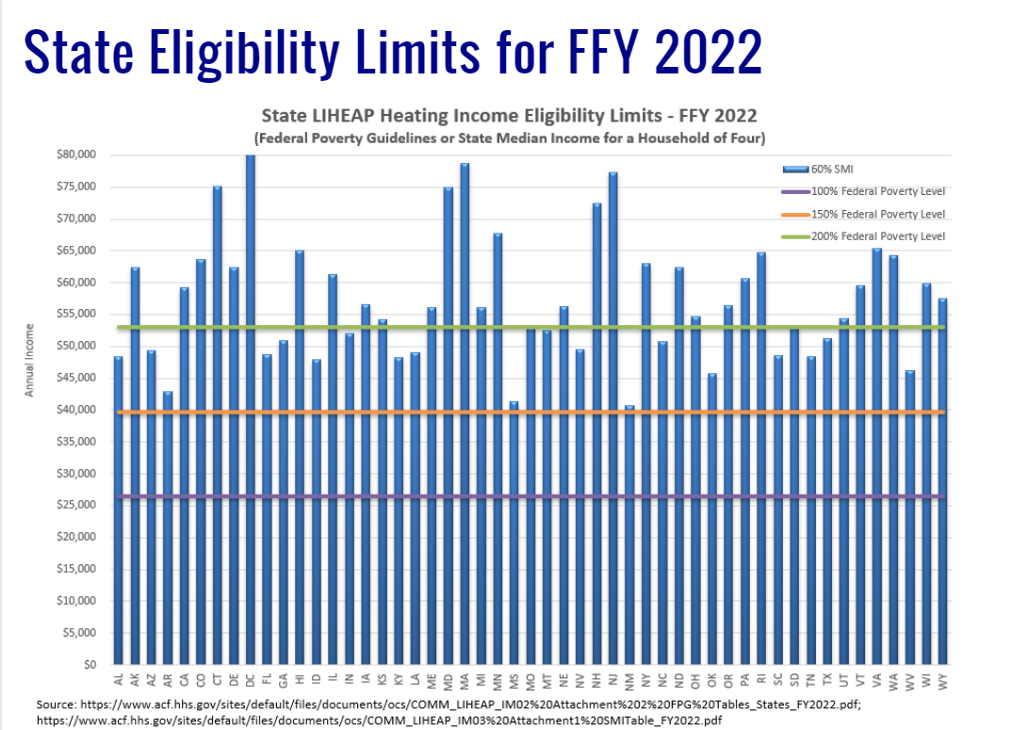
State Program Analysis – State Income Limits Graph
https://liheapch.acf.hhs.gov/delivery/eligibility_graph.htm

Slide 32
Section #3 – State Programs Q&A

Slide 33
Section #4 – Website Navigator

Slide 34
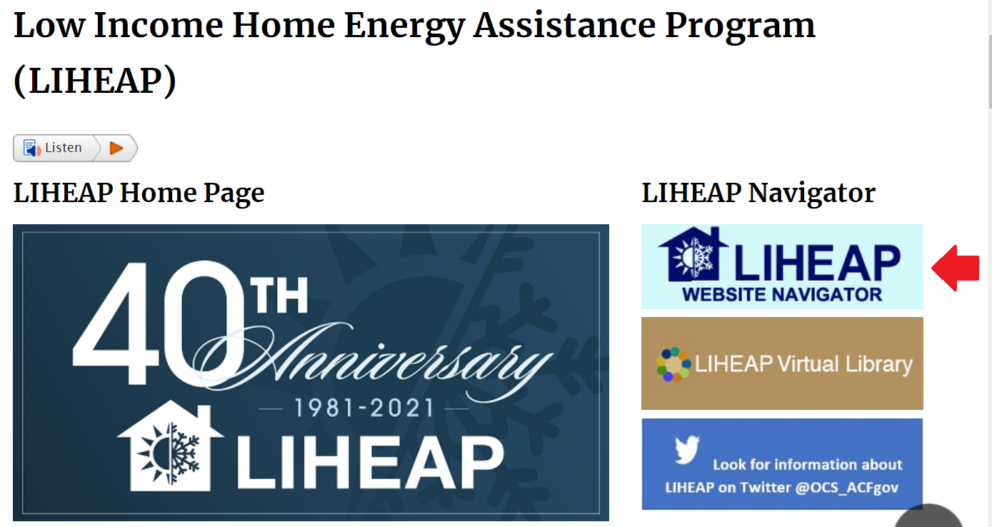
LIHEAP Website Navigator
https://liheappm.acf.hhs.gov/navigator.php

Slide 35
LIHEAP Website Navigator – Background and Purpose
The LIHEAP Website Navigator is a navigation tool to help LIHEAP grantees, stakeholders, and the public find LIHEAP information they need across the three federal LIHEAP websites.
The Website Navigator is intended as a “one-click” resource to help locate any kind of LIHEAP resources or publishes that are available from HHS.
The Website Navigator was developed with the participation and input of grantees in the Performance Management Implementation Work Group (PMIWG) and OCS.
An icon to the Website Navigator is located on each of the three federal LIHEAP websites.
https://liheappm.acf.hhs.gov/navigator.php

Slide 36
LIHEAP Website Navigator – Options / Features
Testing for the tool found that users vary in how they may think about LIHEAP information categories and how they may search for LIHEAP information.
The Website Navigator has three options to help users search for LIHEAP information:
Main Category Topics
“I’m Looking for” Drop Down Menu
Search Bar
https://liheappm.acf.hhs.gov/navigator.php

Slide 37
LIHEAP Website Navigator – Main Category Options
The menu approach was developed after a comprehensive review of 20+ similar “one-click” website navigators.
9 categories were selected for the tool, and LIHEAP content across the websites was mapped to these categories.
Some items appear in more than one category if the resource may be relevant in both locations.
The Navigator was updated in late 2021 to include updated resources and links.
https://liheappm.acf.hhs.gov/navigator.php

Slide 38
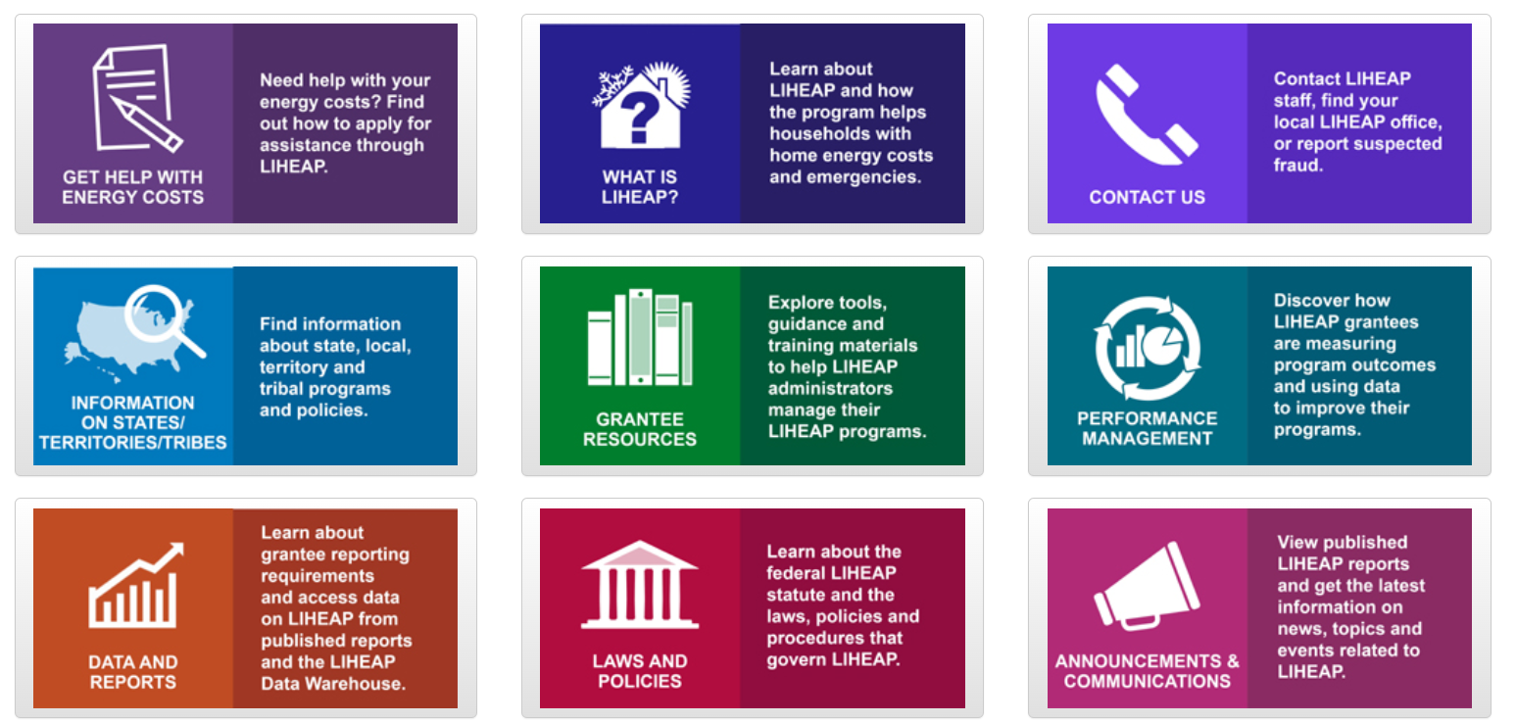
LIHEAP Website Navigator - Main Category Topics
https://liheappm.acf.hhs.gov/navigator.php

Slide 39
LIHEAP Website Navigator – “I’m Look for” Dropdown Menu
During development of the Navigator, NCAT conducted a review of website analytics and searches to determine what resources were most used or search for.
These resources and links to the existing federal website homepages were included in a dropdown menu for users who may want to quickly find a resource or who have difficulty locating it in the main categories.
https://liheappm.acf.hhs.gov/navigator.php

Slide 40
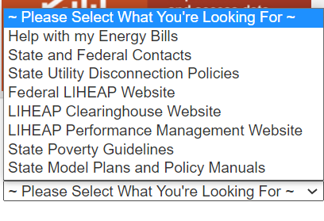
LIHEAP Website Navigator – “I’m Look for” Dropdown Menu
https://liheappm.acf.hhs.gov/navigator.php

Slide 41
LIHEAP Website Navigator – Search Bar
A Search Bar is included so users can search directly for a resource by name.
The Search function will look for resources based on the entered terms.
https://liheappm.acf.hhs.gov/navigator.php

Slide 42
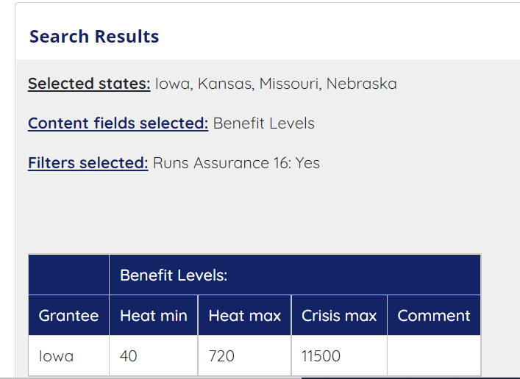
LIHEAP Grantee Search Portal - Background and Purpose
https://liheappm.acf.hhs.gov/datawarehouse/grantee_search_portal/

Slide 43
LIHEAP Grantee Search Portal - Background and Purpose
The Grantee Search Portal is a web-based tool that allows users to obtain state-level LIHEAP program information based on the search criteria they specify.
The Grantee Search Portal was designed by the PMIWG to help grantees:
Systematically select/obtain state-level data or information that is available in each of the separate tables for the Clearinghouse
Identify LIHEAP state grantees that share similar program design and characteristics
Find other state grantees sharing similar desired goals or program characteristics of interest.
https://liheappm.acf.hhs.gov/datawarehouse/grantee_search_portal/

Slide 44
LIHEAP Grantee Search Portal - Functionality
The Grantee Search Portal allows users to:
Display the Clearinghouse tables side-by-side based on the elements they want.
Include states of interest and exclude other states.
Test out different criteria to see what states have those program characteristics.
Download results as a CSV or print results for later use.
https://liheappm.acf.hhs.gov/datawarehouse/grantee_search_portal/

Slide 45
LIHEAP Grantee Search Portal – Process
The Grantee Search Portal has three steps to use the tool:
Step 1: Select the information you want to get
Steps 2: Select filters to look only at states that match the characteristics that you are interested in
Step 3: View results and download table as CSV
https://liheappm.acf.hhs.gov/datawarehouse/grantee_search_portal/

Slide 46
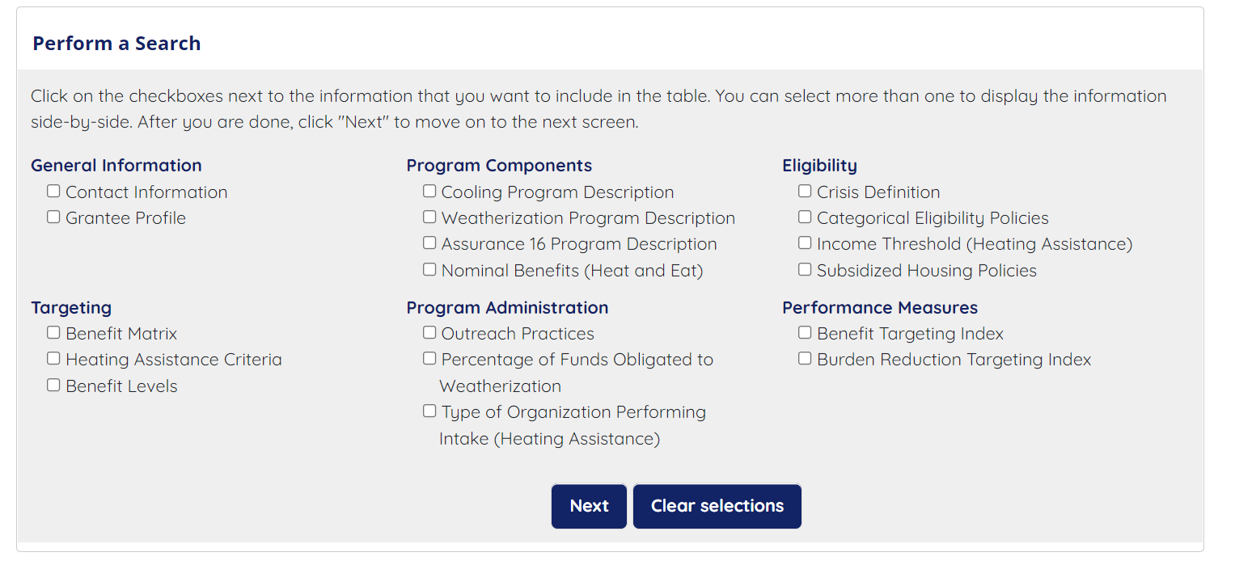
LIHEAP Grantee Search Portal – Step 1
https://liheappm.acf.hhs.gov/datawarehouse/grantee_search_portal/

Slide 47
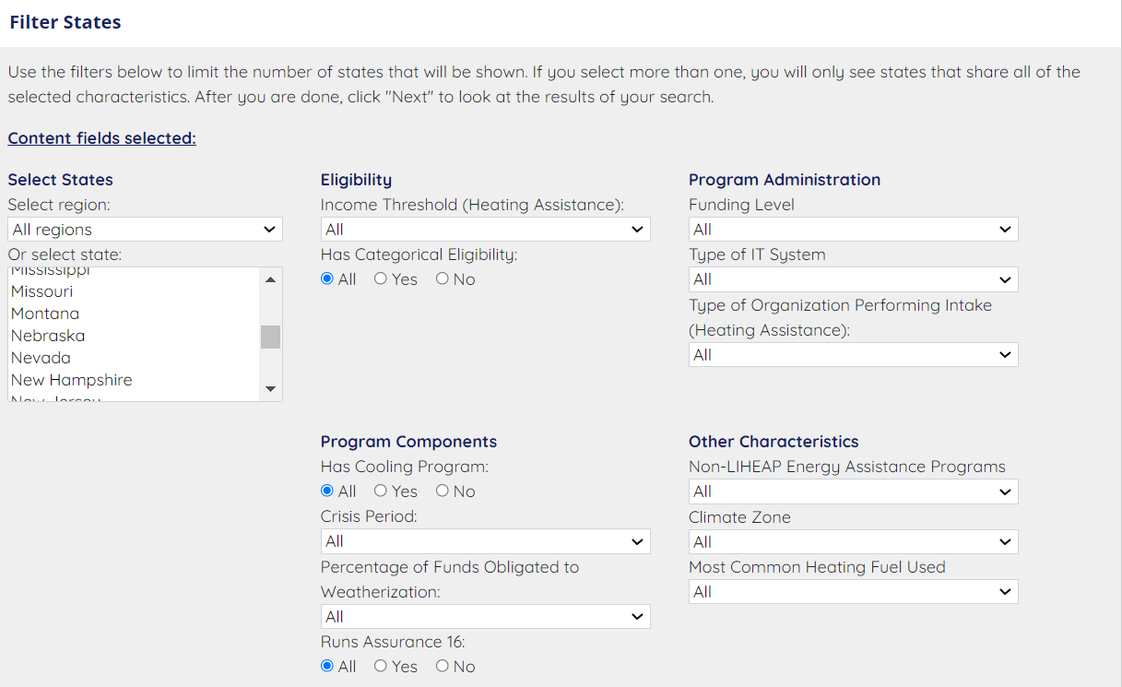
LIHEAP Grantee Search Portal – Step 2
https://liheappm.acf.hhs.gov/datawarehouse/grantee_search_portal/

Slide 48
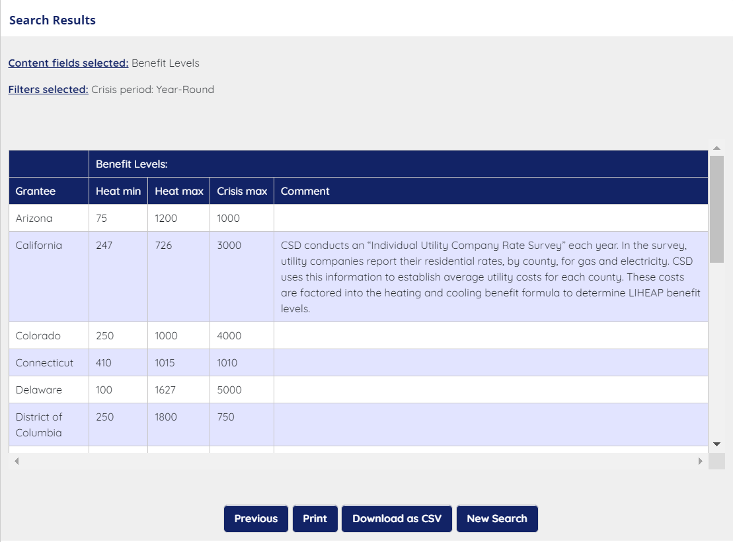
LIHEAP Grantee Search Portal – Step 3
https://liheappm.acf.hhs.gov/datawarehouse/grantee_search_portal/

Slide 49
Website Navigator and LIHEAP Grantee Search Portal – Future Efforts
OCS and the PMIWG are continuously working to identify ways to make LIHEAP information easier to locate and more accessible for use.
Both the Website Navigator and the Grantee Search Portal require regular updates as new content becomes available. Please alert the APPRISE team if you see information that requires updates.
If there is information you would like see included in these tools, please share them with us. This tool is intended to help you!
https://liheappm.acf.hhs.gov/datawarehouse/grantee_search_portal/

Slide 50
Section #4 – Website Navigator Q&A

