Slide 1
LIHEAP 102 – Matching Program Designs to Client’s Needs
June 28th, 2022
Moderator: David Carroll, APPRISE
Theresa Kullen, Colorado Department of Human Services
Jane Blank, Wisconsin Division of Energy, Housing, and Community Resources
Brian Sarensen, Washington State Department of Commerce
Keelie Gustin, Miami Valley Community Action Partnership

Slide 2
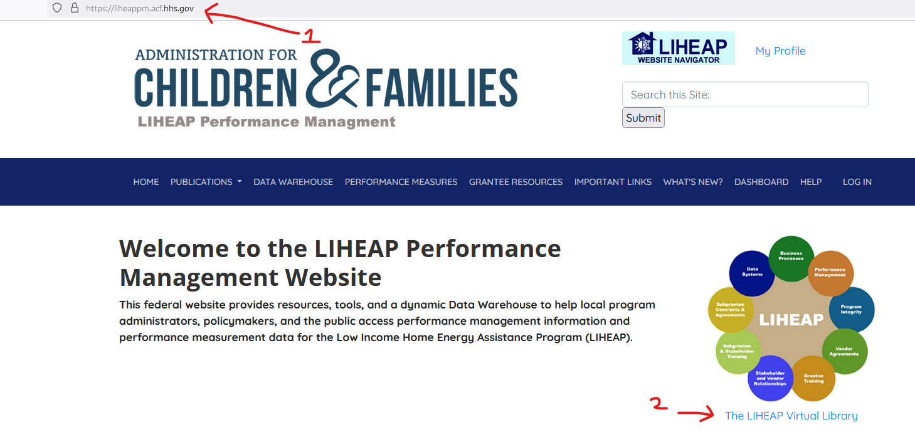
LIHEAP Virtual Library
2
In the LIHEAP 101 presentation, we introduced the “LIHEAP Virtual Library.”
The LIHEAP Virtual Library can be found on the homepage of the LIHEAP Performance Management website:
https://liheappm.acf.hhs.gov/
Presenter:
David Carroll

Slide 3
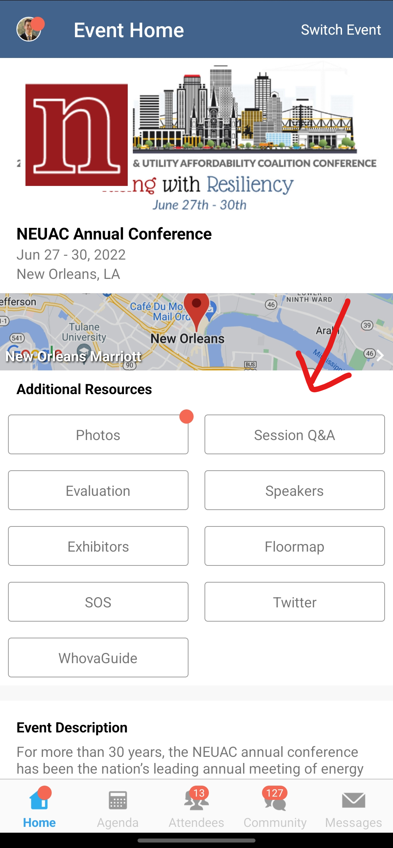
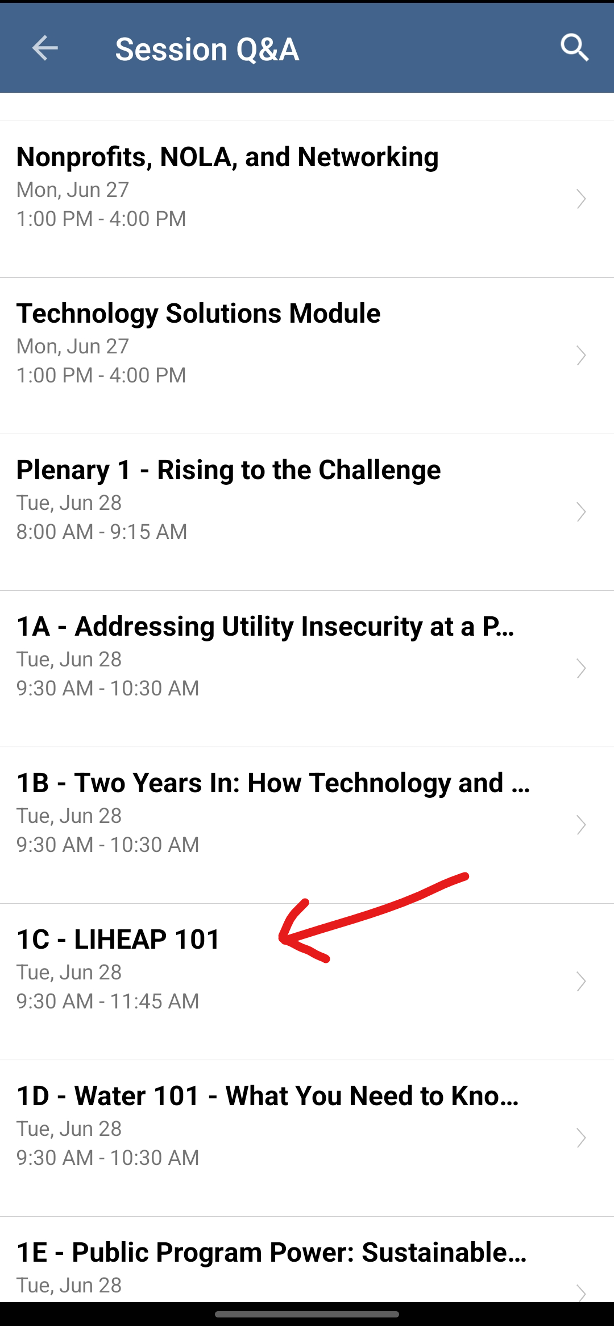
Questions
3
We have set aside 15 minutes are the end of the presentation for discussion of topics you would like covered.
Participants should use the Whova app during this session to enter and “vote up” topics they’d like addressed.
Presenter:
David Carroll

Slide 4
LIHEAP 102 Objective
The purpose of this session is to help you see how LIHEAP grantees and their stakeholders can tailor their programs to ensure that they are delivering the best possible benefits as efficiently as possible.
Presenter:
David Carroll

Slide 5
LIHEAP 102 Topics
Outreach and Marketing – How can you communicate with clients who need assistance?
Program Intake – How can you maintain program integrity but minimize client burden?
Program Coordination – How can you ensure clients receive comprehensive services?
Presenter:
David Carroll

Slide 6
LIHEAP Resources
6
What does my state do?
LIHEAP Clearinghouse – State Snapshot
LIHEAP Performance Management Website
Grantee Profile
Data Warehouse
Presenter:
David Carroll

Slide 7
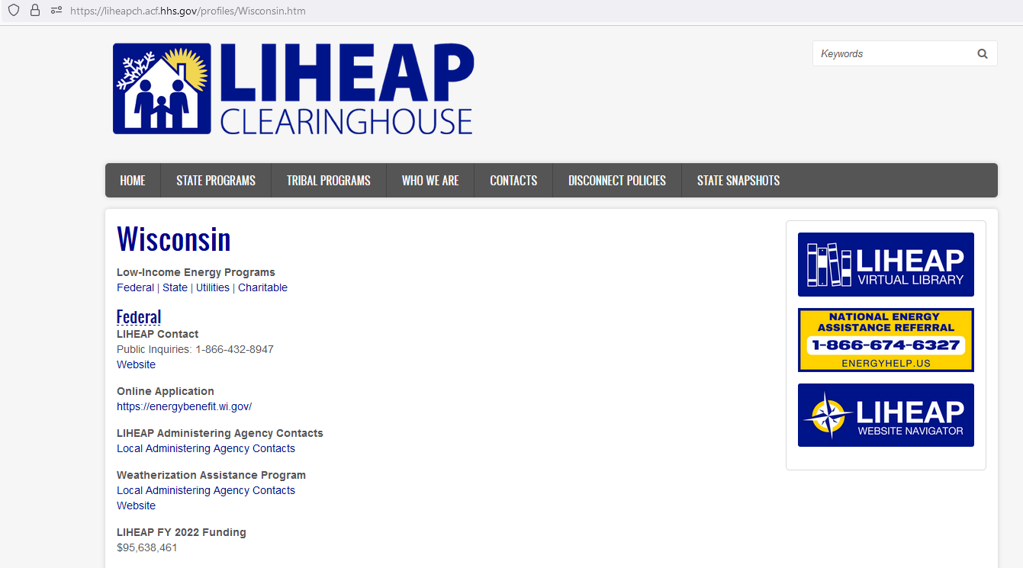
LIHEAP Clearinghouse State Snapshot
Presenter:
David Carroll

Slide 8
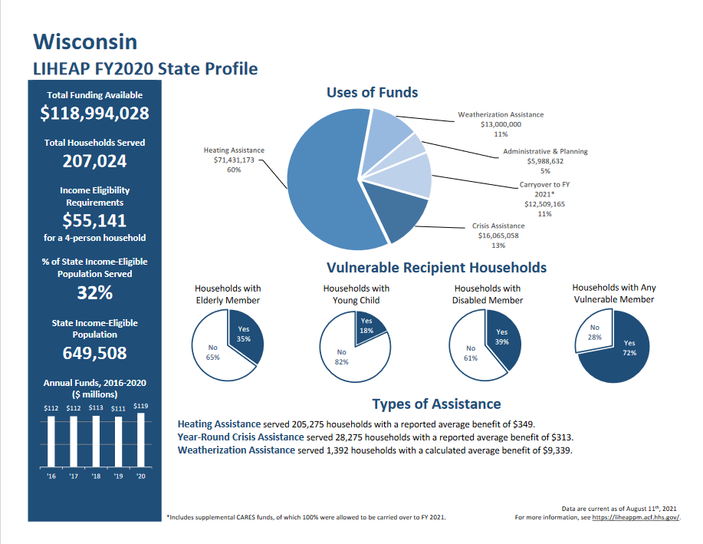
LIHEAP Grantee Profile: Wisconsin
Presenter:
David Carroll

Slide 9
Allocation of LIHEAP Funds: Wisconsin
Year | State | Heating | Crisis | Weatherization | Carryover | Administration
2015 | Wisconsin | 53% | 20% | 12% | 9% | 6%
2016 | Wisconsin | 60% | 17% | 10% | 8% | 5%
2017 | Wisconsin | 64% | 15% | 9% | 6% | 6%
2018 | Wisconsin | 64% | 14% | 10% | 6% | 6%
2019 | Wisconsin | 63% | 16% | 10% | 4% | 6%
2020 | Wisconsin | 60% | 14% | 11% | 11% | 5%
Presenter:
David Carroll

Slide 10
Allocation of LIHEAP Funds: Wisconsin
Year | State | Heating | Crisis | Weatherization | Carryover | Administration
2015 | Wisconsin | $55,474,517 | $21,169,312 | $12,120,244 | $9,908,820 | $6,076,159
2016 | Wisconsin | $67,304,117 | $19,089,948 | $11,333,776 | $8,603,201 | $5,991,566
2017 | Wisconsin | $71,535,306 | $16,780,899 | $9,904,271 | $7,243,799 | $6,320,636
2018 | Wisconsin | $72,592,958 | $15,735,375 | $11,307,154 | $6,412,375 | $6,503,595
2019 | Wisconsin | $70,293,400 | $18,141,382 | $11,102,170 | $4,757,342 | $6,856,845
2020 | Wisconsin | $71,431,173 | $16,065,058 | $13,000,000 | $12,509,165 | $5,988,632
Presenter:
David Carroll

Slide 11
LIHEAP Resources
11
What do other states do?
LIHEAP Clearinghouse – State Programs
LIHEAP Performance Management Website
Grantee Search Portal
Data Warehouse
Presenter:
David Carroll

Slide 12
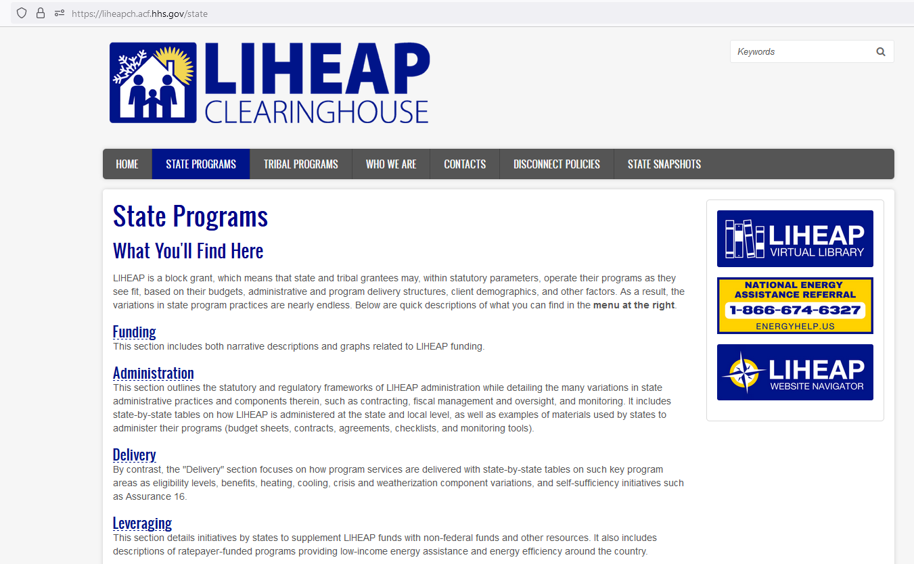
LIHEAP State Programs
https://liheapch.acf.hhs.gov/state
Presenter:
David Carroll

Slide 13
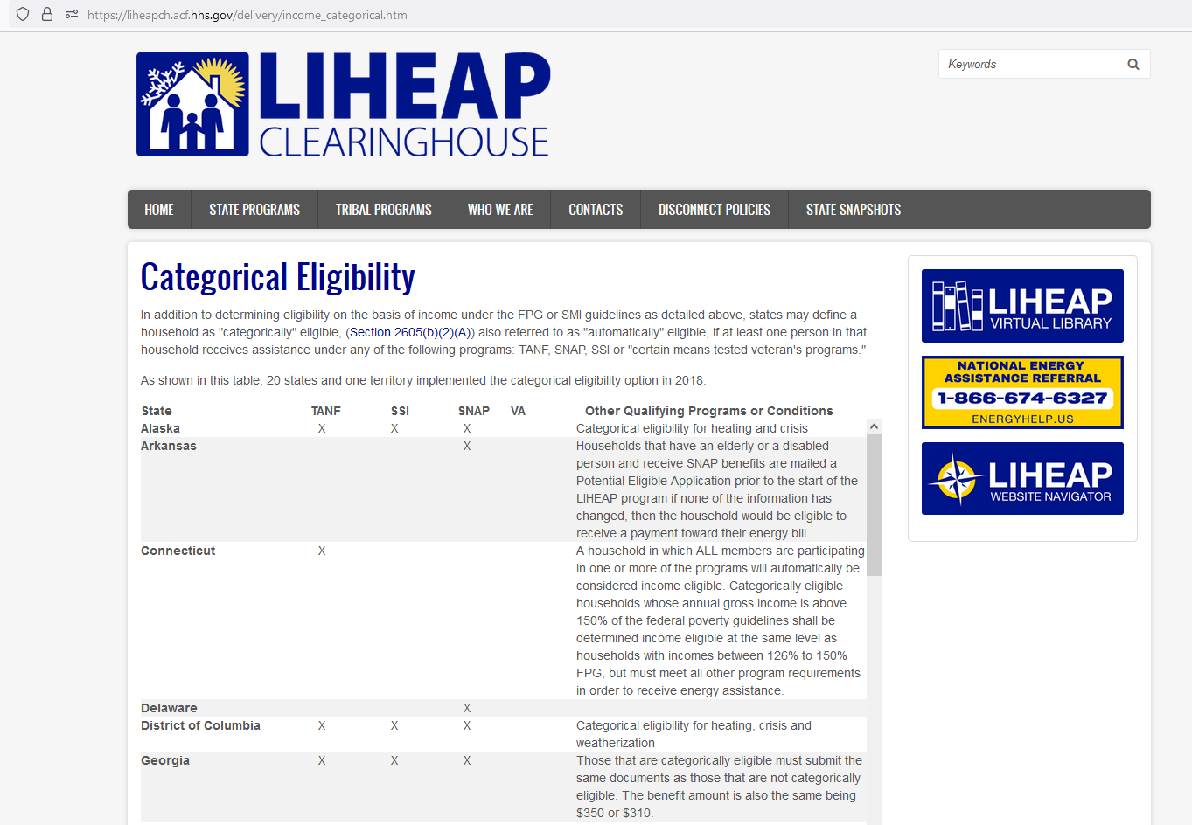
LIHEAP Categorical Eligibility
https://liheapch.acf.hhs.gov/delivery/income_categorical.htm
Presenter:
David Carroll

Slide 14
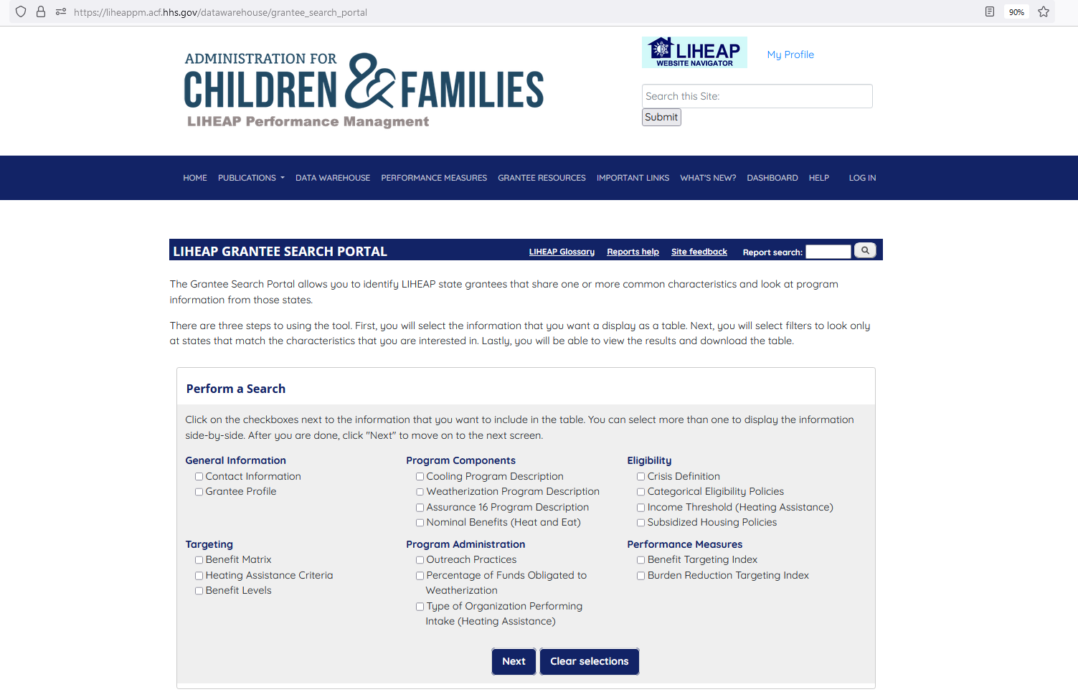
LIHEAP Grantee Search Portal
https://liheappm.acf.hhs.gov/datawarehouse/grantee_search_portal
Presenter:
David Carroll

Slide 15
Allocation of LIHEAP Funds: Wisconsin & Minnesota
Year | State | Heating | Crisis | Weatherization | Carryover | Administration | Other
2020 | Wisconsin | 60% | 14% | 11% | 11% | 5% | N/A
2020 | Minnesota | 46% | 24% | 8% | 8% | 11% | 3%
Presenter:
David Carroll

Slide 16
Allocation of LIHEAP Funds: Wisconsin & Minnesota
Year | State | Heating | Crisis | Weatherization | Carryover | Administration | Other
2020 | Wisconsin | $71,431,173 | $16,065,058 | $13,000,000 | $12,509,165 | $5,988,632 | N/A
2020 | Minnesota | $60,421,985 | $31,110,208 | $10,608,621 | $10,819,991 | $14,233,562 | $3,362,322
Presenter:
David Carroll

Slide 17
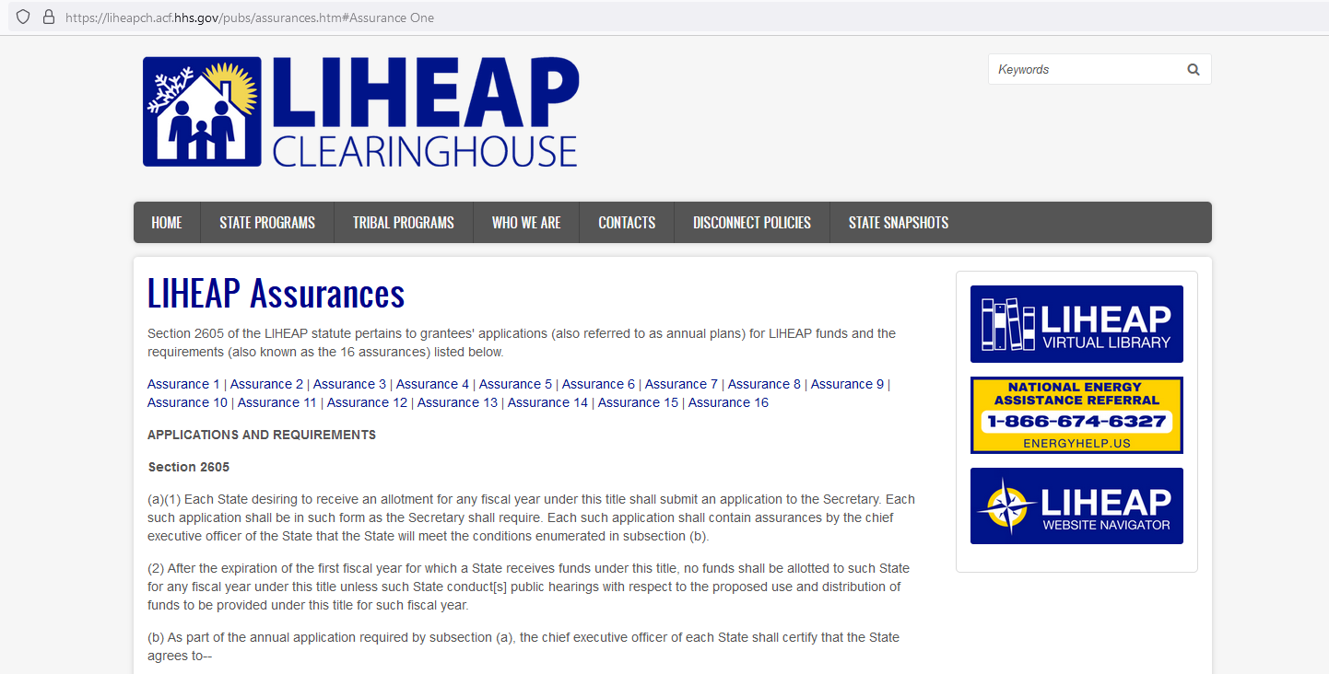
LIHEAP Assurances
17
The requirements for grantees’ applications are stipulated in Section 2605 of the LIHEAP Statute.
https://liheapch.acf.hhs.gov/pubs/assurances.htm#Assurance%2016
Presenter:
David Carroll

Slide 18
Outreach and Marketing
According to Assurance 3, outreach activities must be designed to ensure that eligible households, particularly households with elderly or disabled individuals, are made aware of assistance available.
How are your outreach activities fulfilling this objective?
Presenter:
David Carroll
Notes:
“the Assurance explicitly required states to make sure that people know about the programs. And that they current federal initiatives encourage grantees to reach out to underserved populations. Each panel is will then about things they are doing to fulfill that objective. “

Slide 19
Wisconsin Outreach and Marketing
19
Market Research Firm Analysis and Recommendations
Cost-Effective – PSA Coverage
Cultural – Hispanic Language Radio Events
High Technology – Geocode Targeting of Advertising
Low Technology – Targeted Postcard Mailings
No Technology- Market in buses and bus stops.
Presenter:
Jane Blank
Notes:
We know that we have to have a diverse marketing strategy to reach all of the different population groups that need our program services. We have consulted with a market research firm to analyze our data and make recommendations. We take advantage of the most cost-effective form of advertising by making use of PSA opportunities. We pay attention to cultural issues by working with Hispanic-language radio. We use high technology with geocoded targeting of some advertising. We use lower technology to target households that have participated in prior years and in other types of programs. We even use what you might call our no technology approach. Our clients often have to use public transportation and live in neighborhoods where they would see buses and bus stops. We use those as effective marketing platforms.

Slide 20
Colorado Outreach and Marketing
20
Strategic marketing in communities with lower-enrollment
Marketing boards in the mountainous region communities
Marketing boards in targeted neighborhoods in larger metro areas
Targeted Advertisement
Commercials on Roku TV.
Low-income residents buy Roku sticks and watch Roku TV but don’t pay to opt-out of commercials.
Presenter:
Theresa Kullen
Notes:
Our enrollment in our mountainous communities is low and there are many low income folks working at the ski resorts in hidden communities within those towns. We strategically placed marketing boards in areas of those communities, such as a carnicerias, to bring awareness to the program.
We also did the outreach boards in our larger metro areas of low income populations and strategically placed them in those communities. Very successful!
We purchased commercial time for "Roku" TV - many low income folks either buy the Roku stick or have it on their television and you can watch Roku for free - you have to pay to opt out of the commercials so many low income households do not pay to opt out. Again a very successful outreach mechanism.

Slide 21
Ohio - Miami Valley Community Action Partnership Outreach and Marketing
21
Adapt outreach plans to provide the same program information in different formats.
More urban areas – Social media (young parents)
More rural areas – Print media and radio (seniors)
Tools to educate customers about the application process includes Facebook Live events, email billboards, signage (in drop-off areas), news broadcasts, and print media.
Recently reintegrated face-to-face appointments.
Presenter:
Keelie Gustin
Notes:
Social media has become indispensable to our outreach programming, but only in two of the counties we serve. We have to be nimble in our adjustments with our more rural counties, as they have a larger senior population that reads print media, rather than electronic media. There is no "one size fits all" marketing and outreach plan for an agency that serves rural, urban, and suburban clients. We are constantly pivoting to provide the same program information in various formats.
Our agency just began reintegrating face-to-face appointments for the first time since our shut down in March 2020. This is due to several reasons, most of them being a lack of staff, training hurdles for new staff, and the physical layout of our building that does not provide for adequate social distancing. This hurdle has been HUGE for our customers. To communicate how to submit applications and speak with someone at our office, we've tried everything from Facebook Live events, Constant Contact email communications to partners and clients, billboards, signage for our drop-off areas, news broadcasts and print media. It's a full-time job to keep our clients apprised of how we are processing their applications, and we're still figuring out the best way to do it as we continue to offer increased virtual processing options, alongside face-to-face appointments, when required by our programs.

Slide 22
Washington Outreach and Marketing
22
Geospatial Dashboard, using LIHEAP program data and census data, to examine program results and to investigate which counties might need to increase their outreach to specific populations.
For example, we identified a county that was underserving a specific demographic. We were able to provide that county with guidance and translation services to meet the underserved population.
Conduct outreach in multiple languages.
Partner with other state agencies to provide LIHEAP & LIHWAP outreach.
Presenter:
Brian Sarensen
Notes:
Our latest endeavor has been to develop a geospatial dashboard that helps us to visualize how our low-income households are distributed in comparison to our LIHEAP clients and then developing strategies for conducting outreach to the underserved areas. In some cases, we see that all types of households in a particular geographic are underserved, while in others it is one or more population subgroup that need more attention.
As you heard from others, we also work to conduct outreach in several different languages and work to partner with other state agencies to provide LIHEAP and LIWHAP services to their clients.

Slide 23
23
Questions/Comments

Slide 24
Program Intake
According to the LIHEAP application requirements, grantees are asked to ensure that households served are eligible for program benefits.
How are your intake activities fulfilling this objective?
Presenter:
David Carroll
Notes:
“…the strict LIHEAP application requirements are in direct response to the GAO report that told HHS that grantees needed to do a better job in making sure that households served by the program were eligible for program benefits... each of you have worked hard to maintain program integrity while also making sure that you are doing everything you can to ensure that clients are able to navigate these challenging documentation requirements. Each panelist will then talk about things they are doing to fulfill that objective. “

Slide 25
Colorado Program Intake
25
We have begun an outreach incentive program that offers additional funds to counties that reach out to households that were denied assistance for failing to provide additional verification.
Since COVID began, we’ve added the option for households to apply via telephone through our centralized call center.
This provided a new application method for individuals without a computer.
Presenter:
Theresa Kullen
Notes:
We started offering an outreach incentive program for all of our counties to apply for additional outreach funds to reach out to any households in their counties denied for failing to provide the necessary verification to work their application to approval or denial status. This required a change to our state rules so that applications could be reopened vs. the household having to reapply.
Colorado does not require a face-to-face interview to apply for our program. Prior to COVID a person could apply in person at a county office, online at our single point of entry application, CO PEAK, or by downloading and completing an application to email into the administering agency. The year of COVID we had added the ability to apply via telephone through our centralized call center which really helped open up application options for folks without a computer while many counties offices were closed. That saved us! Enrollment has gone up steadily over the past 3 years.

Slide 26
Wisconsin Program Intake
26
Reviewed program documentation requirements to reduce the amount of information required of clients.
Automated and online applications.
Agencies may “complete” applications for customers who have outstanding information even after 30 days of an incomplete application.
Expanded third-party system access.
Presenter:
Jane Blank
Notes:
In the last couple of years, we have implemented a lot of changes that we feel are beneficial to the client without impacting our program integrity.
We reviewed our program documentation requirements and found ways to reduce the amount of information that they were requiring of clients. In addition.
We have newly developed automated and online applications were developed to address the problems caused by the Covid pandemic.
We developed application “reinstatement” procedures the allow agencies to restart the application process even when the client has taken more than 30 days to furnish all of the required documentation.
We have found ways to expand our third-party system access that allows others to assist the client with completing the application.
One other thing that we have always done is that we use subgrantees that have the ability to access other program records and can make use of some of those to help with client documentation requirements.

Slide 27
Ohio - Miami Valley Community Action Partnership Program Intake
27
Prior to covid, used new new technology to ensure that people had firm, in-person appointments to receive application assistance, and individuals no longer had to stand in line to wait.
During covid, we developed procedures that allow clients to apply through dropbox, an online application, and an online appointment. Clients may check on their application status through our LIHEAP Call Center.
We are gathering clients’ feedback to create a universal application within our agency.
Presenter:
Keelie Gustin
Notes:
“Prior to Covid, we had worked hard to implement an intake system that gave clients the ability to schedule an appointment online so that they were see immediately when they came to the office. We even had developed services for allowing parents to bring their children to the appointment so that they could get all of the paperwork submitted in a timely way.
Of course, the pandemic made us set aside all of that good work and to look for new ways to enable clients to submit their application information. We allow them to apply through a dropbox, an online application, and an online appointment. We also give clients the ability to check their application status through our LIHEAP call center.
We are in the process of getting feedback from clients on how we can develop a universal application within our agency for all of the service that we provide.
The COVID-19 pandemic has made apparent the need for a universal application within our agency. We are gathering stakeholder information via surveys of clients and partners to figure out how to make this happen while respecting the parameters and requirements of each program app within our agency (CSBG, HWAP, LIHWAP, etc.). The process is long and challenging as we balance the interests, but the aforementioned marketing and outreach efforts are allowing us to survey those we serve to figure out what they NEED, rather than our internal stakeholders determining what the client should want or do. This is essential as we societally transform how we interact with one another throughout this pandemic.
Item 3 from Outreach and Marketing goes here - we are working to streamline the Intake process to encourage clients to maintain updated information with our agency to ensure access to all programs - CSBG, LIHEAP, HWAP, LIHWAP, in a more efficient manner. We want to maintain a better "conversation" with our clients to ensure they are keeping their information up to date to prevent debilitating utility defaults. Currently, we are trying to find the right balance between an "Intake Specialist" and "Case Manager." This gap has become one we've desperately needed to fill as we felt the weight of our clients worries during the COVID-19 pandemic. We are working to set clear expectations about what services we can provide, what referrals we can make, and to be honest about the timelines of each of those items. Creating opportunities for transparent conversations with our clients has become a top priority since the COVID-19 pandemic.
We currently use several options for clients to apply - dropbox (paper applications), online applications, online appointments (scheduled via phone or online scheduler, available 24/7) and outreach to our newly developed LIHEAP Call Center to check on application status or answer application-specific questions. Again, cultivating transparent conversations is our main goal. Accessibility is the second goal the COVID-19 pandemic highlighted. Though we have to ensure our efforts are specifically tailored to the community we are serving (rural, suburban, urban), technological platforms provide us with a way to not only communicate with our clients, but also track their satisfaction. Surveys are provided after each appointment, regardless of program, and available online at our website.
Stakeholder feedback continues to improve our application process. While we cannot change the rules our State has put in place, we can gather data to provide to the State of Ohio during the comment period on our State Plan, each year. Clients express frustration with certain areas of the rules - especially surrounding citizenship. While we may not be able to do something in that precise moment, we note the comment and provide that feedback each year to the State. What happens in our intake appointments, matters. We are responsible not only for providing the service to the client, but for harnessing their feedback and explaining to the State how the program could be adjusted to meet the needs of our vulnerable customers.

Slide 28
Washington Program Intake
28
Online applications at the Community Action Agency level.
Remote application procedures. Clients may mail documents, use virtual appointments, and use computers in isolation rooms at community action agencies.
Income certification every two years for those on fixed incomes.
Presenter:
Brian Sarensen
Notes:
Even prior to covid, but particularly in the last three years we have invested in diversifying our application procedures.
We ensure that each of the CAAs can work with online applications. We try to give clients opportunities to complete applications remotely by mailing documents, having a virtual appointment with a staff member, and even setting up isolation rooms at the CAAs for clients to complete the application online if they do not have access to a computer.
We also think that it is important to make sensible decisions about client eligibility determinations. For example, for households on fixed incomes, we only require certification every other year.

Slide 29
29
Questions/Comments

Slide 30
Program Coordination
According to the Assurances, states must coordinate with other program services.
Assurance 16 allows grantees to use up to 5% of funds to help individuals access other program services.
The LIHEAP statute allows grantees to allocate up to 15% (25% with a waiver) of funds to coordinate with WAP and other programs.
The leveraging incentive program allows grantees to fund program leveraging activities.
How are your coordination activities fulfilling this objective?
Presenter:
David Carroll
Notes:
“…will emphasize that the assurances ask states to coordinate with other program services. In addition, Assurance 16 allows grantees to use up to 5% of funds to help people access those kinds of services, the statute allows grantees to allocate up to 15% (25% with a waiver) to coordinate with WAP and other energy efficiency programs, and the leveraging incentive program allows grantees to fund program leveraging activities…emphasize that this is the area in which there is the greatest amount of diversity in grantee program offerings. “

Slide 31
Wisconsin Program Coordination
31
Qualifying for a LIHEAP grant qualifies the client for a benefit from the electric IOU in the area, and in some cases, the municipal electric company.
Public Benefits (rate payer program) expands program coordination and leveraging.
Our Web Service is programmed in the centralized database that requires live interface with IOU systems for account information.
Our system generates weatherization and economic support program referrals for clients.
We have strong working relationships with local aging departments, Aging and Disability Resource Centers, Heat for Heroes, and other Veteran support programs.
Presenter:
Jane Blank
Notes:
Read text from slide ….

Slide 32
Colorado Program Coordination
32
We coordinate with Energy Outreach Colorado (EOC), a nonprofit organization that offers energy assistance to low-income households.
In cases where LIHEAP cannot assist a household, we refer those applicants to EOC, particularly when our application period is closed and when the applicant is facing disconnection with a fuel that our agency cannot assist with.
EOC ensures that applicants have already applied for LIHEAP, before they receive assistance from them.
LIHEAP and EOC contract with the same call center, so that applicants can be referred to the appropriate assistance program.
Presenter:
Theresa Kullen
Notes:
Energy Outreach Colorado (EOC)is a non-profit organization that offers energy assistance to low income households. During our application period both the LIHEAP program and EOC's bill payment assistance program refer households to each others agency to ensure when LIHEAP cannot help that the household is aware of their other avenue of possible assistance, we refer folks to EOC during the time when our application period is closed, and refer households to EOC when the household is facing disconnect with a supportive fuel that our agency cannot assist with. During the LIHEAP program application period if households apply through EOC they insure that their applicants have already applied to our program to ensure their limited funding can be used for folks that do not qualify for LIHEAP. LIHEAP and EOC contract with the same centralized call center and share expenses to ensure applicants can be referred to the correct program for assistance.

Slide 33
Ohio - Miami Valley Community Action Partnership Program Coordination
33
We coordinate heavily with services, both internally and externally. We are working to implement naming conventions in email subject lines, so that we can search client communications easily.
We send out internal and external newsletters to communicate with staff and partners, which allows us to coordinate client services more efficiently.
Presenter:
Keelie Gustin
Notes:
• Email, email, email. We coordinate heavily with services, internally and externally, to ensure client needs are met. It sounds crazy, but coordination of services in "COVID times" has truly come down to how organized we can be in our communication. For us, it was ensuring we had a naming convention in the subject line of each of our emails. So many priorities and clients were flying around, we needed to be able to search our secure server for communications as to client situations easily. We're working to implement this network-wide (internal and external stakeholders) and have already seen the benefits of "organizing the chaos."
• Newsletters - Internal and External. Though we don't often have the time, we've decided it's essential to carve it out to utilize internal and external newsletters to communicate with our staff and partners as to the ever-changing programs and program requirements within our agency. It's a tough job to make time for, with so many priorities floating around, but we have to carve out the time to communicate, on a mass scale, the changes happening to create the aforementioned program transparency and accessibility. These efforts allow us to coordinate client services more efficiently throughout our network.

Slide 34
Washington Program Coordination
34
We have one application for Energy Assistance (LIHEAP), Water Assistance (LIHWAP), and Weatherization Assistance (WAP).
We coordinate with the Office of Drinking Water to promote LIHWAP.
We coordinate with the Department of Aging and the Department of Disabilities to promote cooling assistance.
Presenter:
Theresa Kullen
Notes:
Read text from slide.

Slide 35
35
Questions/Comments

Slide 36
LIHEAP Grantee Panel – Responding to Attendee Questions and Concerns
36
During this part of the session, we will ask our panelists to respond to your most pressing questions on designing and implementing LIHEAP programs for your state or tribe. We’ve allocated 5 minutes to each of three topics that have been proposed by attendees.
Presenter:
David Carroll

Slide 37
Continuing the Learning
Office of Community Services
LIHEAP: www.acf.hhs.gov/ocs/low-income-home-energy-assistance-program-liheap
LIHWAP: www.acf.hhs.gov/ocs/programs/lihwap
LIHEAP Performance Management Website and the Data Warehouse
Performance Management Website: liheappm.acf.hhs.gov/
Data Warehouse: liheappm.acf.hhs.gov/data_warehouse/index.php?report=homepage
Virtual Library: liheappm.acf.hhs.gov/assessment/#nbb

