Slide 2
Water Affordability Study
David Carroll, Managing Director, APPRISE
Thomas Hanes, Policy Analyst, APPRISE

Slide 3
Agenda
Data Analysis Issues / Definitions
DC OPC Population Characterization Report
Overcoming Statutory and Regulatory Barriers
Comparative Analysis of Programs

Slide 4
Section #1 - Data Analysis Issues
Measuring Water Burden
Defining Income Groups

Slide 5
Measuring Water Burden
Households can pay for water in the following ways….
Pay water directly / pay sewer in property taxes
Pay water and sewer directly
Have a well and septic / pay for electric to operate the system
Water and sewer is included in the rent
5

Slide 6
Water/ Sewer Systems
Source of Water
Water system: 90%
Private well: 10%
Sewer System
Public system: 80%
Household system: 20%
National Data from American Housing Survey
6

Slide 7
Water/Sewer Payment
40% of households water bill is included in rent or fees
50% of households pay water bill directly
10% of households have a private system
National Data from American Housing Survey
7

Slide 8
Low-Income Households
LIHEAP Program Statue:
The greater of…
150% of Federal Poverty Level
Family of 4 = $41,625
60% of State Median Income (SMI)
Family of 4 in Illinois = $61,300
Family of 4 in Tennessee = $48,464
Data from US Department of Health and Human Services
8

Slide 9
Moderate-Income Households
HUD Housing Programs:
80% of Area Median Income
Family of 4 in Buffalo
Family of 4 in Long Island
$70,150
$96,300
9

Slide 10
Population Segmentation
DC Program Eligibility
SNAP Eligible
<= 130% of FPL
$36,075 for a family of 4
CAP3 Eligible
< 100% AMI
$137,563 for a family of 4
Non-SNAP Low Income
> 130% FPL < 60% SMI
CAP2 Eligible
>60% SMI < 80% AMI
$62,340 for a family of 4
$110,050 for a family of 4
Data from US Department of Health and Human Services
10

Slide 11
Section #1 - Data Analysis Issues Q&A

Slide 12
Section #2 - DC OPC Population Characterization Report

Slide 13
Water Bill Payment Status by CAP Eligibility
LMI Households by Water Payment Status and CAP Eligibility Group
Water Payment Status | CAP Eligible | CAP2 Eligible | CAP3 Eligible
Pay Directly | 23% | 35% | 40%
Included In Rent | 53% | 51% | 47%
No Charges | 25% | 14% | 13%
All Households | 100% | 100% | 100%
Data from American Community Survey (2013-2017) / All Households
13

Slide 14
Water Bill Payment Status by Housing Unit Type
LMI Households by Water Payment Status and Housing Unit Type
Water Payment Status | Household Unit Type
 | Single Family Detached | Single Family Attached | Small MF (2-4 Units) | Large MF (5+ Units)
Pay Directly | 93% | 78% | 10% | 6%
Include In Rent | 4% | 16% | 57% | 69%
No Charges | 2% | 6% | 33% | 25%
All Households | 100% | 100% | 100% | 100%
Data from American Community Survey (2013-2017) / All LMI Households
14

Slide 15
Households Income-Eligible for CAP Programs
Direct Water Payment LMI Households by Program Eligibility Group
Program Eligiblity Group | Number of Households | Percent of Households | Average Income
SNAP Eligible | 9,711 | 22% | $11,341
Non-SNAP CAP Eligible | 9,028 | 21% | $33,240
CAP2 Eligible | 15,572 | 36% | $55,867
CAP3 Eligible | 9,021 | 21% | $80,638
All LMI Households | 43,332 | 100% | $46,331
Data from American Community Survey (2013-2017) / All Households with a water bill
15

Slide 16
Gross Water Burden by Income Group
Data from American Community Survey (2013-2017) / All L,I or Median Income Households with a water bill
16

Slide 17
Water Participation Rates by Income Group
2020 Program Participation Rates by Program Eligibility Group
Data from American Community Survey (2013-2017) / All LMI or Median Income Households with a water vill / FY 2019 DC Program Data Files
17

Slide 18
CAP Program Impacts by Income Group
Estimated Net Water Burden by Program Eligibility Group
Data from American Community Survey (2014-2018) / All LMI or Median Income Households with a water bill
18

Slide 19
CAP Program Impacts by Income Group
Gross and Net Water Burden by Program Eligibility Group
Eligibility Group | Mean Gross Water Bill | Mean Burden | Mean Benefit | Mean Net Burden
SNAP Eligible | $1,075 | 9.4% | $805 | 2.4%
Low Income | $1,237 | 3.7% | $805 | 1.3%
CAP 2 | $1,020 | 1.8% | $510 | 0.9%
CAP 3 | $1,084 | 1.3% | $162 | 1.1%
Data from American Community Survey (2013-2017) / All LMI or Median Income Households with a water bill
19

Slide 20
Summary of Findings
What Works?
Benefits increase affordability
Higher benefits for lower income households
Include moderate income households
20

Slide 21
Summary of Findings
What Improvements are Needed?
Further tailor benefits within income group
Increase participation rates
Address the needs of households in multifamily buildings
More information on individual households
21

Slide 22
Section #2 - DC OPC Population Characterization Report Q&A

Slide 23
Section #3 – Statutory and Regulatory Framework

Slide 24
DC State and Regulatory Approach
State/Municipal Law: Mandated by Municipal Code
Around $2.7 million in benefits in 2020
3,416 participants in 2020
Mean benefit: $844
24

Slide 25
Statutory and Regulatory Barriers in Other Jurisdictions
General barriers include:
Rules against increases in taxes without approval
“Reasonable and non-discriminatory” classification rules
State rules against gratuities
“Cost of Service” rules
25

Slide 26
Water Programs Studied in Other Jurisdictions
Jurisdiction | Program | Nature of laws
Atlanta, GA | Care and Conserve | Discouraged
Raleigh, NC | Utility Customer Assistance Program | Discouraged
Detroit, MI | Water Residential Assistance Program | Discouraged
Seattle, WA | Utility Discount Program | Permitted
Portland, OR | Financial Assistance Program | Permitted
Philadelphia, PA | Tiered Assistance Program | Permitted
California Water, CA | Low Income Rate Assistance Program | Encouraged
Washington, DC | Customer Assistance Program | Mandated
26

Slide 27
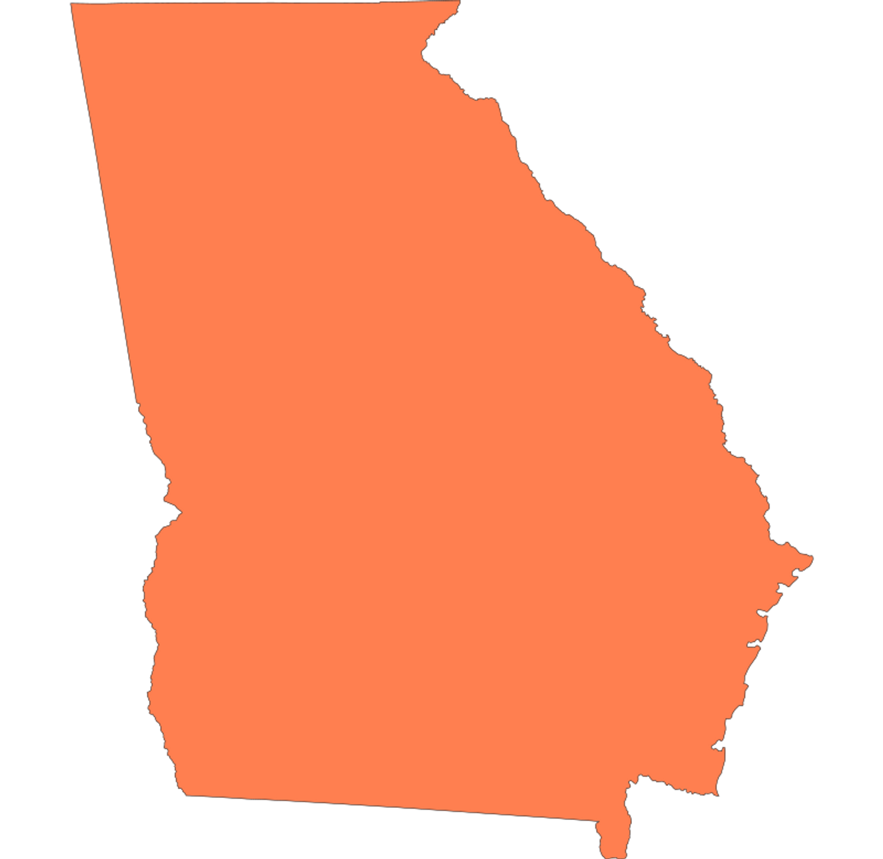
Atlanta, Georgia
Barrier: State Constitution Gratuities Clause
Overcame by: Funding by donations until the municipal code was revised
$2 million in benefits annually
450 beneficiaries in 2019
$559 average benefit in 2019
27

Slide 28
Raleigh, North Carolina
Utility Customer Assistance Program
Barrier: “Classes of Service” rule
Overcame by: Paying benefits from general government revenues
Initially funded at $215,000
Assisted 895
Up to $240 in benefits annually
28

Slide 29
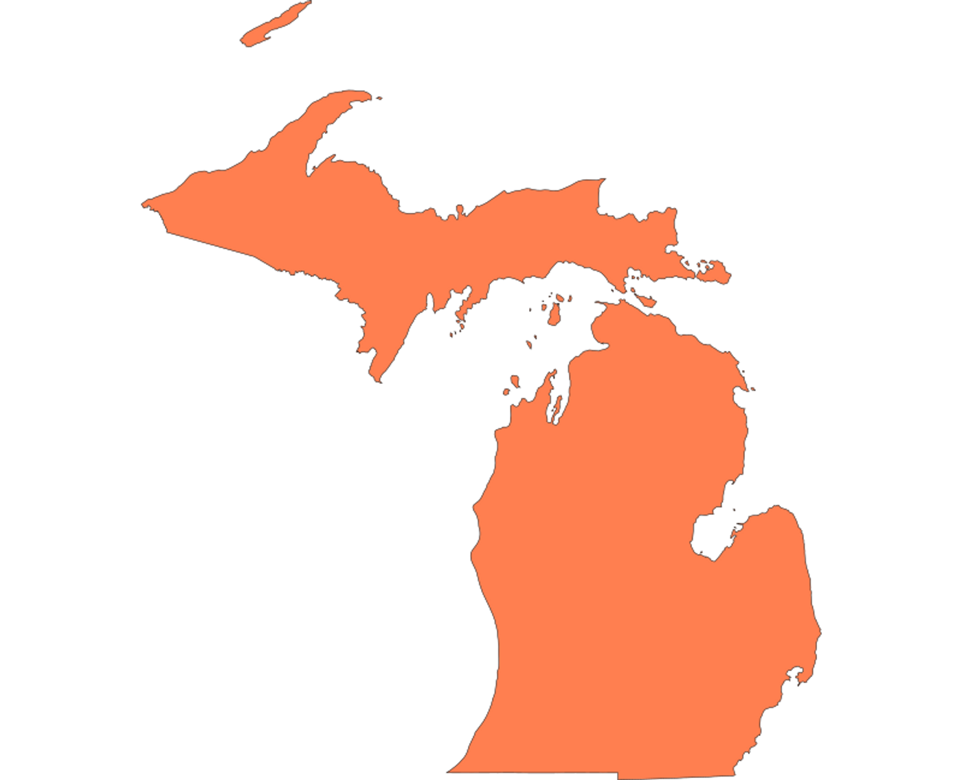
Detroit, Michigan
Barrier: Headlee Amendment to State Constitution
Overcame by: Paid out rates as an assistance program
Funded at around $6 million in 2019
Assisted 5,500 in Detroit in 2019 and more outside of Detroit
Average benefit: $300
29

Slide 30
Seattle, Washington
Utility Discount Program and Emergency Assistance Program
$23.2 Million in discounts provided in 2017
State Law: Permits assistance programs
Established in Seattle Municipal Code
32,800
assisted
Average discount: $708
30

Slide 31
Portland, Oregon
Financial Assistance Program and Utility Safety Net
State Law: Permits municipal assistance programs
Established by Portland City Council
2017 Program Statistics:
$5,934,612 in funding
About 7,000 participants
Average benefit: $700
31

Slide 32
Philadelphia, Pennsylvania
Tiered Assistance Program
State Law: Permits municipal assistance programs
Mandated by the City Government
2020 Program Statistics:
Around $7.5 million in benefits
16,433 participants
Mean benefit: $550
32

Slide 33
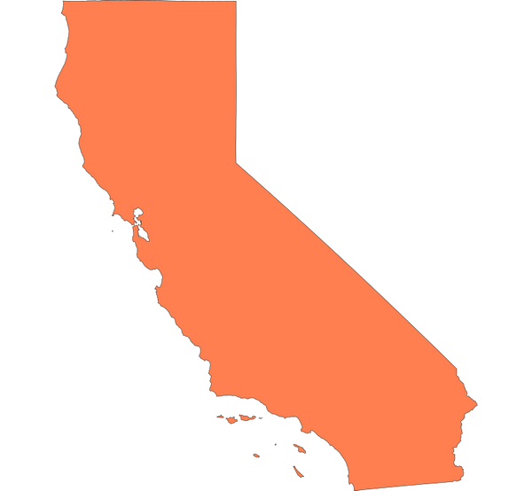
California Water
Low Income Rate Assistance Program
State/Municipal Law: Encouraged by Public Utilities Commission, discouraged for municipal providers
$10 million in benefits provided in 2017
81,804 households assisted in 2017
Mean benefit: $125
33

Slide 34
Section #3 – Statutory and Regulatory Framework Q&A

Slide 35
Section #4 – Comparative Analysis of Programs

Slide 36
% Direct Pay
Jurisicition | SNAP Eligible | Low-Income | Moderate Income
District of Columbia | 20% | 27% | 31%
Atlanta, GA | 51% | 57% | 65%
Cal Water | 51% | 59% | 65%
Detroit, MI | 56% | 69% | 74%
Philadelphia, PA | 54% | 65% | 67%
Portland, OR | 41% | 53% | 58%
Raleigh, NC | 65% | 65% | 77%
Seattle, WA | 43% | 48% | 53%
Data from American Community Survey (2014-2018) / All households
36

Slide 37
Average Burden
Jurisdiction | SNAP Eligible | Low-Income | Moderate Income
DC | 9.7% | 3.9% | 2.1%
Atlanta | 9.1% | 4.2% | 2.7%
Cal Water | 4.0% | 2.1% | 1.3%
Detroit | 7.2% | 3.0% | 2.2%
Philadelphia | 6.4% | 2.6% | 1.7%
Portland, OR | 9.8% | 5.2% | 3.4%
Raleigh, NC | 3.7% | 1.8% | 1.2%
Seattle | 13.2% | 5.3% | 3.3%
Data from American Community Survey (2014-2018) / All households
37

Slide 38
Total and Average Investment by Jurisdiction
Jurisdiction | Funding ($ mil) | LI HHs | Per LI HH
DC | $2.7* | 17,907 | $150
Atlanta | $1.6** | 34,609 | $46
Cal Water | $9.0 | 88,524 | $102
Detroit | $4.5** | 82,327 | $55
Philadelphia | $4.9 / $20.0 | 151,532 | $32 / $132
Portland, OR | $5.9 | 27,228 | $217
Raleigh, NC | $0.2 / $5.0 | 18,989 | $11 /$263
Seattle | $23.2*** | 28,605 | $812
Data from American Community Survey (2014-2018) / All households ; *Includes funding for moderate- and median-income households / ** Includes funding for assistance programs and water equipment repairs / *** Includes funding for households with water included in rent /
38

Slide 39
Participation Rates
Jurisdiction | Low-Income Customers | Program Participants | Participation Rate
DC | 17,907 | 3,142 | 18%
Atlanta | 34,609 | 450 | 1%
Cal Water | 88,524 | 81,804 | 92%
Detroit | 82,327 | 5,500 | 7%
Philadelphia | 151,532 | 13,395 | 9%
Portland, OR | 27,228 | 7,000 | 26%
Raleigh, NC | 18,989 | 895 | 7%
Seattle | 28,605 | 32,800 | At least 55%
Data from American Community Survey (2014-2018) / All households
39

Slide 40
Net Burden
Jurisdiction | Mean Water Bill | Gross Water Burden | Mean Benefit | Net Water Bill | Net Water Burden
DC | $1,080 | 9.7% | $810 | $270 | 2.4%
Atlanta | $1,095 | 9.1% | $559 | $536 | 4.5%
Cal Water | $672 | 4.0% | $122 | $550 | 3.3%
Detroit | $941 | 7.2% | $300 | $641 | 4.9%
Philadelphia | $849 | 8.6% | $651 | $198 | 4.0%
Portland, OR | $1,251 | 12.2% | $431 | $820 | 8.0%
Raleigh, NC | $532 | 3.7% | $240 | $292 | 2.0%
Seattle | $1,466 | 13.2% | $733 | $733 | 6.6%
Data from American Community Survey (2014-2018) / All households
40

Slide 41
Summary of Programs
Jurisdiction | Regulatory Framework | Funding Source | Program Management | Program Eligiblity | Water in Rent
DC | Statutory | Ratepayer and Taxpayer | Government Agency | LMI | No
Atlanta | Voluntary | Taxpayer | Water Department | LI | No
Cal Water | Regulatory | Ratepayer | Water Company | LI | No
Detroit | Statutory | Ratepayer | Water Department | LI | No
Philadelphia | Statutory | Ratepayer | Water Department | LMI | No
Portland, OR | Statutory | Ratepayer | Combination | LI | No
Raleigh, NC | Voluntary | Taxpayer | Government Agency | SNAP | No
Seattle | Statutory | Ratepayer | Combination | LI | Yes
41

Slide 42
Section #4 – Comparative Analysis of Programs Q&A

Slide 43
Resources
Reports
Navigating Legal Pathways to Ratepayer Funded Assistance Programs, UNC Environmental Finance Center, 2017
Organizations
National Association of Clean Water Agencies (NACWA)
Model Water Utility Affordability Programs, Bradford L. Blake, Gary A. Brown, Eric Rothstein, 2017
National Consumer Law Center (NCLC)
Contact: Olivia Wein, owein@nclc.org
Contact: info@nacwa.org
43

Slide 44
Presenter Information
David Carroll
APPRISE
32 Nassau Street, Suite 200
Princeton, NJ 08542
609-252-8010
david-carroll@appriseinc.org
www.appriseinc.org
44

