Slide 1
Smart Thermostats – Opportunities & Challenges
April 11-14, 2022 | Nashville, TN
Insights from a Study of Residential Thermostat Settings & Temperature Preferences
Jackie Berger
APPRISE
jackie-berger@appriseinc.org
Ben Adams
MaGrann Associates
benadams@magrann.com

Slide 2
Study Overview
Thermostat
Settings
Introduction
Temperature
Setbacks
Methodology
Thermostat Types
Recommendations

Slide 3
Study Goals
Temperature Preferences
Temperature Setbacks
Thermostat Types
Smart Thermostat Use
Understand thermostat setpoints for households in the Northeast
Develop information on the use of setbacks in winter/summer, away from home, at night
Estimate programmable and smart thermostat penetration
Develop information on smart phone app usage and other features

Slide 4
Methodology

Slide 5
Methodology
Sample
States Included
Address Based Sample
United States Postal Service Computerized Delivery Sequence File
Covers nearly all U.S. households
Selected random sample of 2,000 households stratified by state
New England Region
Connecticut
Maine
Massachusetts
New Hampshire
Rhode Island
Vermont
Middle Atlantic Region
New York
New Jersey
Pennsylvania
A

Slide 6
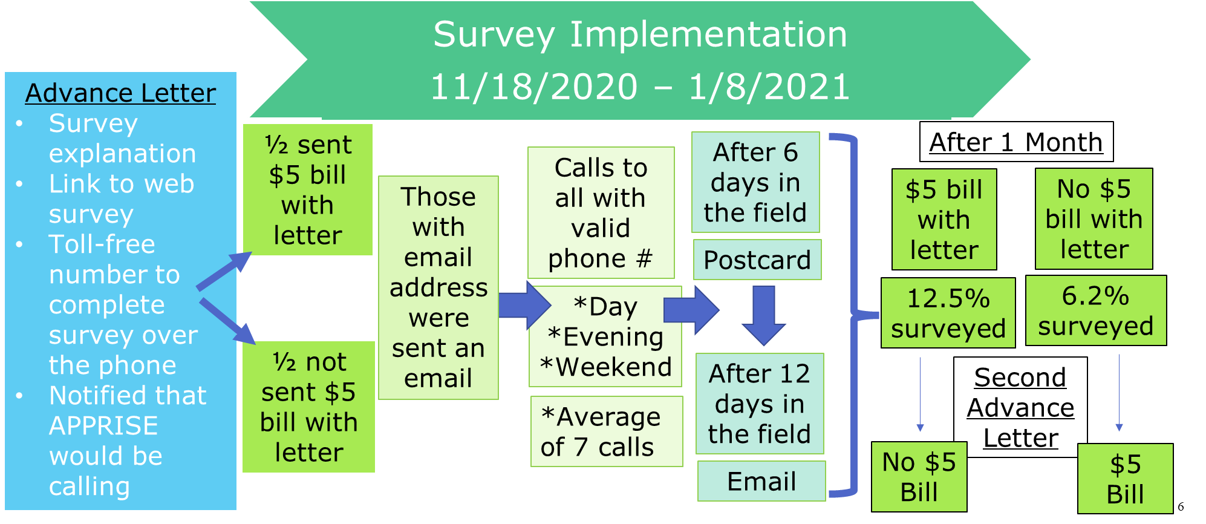
Methodology

Slide 7
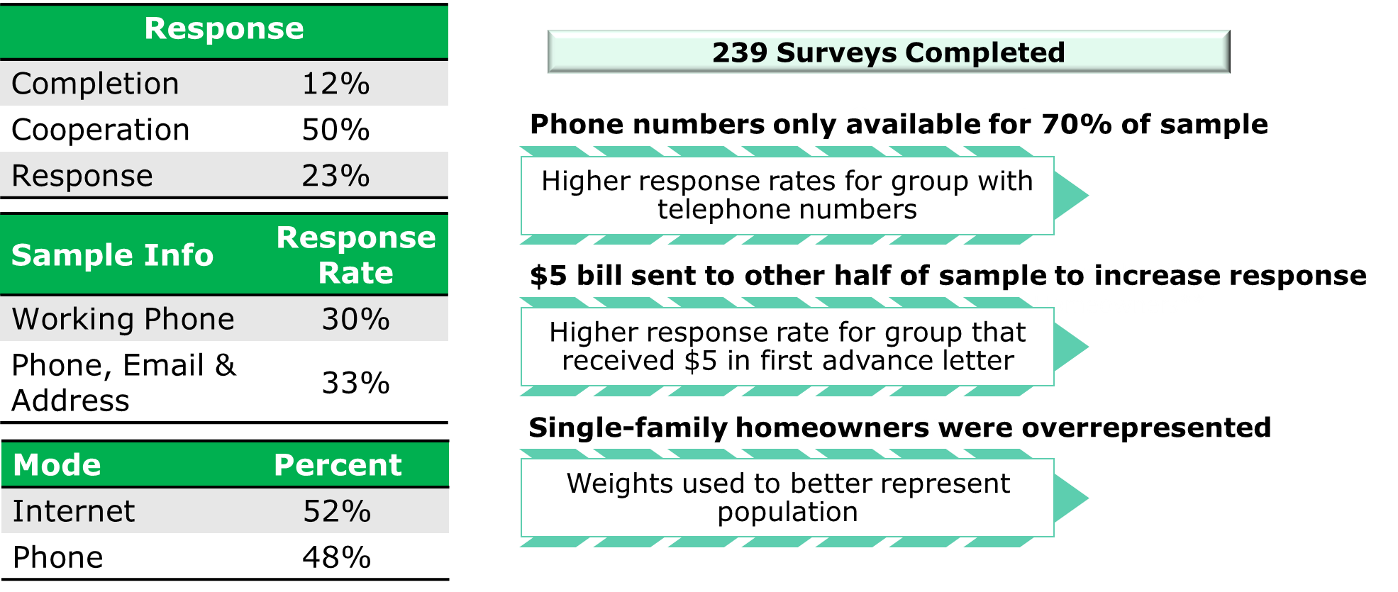
Methodology

Slide 8
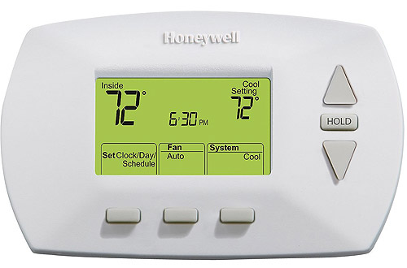
Thermostat Settings

Slide 9
A Word About Terminology
Winter Heating Season
Setback refers to turning the thermostat down to a lower setpoint
Summer Cooling Season
Setback refers to turning the thermostat up to a higher setpoint
Nighttime
Considered energy period savings
Not true for the summer

Slide 10
A Word About Temperature Preferences

Slide 11
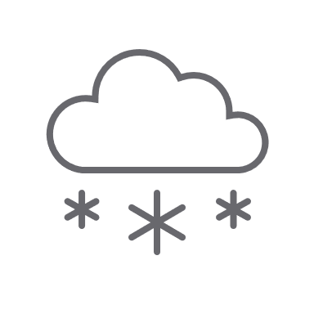
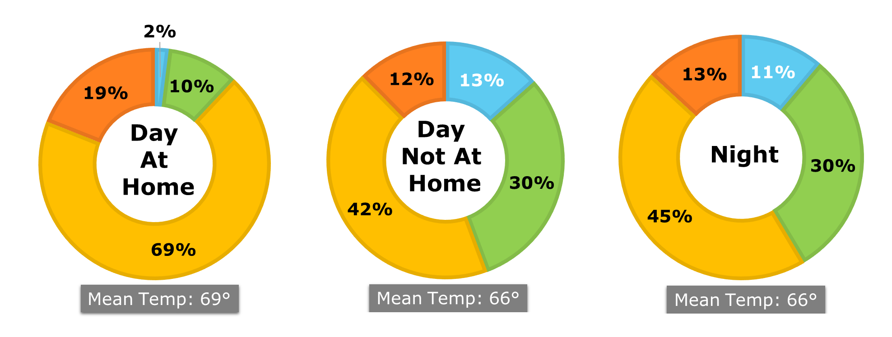
Winter Settings (Single Family)
Notes:
Average winter settings among all single-family respondents: 69 degrees (right between 68 degrees typically thought of as an efficient at-home setting, and 70, the default for many consumer grade thermostats).
On average, households are using a lower set point when away and at night (next slide)

Slide 12
Winter Setbacks
Notes:
Nearly half of SF respondents are not practicing winter setbacks, and this increases to more than half among MF residents
Note that to reach the typical energy saving default setback of 62, a full 7 degrees of setback would be required, but only a small minority are setting back that much

Slide 13
Summer Settings (Single Family w/AC)
Notes:
In summer, the average setpoints appear to be fairly consistent throughout the day (72-74) regardless of occupancy
But we get a hint of something else going on at night

Slide 14
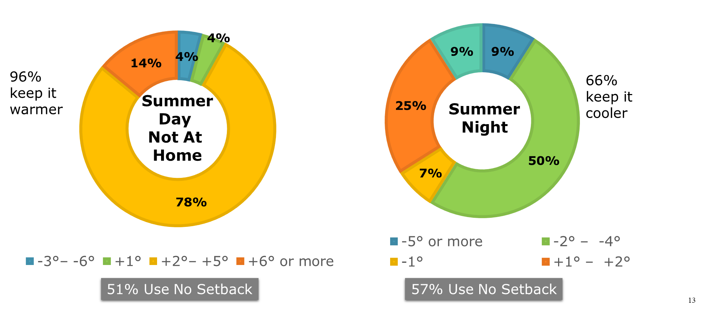
Summer Setbacks
Notes:
In fact, households are not practicing setbacks, meaning they’re not modifying the temperature at all when no one is home or at night, at a higher rate in summer than in winter (more than half in both cases).
But what’s really interesting here is that about 2/3 of households report turning down the temperature at night – meaning they prefer to sleep cooler both in winter and in summer.
This is opposite from the conventional wisdom of OEM default settings that regard nighttime as a potential energy saving period in both seasons. In reality, for 2/3 of these households the energy saving period in the summer is during the day, not at night.

Slide 15
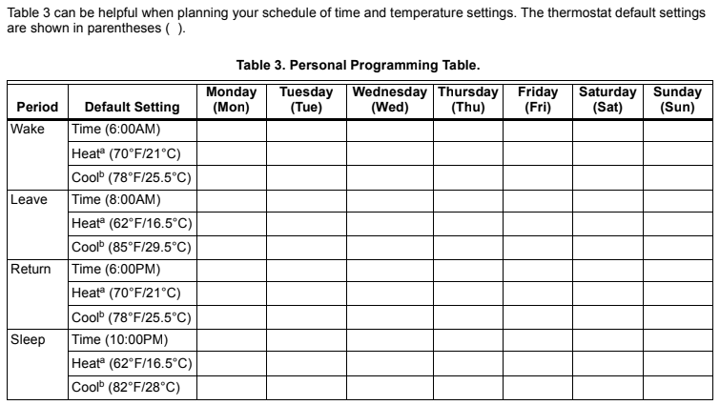
Default Assumptions About Summer Setbacks

Slide 16
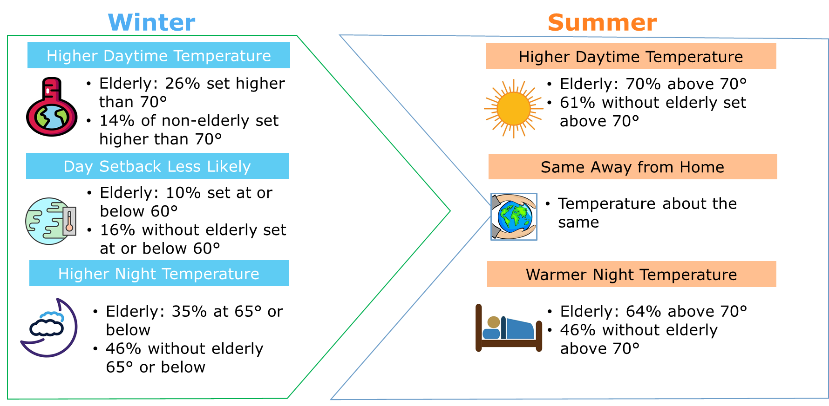
How the Elderly Differ
Notes:
This appears to be compounded by the age of occupants. Households with an elderly member consistently report higher average temperatures for all periods, including at night in both seasons.
Greatest difference is summer nighttime, when elderly prefer to sleep warmer

Slide 17
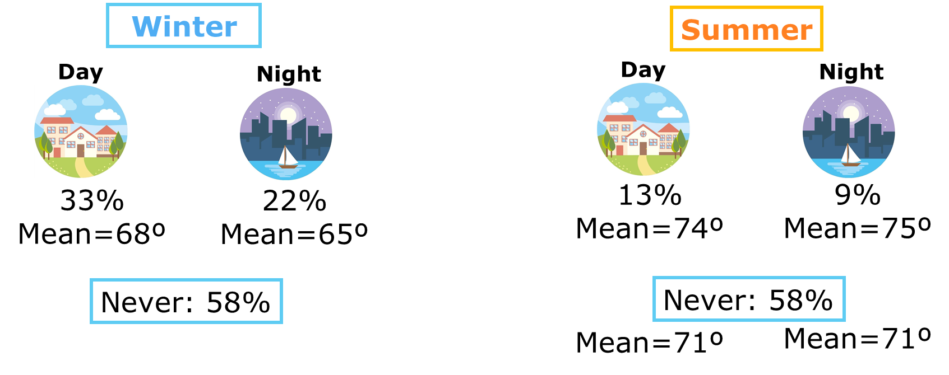
Conservation (Single Family)
“Do you ever set your thermostat at a less than comfortable temperature
during the day or at night in the winter/summer because you are trying to use less energy?”
Notes:
And it is also worth noting that more than a third of respondents reported that they do sometimes deploy uncomfortable setpoints in order to save energy, and that they were more likely to do so during the day. Only 58% said they never experienced this.

Slide 18
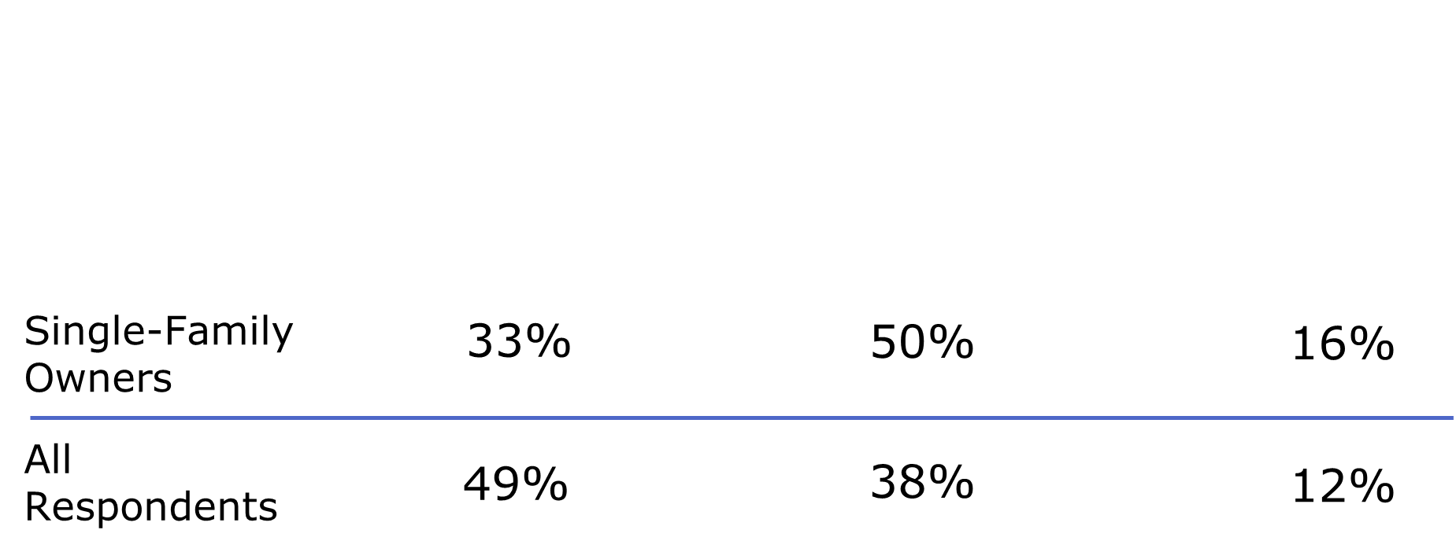
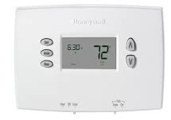
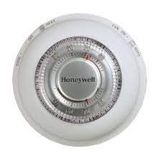
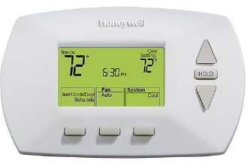
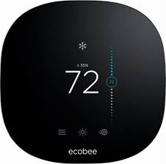
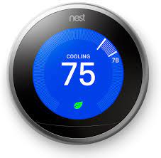
Thermostat Types
Manual Programmable Smart
Notes:
Looking at the frequency of thermostats by type, smart thermostats still represent a small minority among this population, especially in multifamily

Slide 19
Setback by Type
Manual Programmable Smart
WINTER: Do you set your heating at a lower, colder temperature when no one is at home during the day in the winter?
51%
59%
71%
SUMMER: Do you set your AC at a higher, warmer temperature when no one is at home during the day in the summer?
18%
38%
36%
Notes:
Interesting observations:
Manually turning down the heat when away in winter is more intuitive than turning up A/C in summer?
A programmable thermostat requires intentional thought that may promote adoption
A smart thermostat makes this even easier and builds on the intuitiveness of heating setbacks in winter
But smart thermostat doesn’t multiply the effect in the same way in summer – but may still be delivering the savings through occupancy settings that require (almost) no user set-up

Slide 20
Recommendations

Slide 21
Recommendations: Setpoints
Different protocols recommended for elderly and non-elderly households
Non-Elderly Households
Elderly Member Households
Setback Opportunity Periods
Winter
69º day setting
66° night setting
66° away setting (discuss)
Summer
74º day setting
72º night setting
76º away setting (discuss)
No Pre-determined Setbacks
Winter
70º default setting
Summer
73º default setting
Direct resident interaction is preferred.
Education is important.
Provide documentation & support opportunities.
Notes:
In terms of recommendations, we believe the data emphasizes the need to treat elderly and non elderly households differently,
and that it may be important to not to activate a default energy saving protocol for elderly households without speaking with them first to determine their occupancy patterns and comfort thresholds.

Slide 22
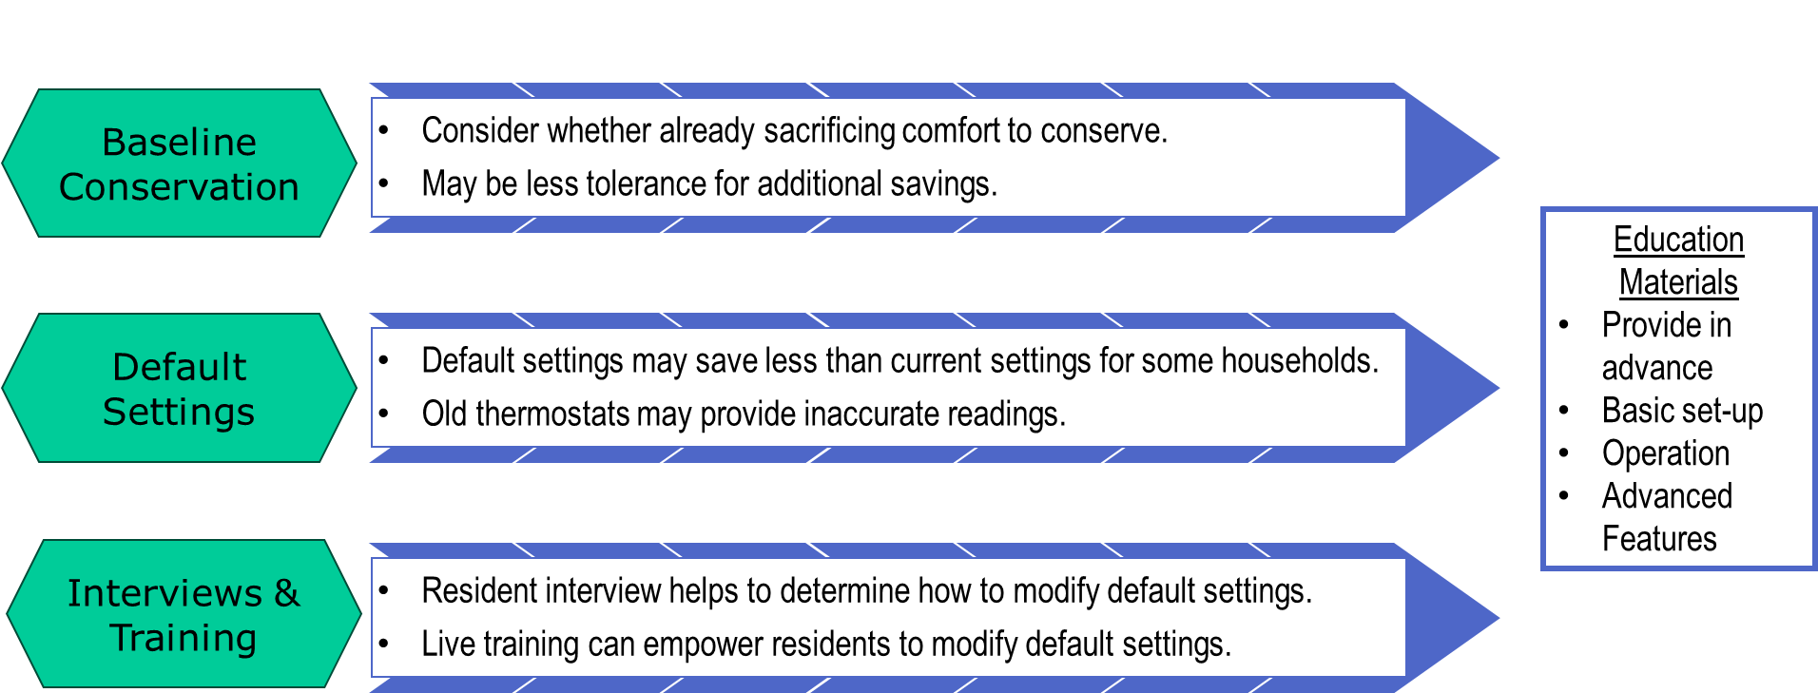
Recommendations: Baseline Behavior
Notes:
Keep in mind that some households may already be conserving – and may even be using more aggressive setpoints than your programmatic defaults…
And that the best way to do what’s right for the customer is to speak with them prior to making assumptions,
and have installer set-up protocols prepared for a variety of different occupancy and demographic scenarios.

Slide 23
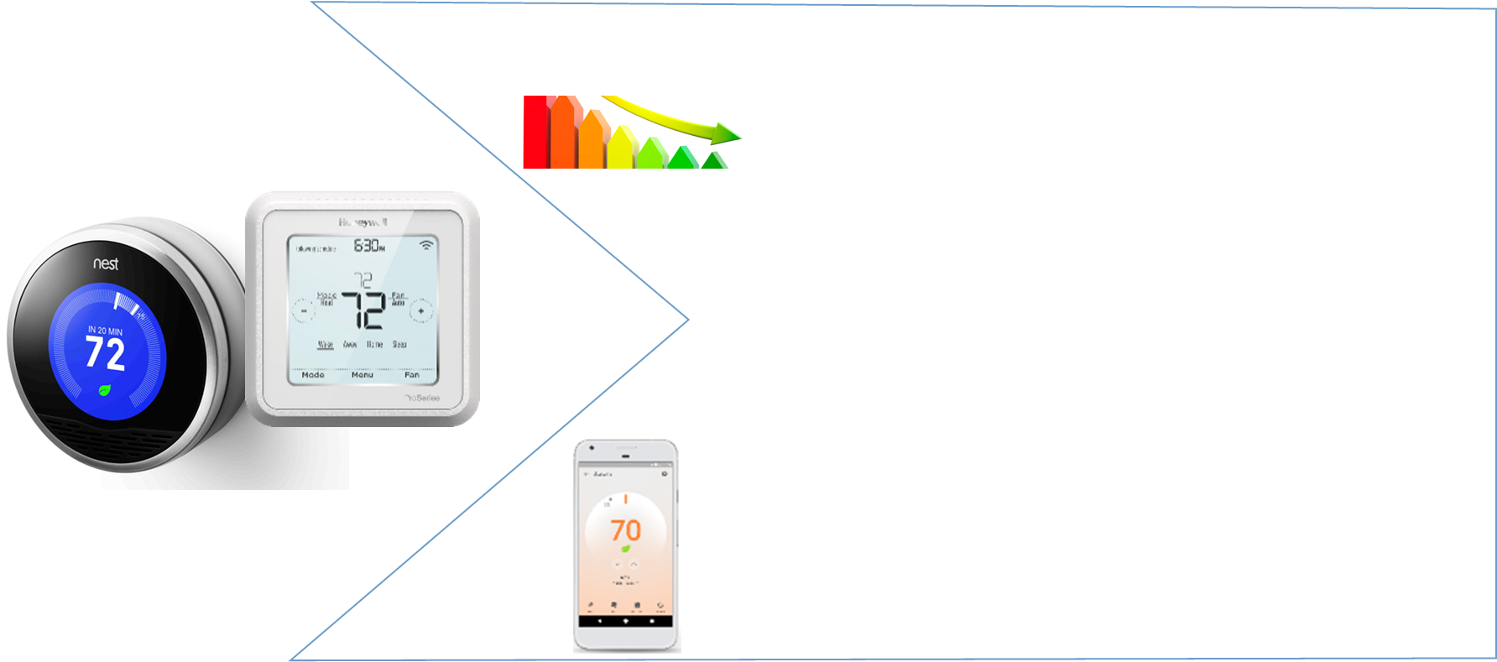
Recommendations: Smart Thermostats
Energy Savings
Smart thermostats provide good opportunity for energy savings.
Low penetration
Many do not setback
Those who do setback, often manual
Occupancy Sensors
Some smart thermostats can adjust based on occupancy awareness.
Apps Not Often Used
But geofencing may be less effective than device integrated (“on-board”) sensors
Notes:
Finally, smart thermostats represent an excellent opportunity to drive savings based on the still-low penetration rate.
This may be especially true when an integrated occupancy sensor can automate home & away settings, since our study also showed that many residents fail to follow through on app set-up for smart thermostats, effectively disabling this feature for thermostats that depend on geofencing to trigger home/away settings.

Slide 24
Questions

Slide 25
Smart Thermostats – Opportunities & Challenges
April 11-14, 2022 | Nashville, TN
Insights from a Study of Residential Thermostat Settings & Temperature Preferences
Jackie Berger
APPRISE
jackie-berger@appriseinc.org
Ben Adams
MaGrann Associates
benadams@magrann.com

