Slide 1
Challenges and Opportunities in Providing Solar to Low-Income Households
Jennifer Schmidt, Illinois Power Agency
Laura Oakleaf, Elevate Energy
Jackie Berger, APPRISE

Slide 2
Overview
Presenters
Jennifer Schmidt, Illinois Power Agency
Laura Oakleaf, Elevate
Jackie Berger, APPRISE
Outline
Illinois Solar for All Program
Customer Protections & Education
Environmental Justice
Barriers to Rooftop Solar
State Agency
Program Administrator
Evaluator
2

Slide 3
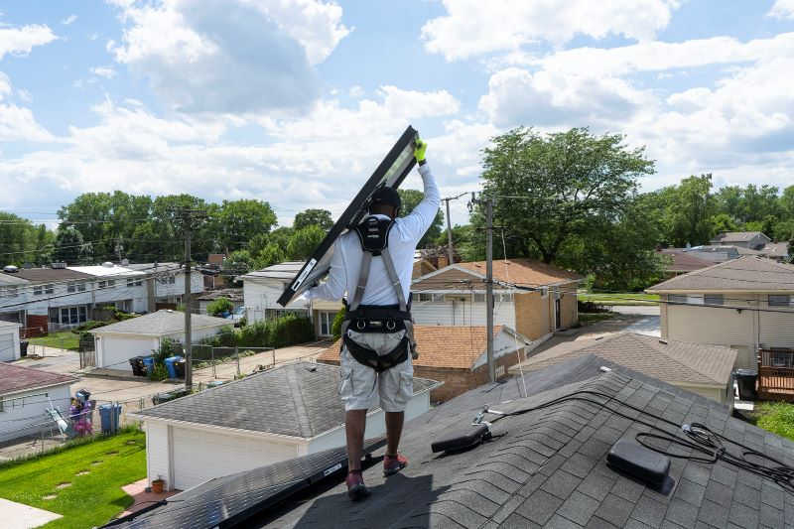
Illinois Solar for All Program
3

Slide 4
ILSFA Overview
Made possible by the Future Energy Jobs Act (FEJA)
Provides incentives to help make solar installations in low-income and environmental justice communities more affordable
Administered by Elevate on behalf of the Illinois Power Agency (IPA)
Independent third-party evaluation by APPRISE
Illinois Shines (Adjustable Block Program) - general market rate program in Illinois resulting from FEJA
4

Slide 5
ILSFA Offerings
Distributed Generation
Non-Profit/
Public Facilities
Community
Solar
Community
Solar Pilots
$7.5 million per program year
Costs and fees won’t exceed 50% of value of electricity produced
No upfront cost to participants
$5 million per program year
Non-profit or public sector facilities serving and located in low-income or EJ communities
Costs and fees won’t exceed 50% of value of electricity produced
No upfront cost to participants
$12.5 million per program year
Low-income residents can subscribe
Costs and fees won’t exceed 50% of value of electricity produced
No upfront cost to subscribers
$5 million per program year
Funding low-income community solar pilot projects
Competitive procurement
5

Slide 6
Market Based Approach
Approved Vendors are responsible for executing the requirements of the program and are the ones to receive the Renewable Energy Credits (RECs)
Requirements:
Consumer Protections and Savings Requirements
Job Training Goals
Income Verification
6

Slide 7
Evaluation Design
Evaluation Goals
Evaluation Activities
Assess Program Design & Implementation
Phase I
*Document and Materials Review
*Illinois Power Agency Interviews
*Program Administrator Interviews
*Stakeholder Interviews
*Grassroots Educator Interviews
*Program Data Analysis
Phase 2
*Document & Materials Review
*IL Power Agency Interviews
*Program Admin Interviews
*Stakeholder Presentations
*Stakeholder Interviews
*Grassroots Educator Interviews
*Approved Vendor Interviews
*Approved Vendor On-Line Survey
*Electric Utility Interviews
*Job Trainee Interviews
*Participant In-Depth Interviews
*Participant Surveys
*Program Data Analysis
*Environmental & Economic Analysis
*Elevate Energy Assessment
Measure Program Impacts
Assess Program Administrator
Recommend Program Improvements
Statute-Required Metrics
# Projects Installed
Installed Capacity (kW)
Avg $/kW Installed
# Jobs Created
Economic Impact
Environmental Impact
Social Impact
Admin $
Additional Performance Metrics
Incentive $ Awarded
Average $/kWh Produced (expected)
Housing Issues that Prevented DG
% Projects Not Completed & Factors
Vendor Satisfaction/ Complaints
Average Savings by Business Model Types
Jobs Created Analysis Categories
Construction/ Installation
Sales, System Design, General Construction, Trades
Supply Chain
Indirect/Induced
Permanent/Temp
% of Install Hours by Job Trainees
Average Salary
Coordination between Job Training Providers & Vendors
Non-Energy Impacts
Participant Energy Costs & Burden
Installation Locations and Job Trainee Residence
% Panels Produced in U.S.
Community Awareness, and other well-being
Electric Distribution System Reliability
CO₂ Reduction
Homes Powered, Fossil Fuel Displacement
Other
Evaluation Finding Example
Job Trainee Interviews
Challenges
Job Location, Hands On Training
Successes
Employment, Wages, Experience
7

Slide 8
Customer Protections & Education
8

Slide 9
Customer Protections
Projects developed only by vetted Approved Vendors
Cost and savings requirements
Financial protections
Standard disclosure forms
Marketing requirements
Projects must include warranties and guarantees of workmanship
9

Slide 10
Grassroots Education
Funding for Grassroots Education is outlined in the law
60% of Grassroots funding is for campaigns in Environmental Justice Communities
Considered an important part of consumer protections as well as outreach and education partners.
RFP issued annually allows for new groups to come into the program and expand reach to new communities
10

Slide 11
Outreach Challenges & Successes
Research Interviews
Challenges
Successes
Elevate Energy
Approved Vendors
Program Complexity
Case Studies
Grassroots Educators & Participants
Stakeholders
Community Action Agencies
Community Distrust
Outreach during COVID
Grassroots Educators
Partnerships with Other Programs
Alternative Energy Suppliers
Solar Readiness
Community Solar Accessibility
11

Slide 12
Environmental Justice
12

Slide 13
ILSFA EJ Requirements
Environmental justice (EJ) communities demonstrate a higher risk of exposure to pollution based on environmental and socioeconomic factors
Goal of at least 25% of program funds allocated to projects in EJ communities.
Up to 60% of available grassroots education funding will be awarded to Grassroots Education proposals targeting EJ communities
2,422 of 9,683 census block groups in Illinois were designated EJs based on localized environmental and socioeconomic factors
Represents appx. 3.1 million people or 1.2 million households
Option for communities to pursue “self-designation”
13

Slide 14
ILSFA EJ Determination
Self-designation allows for additional relevant factors that were not able to be incorporated into the analytical methodology to be considered.
Designators define the community and submit quantitative or qualitative support demonstrating a disproportionate environmental, health, or socioeconomic burden experienced by their community.
A committee comprised of IPA and Elevate staff along with environmental justice experts evaluate the submission.
14

Slide 15
EJ Statistics
EJ Self-Determination
21 Submissions
8 received EJ self-designation status
Community Type | PY1-PY3: 2018-2021
 | NP/PF |  | CS |  | DG |  | Total
 | $ | % | $ | % | $ | % | $ | %
In EJ | $9.49 | 67% | $29.77 | 83% | $0.12 | 3%* | $39.38 | 73%
Not in EJ | $4.71 | 33% | $6.06 | 17% | $4.02 | 97% | $14.80 | 27%
In LI Tracts | $13.47 | 95% | $35.62 | 99% | $4.15 | 100% | $53.24 | 98%
Not LI Tracts | $0.72 | 5% | $0.21 | 1% | $0.00 | 0% | $0.93 | 2%
Total | $14.20 | 100% | $35.83 | 100% | $4.15 | 100% | $54.17 | 100%
*This is due to one large DG project that was not in an EJ community.
15

Slide 16
LI Distributed Generation Barriers
16

Slide 17
ILSFA LIDG Approach
Over 50% of building households meet income guidelines
Savings requirements
Increased system documentation and workmanship requirements from Illinois Shines DG
ILSFA AVs must have developed community connections
Marketing and consumer protections
Job trainee requirements
25% of LIDG budget 9-month carveout for 1-4 unit buildings
17

Slide 18
Vendor Challenges
Batch size requirements
Incentives are paid on completion of projects; timeframe between customer acquisition, project approval, construction and payment is long.
New idea in the marketplace; there is uncertainty and a feeling that the offer is too good to be true, especially because of past experiences with ARES.
High customer acquisition costs
Site suitability screening
Customer eligibility
18

Slide 19
LIDG Progress
Project Stage | Type of Project | Number of Projects
Part I Submitted and Under Review | 1-4 Distributed Generation | 13
ICC Approved/Construction | 1-4 Distributed Generation | 18
ICC Approved/Construction | 5+ Distributed Generation | 9
Part II Review | 1-4 Distributed Generation | 20
Inspection | 1-4 Distributed Generation | 11
Project Complete | 1-4 Distributed Generation | 8
Project Complete | 5+ Distributed Generation | 1
Dropped- Ineligible | 1-4 Distributed Generation | 1
Dropped- Ineligible | 5+ Distributed Generation | 8
19

Slide 20
ILSFA Summary
Distributed Generation, Non-Profit/Public Facility, Community Solar
Market-Based Program
Extensive Consumer Protections
Job Training Requirements
Challenges in generating DG Participation
20

Slide 21
Continuing the Learning
ILSFA Website:
https://www.illinoissfa.com/
Evaluation reports
https://www.illinoissfa.com:888/evaluation/

