Slide 1
Analysis and Assessment of Non-Energy Impact Calculations
Jackie Berger
2021 Home Performance Conference

Slide 2
Overview
What are Non-Energy Impacts (NEIs)?
Why are NEI’s Important to Study?
Challenges in the NEI Literature
Assessing NEI Calculations
Recommendations for NEI Research
NEI Estimation
2

Slide 3
APPRISE
APPRISE
Nonprofit Research Institute
Mission
Research Areas
Clients
Federal Government (DOE, HHS)
State Governments
Utility Companies
Nonprofits
Energy Efficiency & Renewables
Energy Affordability
Princeton, NJ
Established in 2002
Analyze data and information to assess and improve public programs
3

Slide 4
Non-Energy Impacts
Non-Energy Impacts
4

Slide 5
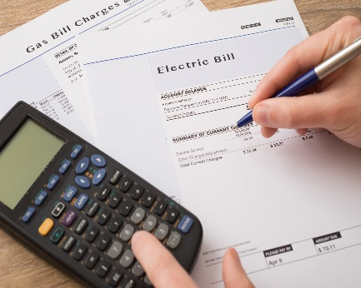
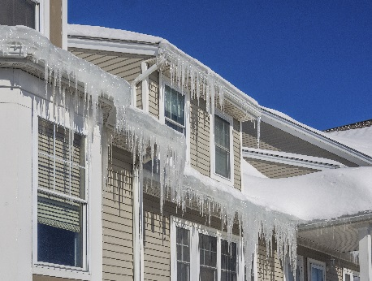
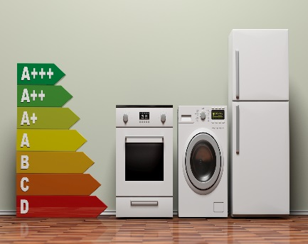
What are Non-Energy Impacts?
Energy Efficiency Evaluation Typical Assessments
Annual Energy Savings (kWh, ccf)
Demand Reduction (kW)
Measure-Level Savings
Cost-Effectiveness
Additional Impacts
Environmental Impacts
Economic Impacts
Comfort Impacts
…and many more!!
5

Slide 6
What are Non-Energy Impacts?
Home Comfort
Health & Safety
Drafts
Humidity
Mold
Cold/Hot Rooms
Noise
Air Quality
Carbon Monoxide
Asbestos
Pests
6

Slide 7
What are Non-Energy Impacts?
Ratepayer Benefit Examples
Air sealing increases comfort
Reduced usage improves affordability and may reduce collections costs
Societal Benefit Examples
Reduced emissions positively impact the environment
Household Benefit Examples
7

Slide 8
What are Non-Energy Impacts?
Benefit Level | Societal | Household
Benefits To | General Population | Ratepayer | Participant
Economic | ✓
Environmental | ✓
Health & Safety | ✓ |  | ✓
Affordability |  | ✓ | ✓
Collection Costs |  | ✓
System Reliability |  | ✓
Indoor Air Quality |  |  | ✓
Noise |  |  | ✓
Water Usage |  |  | ✓
Maintenance |  |  | ✓
8

Slide 9
What are Non-Energy Impacts?
Household level benefits may result in benefits to society
Program participant affordability improvements
Household level benefits may result in benefits to ratepayers
Program participant health improvements
May lead to reductions in Medicaid or Medicare costs
Benefits accrue to taxpayers
May lead to reductions in the cost of bill payment subsidy
Benefits accrue to ratepayers
9

Slide 10
Why Study Non-Energy Impacts?
Various Motivations for EE Participation
Monetary
Program Marketing
Comfort
Health & Safety
Environmental
Non-Energy Benefits Increase SIR
Greater Investment in Measures
Cost-Effectiveness Testing
Increased Energy Savings
10

Slide 11
NEI Literature
11

Slide 12
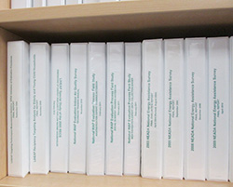
Challenges in the NEI Literature
Review Past Studies
Select Particular Benefits for Inclusion
Take Average of Past Study Impacts
Common Approach to NEI Estimation
12

Slide 13
Challenges in the NEI Literature
Utilizes Past Estimates
Lack of Documentation
Research Quality Not Assessed
Methodology
Assumptions
Robustness of Approach
Sample Size
Statistical Significance
Not Applicable to Current Study
Limitations
Out of Date
13

Slide 14
Challenges in the NEI Literature
Important Questions
Methodology
Robustness
Factors
Design
Sample Size
Statistical Significance
Calculations Performed
Causality
Response Rate
Impact of Attrition
Comparison Group Quality
Population Served
Program Design
Program Delivery
Weather
Fuels
Baseline
Other Services Available
14

Slide 15
Challenges in the NEI Literature
Important Questions
Economic Benefits
Net Benefit
What would the funds be used for in the absence of the program?
Other Influencing Factors
Energy Assistance
When households sign up for WAP, are they enrolled in LIHEAP?
Double
Counting
Health Impacts
Is the same benefit counted more than once when valuing the impact of increased prescription adherence, health status, colds, allergies, etc.?
15

Slide 16
NEI Estimation
16

Slide 17
Designing NEI Study Example
Measure Impact
$ Monetize Impact
Survey
Program/Utility Data
Literature Review
17

Slide 18
Designing NEI Study Example
Non-Energy Impact Measurement Framework
Treatment Group
Comparison Group
Baseline Survey
Households scheduled for an audit.
Treated one year prior to survey.
Collect client self-reports of housing unit conditions and health status prior to audit (one year after audit for comparison group).
Follow-Up Survey
One year after services (two years after for comparison group), same time of year as baseline survey, ask same survey questions on housing unit conditions and health status.
Analysis
Restricted to homes that were weatherized and still occupying the weatherized home.
Compare changes for Treatment Group to changes for Comparison Group.
18

Slide 19
Quasi-Experimental Earlier Participant Comparison
Difference-in-Difference Analysis
 | Pre | Post | Change | Measured
Treatment Group | Year Before Services | Year After Services | After - Before | Program Impact +Other Factors
Comparison Group | 1 Year After | 2 Years After | 2 Years After – 1 Year After | Other Factors
Treatment - Comparison |  |  |  | Program Impact
19

Slide 20
Quasi-Experimental Design
B-A
A
Treatment Wx
B
Survey
Survey
Gross Change
D-C
C
Comp Wx
Survey
D
Survey
Comp Change
Gross Change
Comparison Group Change
Net Change
B-A
D-C
20

Slide 21
National WAP Example
 | Treatment Group |  |  | Comparison Group |  |  | Net Change
 | Pre | Post | Change | Pre | Post | Change
AFFORDABILITY
Very hard or hard to pay energy bills | 76% | 49% | -26%*** | 58% | 52% | -6%** | -20%***
BILL PAYMENT
Fuel ran out | 9% | 5% | -4%*** | 5% | 4% | -1% | -3%*
PESTS
Extremely/very infested w/roaches, spiders, other | 5% | 2% | -3%** | 2% | 2% | 0% | -3%**
Somewhat infested | 19% | 12% | -7%*** | 13% | 15% | 3% | -10%***
MOISTURE
Mildew odor or musty smell | 29% | 21% | -8%*** | 15% | 16% | 1% | -10%***
Sometimes observed standing water | 15% | 9% | -6%*** | 7% | 7% | -1% | -5%**
NOISE
A great deal of noise | 28% | 17% | -12%*** | 12% | 12% | 0% | -12%***
DRAFTINESS
Drafty all the time | 12% | 2% | -10%*** | 4% | 3% | -1% | -9%***
Drafty most of the time | 17% | 4% | -12%*** | 4% | 2% | -2%** | -10%***
INDOOR WINTER TEMPERATURE
Very Cold | 6% | 2% | -4%*** | 3% | 1% | -2%** | -3%*
Cold | 33% | 14% | -19%*** | 15% | 14% | -1% | -17%***
Comfortable | 58% | 82% | 23%*** | 79% | 83% | 4%* | 20%***
Statistical significance at the ***99 percent, **95 percent, and *90 percent levels.
21

Slide 22
National WAP Example
 | Treatment Group |  |  | Comparison Group |  |  | Net Change
 | Pre | Post | Change | Pre | Post | Change
INDOOR SUMMER TEMPERATURE
Comfortable | 57% | 71% | 13%*** | 72% | 74% | 2% | 12%***
Very hot | 12% | 4% | -8%*** | 4% | 4% | 1% | -8%***
UNSAFE/UNHEALTHY INDOOR TEMP
Some months | 8% | 3% | -4%*** | 3% | 4% | 1% | -6%***
1-2 months | 7% | 2% | -5%*** | 4% | 4% | 0% | -5%***
Never | 81% | 93% | 12%*** | 91% | 91% | 0% | 12%***
MEDICAL CARE ACCESS
Could not afford to see doctor with coverage | 23% | 15% | -8%*** | 17% | 15% | -2% | -7%**
Could not afford prescription with Rx coverage | 21% | 15% | -6%*** | 17% | 17% | 0% | -7%**
Could not afford prescription without Rx coverage | 4% | 2% | -2%** | 1% | 2% | 1% | -3%**
DAYS OF POOR PHYSICAL HEALTH
All 30 days | 23% | 18% | -5%** | 19% | 22% | 4% | -8%**
HOME SAFETY DEVICES
Has working smoke detectors | 90% | 97% | 7%*** | 97% | 96% | -1% | 8%***
Has working carbon monoxide monitors | 44% | 80% | 36%*** | 76% | 73% | -4%* | 40%***
Statistical significance at the ***99 percent, **95 percent, and *90 percent levels.
22

Slide 23
Valuation of Benefits Participant Surveys
Ask participant to…
Estimate monetary value of benefit
Have you noticed a change in your home comfort in the winter since the energy efficiency work? Is the home now much more comfortable, somewhat more comfortable, no change, somewhat less comfortable, or much less comfortable?
What is that dollar value from the change in winter comfort?
Value benefit compared to energy benefit
Think about the positive or negative value you experienced from this change in winter comfort — would you say it is more value, less value, or the same value to you as any possible energy savings you may have received from the program?
How does the dollar value from the change in winter comfort compare to the energy savings — 10% of energy savings, 20%, 30%, etc.? For example, if it was half as valuable you would choose 50%, if it was just as valuable you would choose 100%.
23

Slide 24
Participant Surveys
Participant Surveys
Methodology
Select Survey Sample
Send Advance Letters
Conduct Telephone Interviews
Results & Reporting
Understand who is represented – the sample frame
Stratify to ensure sub-groups are represented
Explain purpose of survey
Provide call-in option
Incentive with letter increases response rates
Calls made day, evening, and weekends
Leave message
12-call minimum
3-week survey period
Weight for selection & response –to represent sample frame
Report response rates
Assess potential bias
24

Slide 25
Assessing NEI Calculations
25

Slide 26
Assessing NEI Calculations Example
Two Non-Energy Impact Estimates from the Same Survey
Benefit | Reduction Estimate |  | Per Job Monetization First Year Benefit
 | Estimate 1 | Estimate 2 | Estimate 1 | Estimate 2
CO Poisoning | 0% | No Report | $0 | $31.43
Home Fires | 0% | 0% | $0 | $84
Cold-Related Illness/Death | 1% | 1% | $0 | $393.26
Heat-Related Illness/Death | 0% | 1% | $0 | $87.45
Asthma Emergency Dept. Visits | 1% | 12% | $0 | $202.00
Sleep Problems/Work Productivity | 1% | 21% | $0 | $182.33
Sleep Problems/Housework Productivity | 1% | 21% | $0 | $133.67
Missed Days of Work | .49 | .52 | $0 | $20.25
Short-Term Loans | 2% | 9% | $0 | $7.12
Prescriptions Affordability | 10%*** | 10% | $43 | $193.98
Food Affordability | 4% | 16% | $0 | $19.92
Food Assistance | 3% | 6% | $0 | $84
Total Benefit |  |  | $43 | $1,439
26

Slide 27
Assessing NEI Calculations Example
Why Did the Results Differ?
Estimate 1
Estimate 2
Longitudinal Framework
Same Participants in Pre and Post Periods
Unmatched Samples
Comparison
Net Change = (Pre-Treatment–Post-Treatment) –
(Pre-Comparison–Post-Comparison)
Gross Change = Pre-Treatment – Post-Treatment
Additional Measure = Pre-Treatment – Pre-Comparison
Statistical Significance
At Least 90 Percent Confidence Level
No Requirement
External Data
Only Data from Referenced Survey
External Data Used when Survey Found Small NEI
27

Slide 28
Assessing NEI Calculations Example
Reduction in Arrearage Carrying Costs
Average Low-Income Arrearage
Impact of Energy Efficiency Program on Arrearages
Interest Rate
*
*
$5.58
$218
32%
8%
Applied from previous study
Assessment
The referenced energy efficiency program reduced arrearages by 32%.
How much energy did that referenced program save?
What bill reduction did that translate into?
What $ amount of arrearage reduction did that translate into?
Should arrearage reduction be a % of average arrearages or a % of bill reduction?
28

Slide 29
Assessing NEI Calculations Example
Referenced Program
Program Studied
Referenced Program
Program Studied
Arrearage Reduction
32%
32%
Starting Arrearages
?
$218
Arrearage Reduction
?
$70
Bill Reduction*
$200
$40
Arrearage Reduction
40% of bill reduction
40% of bill reduction
$ in Reduced Arrearages
$80
$16
*Use energy billing data to calculate bill reduction as opposed to engineering estimates or technical reference manuals.
29

Slide 30
Assessing NEI Calculations Example
Large benefit value from small probability event
Avoided deaths due to thermal stress
Reduction in deaths due to weatherization=.00004/home
For every 100,000 homes treated, 4 deaths are avoided
Benefit of one avoided death = $9.6 million
Benefit to average home = $384
30

Slide 31
Recommendations
Recommendations
31

Slide 32
Recommendations for NEI Research
Review Referenced Studies
Understand Methodologies and Limitations
Assess Applicability to Evaluated Program
If possible:
Conduct primary research
Survey response rates are important
Use billing data instead of projections
32

Slide 33
Summary
Current literature on NEIs has many challenges
Additional research is needed
Difficult to apply findings from previous studies
Factors specific to programs, jurisdictions, participants, and implementation can impact the NEIs
Methodologies have been developed to measure NEIs
Additional challenges relate to valuing benefits relating to health, comfort, and safety
33

Slide 34
Contact
Jackie Berger
APPRISE
32 Nassau Street, Suite 200
Princeton, NJ 08540
609-252-8009
jackie-berger@appriseinc.org
www.appriseinc.org
34

