Slide 1
EE Meets IoT in MF Smart Thermostats & Connectivity Networks in Multifamily Buildings
Ben Adams
VP Program & Strategic Development
MaGrann Associates
benadams@magrann.com
Jackie Berger
President
APPRISE
Jackie-berger@appriseinc.org
Notes:
Welcome
Work we've been doing with smart thermostats and connectivity networks in low and moderate income multifamily buildings, and in the second half Jackie will be covering observations from evaluations for a significant subset of installations.
Unfortunately at time of recording we're not at liberty to identify the specific utilities included in these results, but we hope to be able to do that very soon.

Slide 2
Implementation Challenges in MF
System Compatibility?
Condition?
Notice Requirements?
Access?
Split Incentive?
Maintenance?
Wiring?
Staff Turnover?
Structural Constraints?
Notes:
We are all familiar with the challenges associated with deploying energy efficiency measures in multifamily buildings, and when it comes to smart thermostats and connectivity we need to be sure that the right conditions are in place. Additionally, the technologies we’re going to be talking about today are all essentially consumer grade devices intended for individual systems in apartment units, meaning primarily conventional systems and the resident, not the building owner paying the utility bill – we’ll talk about the split incentive a little toward the end of this session.

Slide 3
Compatibility
*
Individual units
Conventional split systems
Gas furnace/AC
Electric furnace/AC
Hydronic fan coil/AC
Air & ground source heat pumps
Some packaged units
“Magic-Pak” heat pumps
Most centralized systems
Steam/hot water
Electric baseboard
Most minisplit systems
Ductless/ducted
VRF
Some packaged units
PTACs
*
Other connected solutions increasingly available!
Notes:
But first let's do a quick recap of the compatibility we were looking for in participating properties – so a variety of individual conventional heating and air conditioning systems…

Slide 4
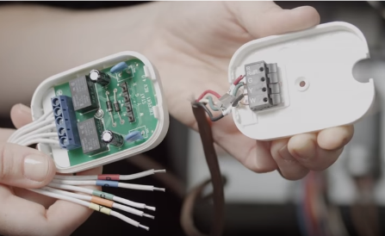
Existing Conditions
Property conditions
Systems operational
Maintenance support in place
Structural constraints addressable
Wiring compatible or fixable
“C” wire in place or easily added
Wire extender kit + time
Notes:
And a reminder that these consumer grade thermostats require either 5 wires in place, which is typical in newer buildings even if the fifth wire isn’t connected to the current thermostat (as shown in the top picture) – or four wires can be made to work like five by using a "wire extender kit" such as the one in the bottom picture. We found this scenario more typical in older buildings and required substantially more time for the install.

Slide 5
Deployments
Units
1026
Buildings
80
Properties
17
Management Companies
8
Notes:
Ultimately we were able to deploy over 1000 units in two pilots, with the breakout of participation illustrated here.

Slide 6
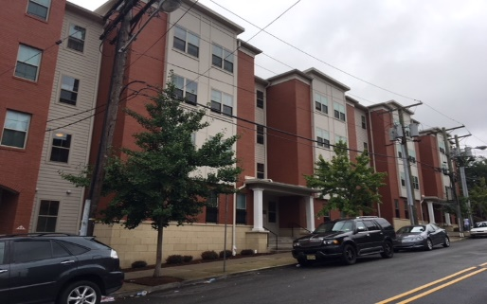
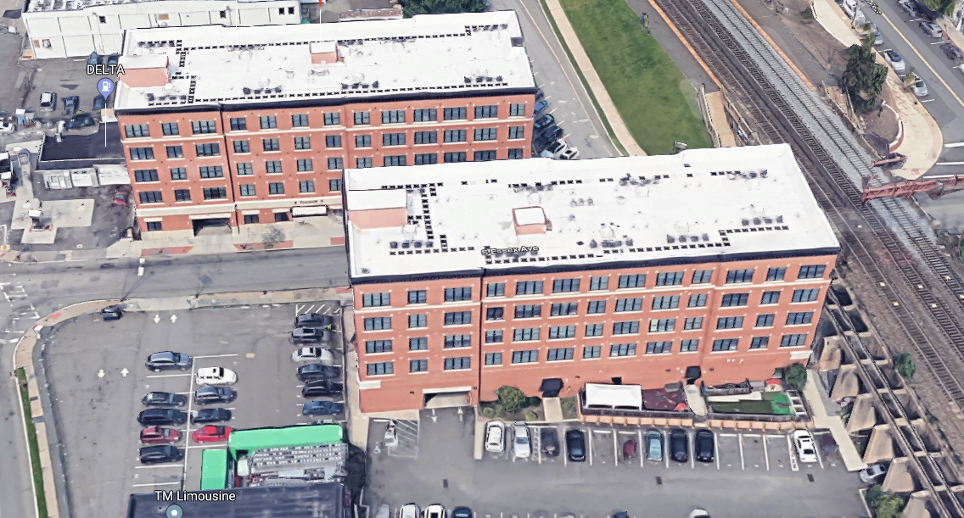
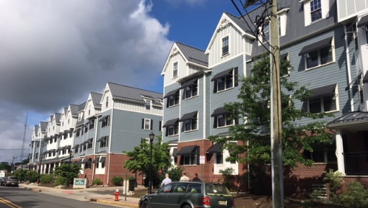
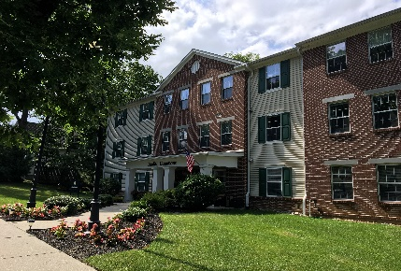
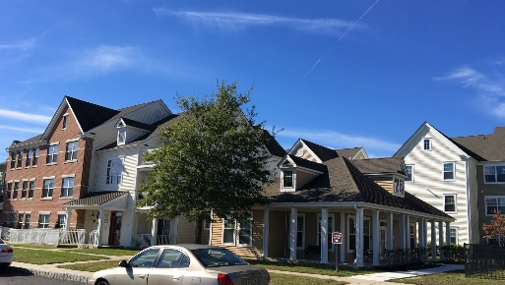
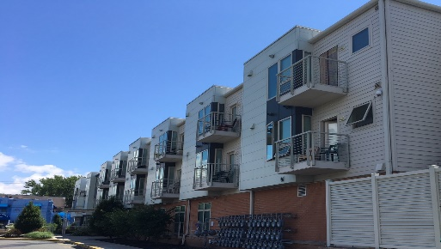
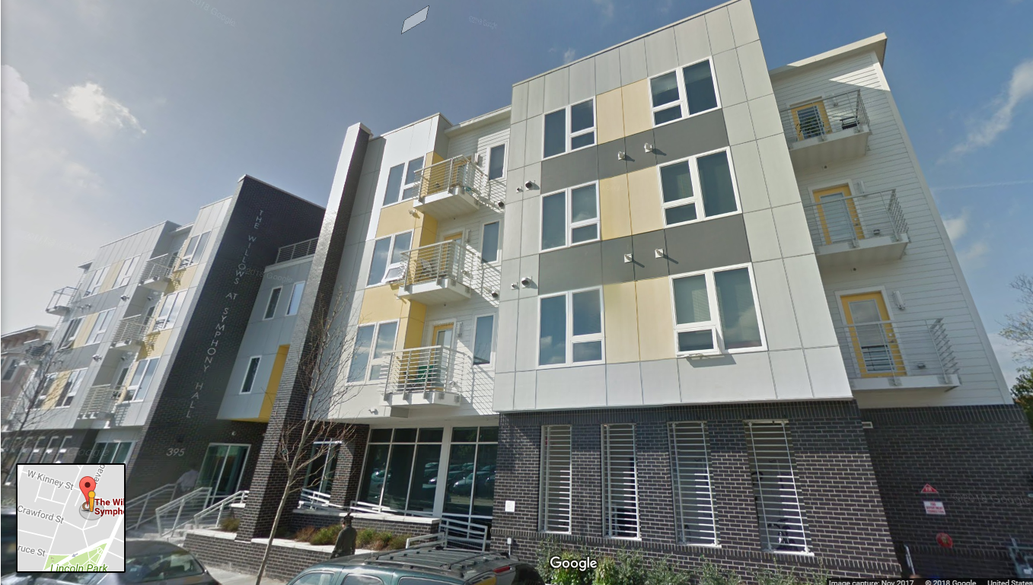
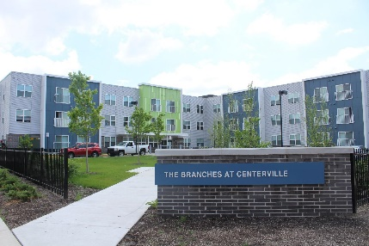
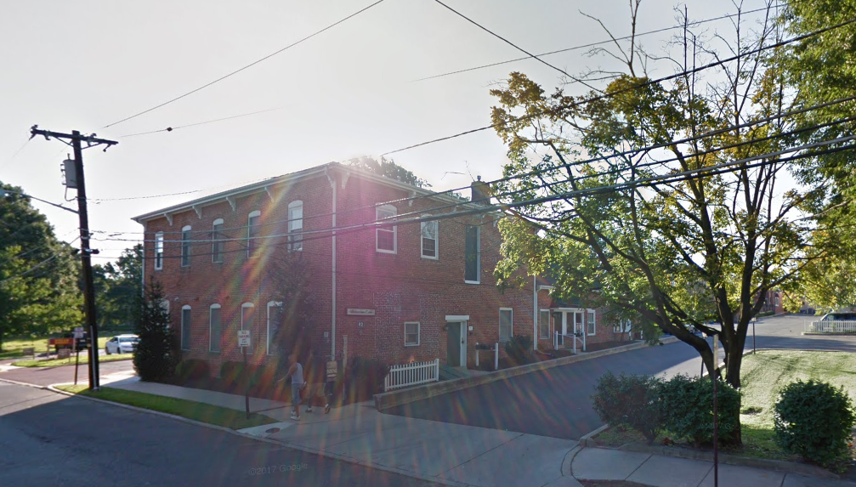
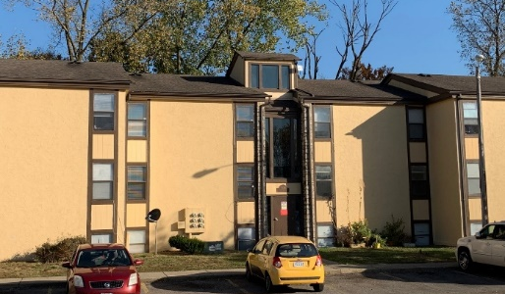
Building Types: Common Entrance Low/Midrise
Notes:
You can see here that our deployments covered a wide variety of building types and ages – both common entrance low and midrise as seen here…

Slide 7
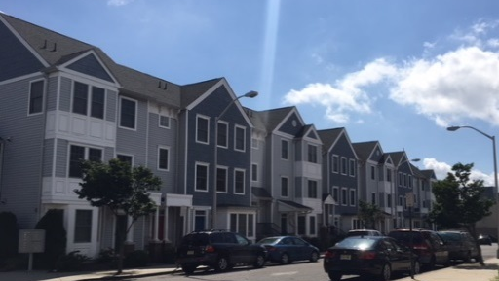
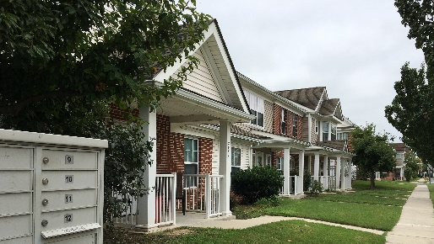
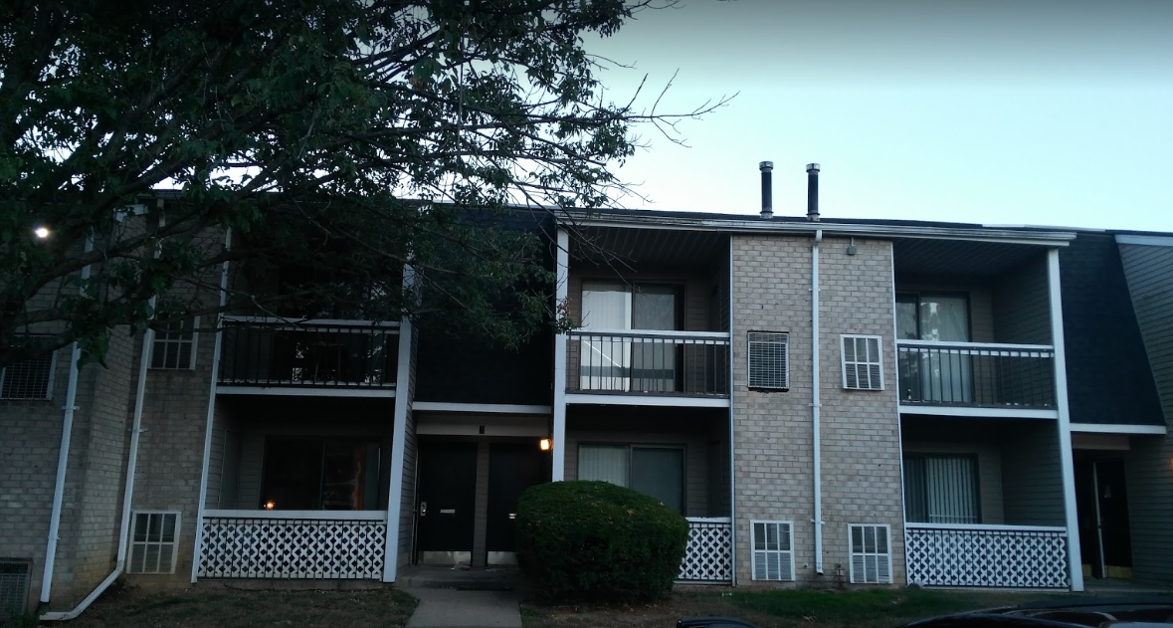
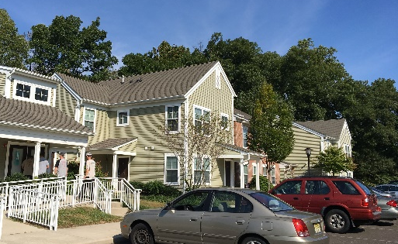
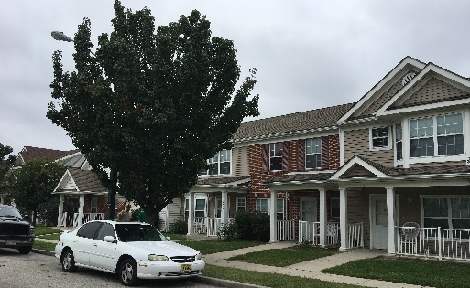
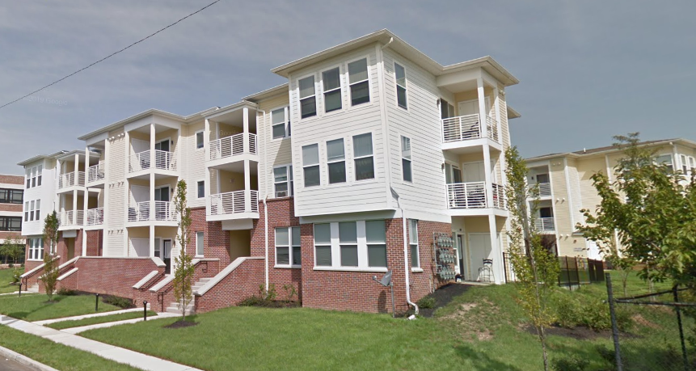
Building Types: Townhomes/Garden
Notes:
...as well as town home or garden style apartments – some built in the last 10 years and some built in the 70s or earlier

Slide 8
Resident Challenges in MF
WiFi?
Language?
Smartphones?
Seniors?
Occupancy Patterns?
High/Low Temps?
Turnover?
Vacant Units?
Notes:
But it’s really the challenges – many of which you see here – associated with the individual resident households and their experience that we want to focus on today…

Slide 9
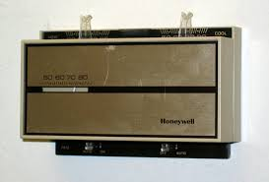
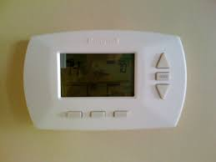
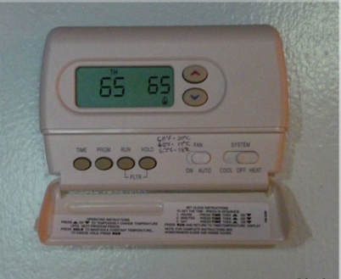
What I Had This Morning
HOLD
Notes:
Rental residents typically have no say in the kind of thermostat they have on their wall – or for that matter the kind of heating and cooling system that comes with the apartment. They may be completely frustrated with what they have now – or perfectly happy (especially if it's simply sitting on hold 24/7). Most likely they have made some kind of peace with whatever they have...

Slide 10
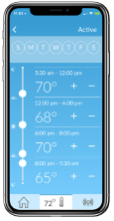
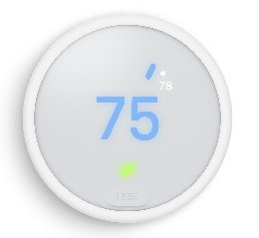
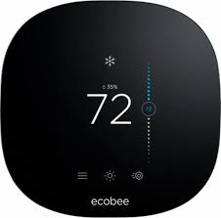
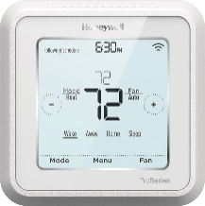
What I Found When I Got Home
Notes:
Yet by the end of the day, they have something very unfamiliar controlling how comfortable they feel, and something new to learn – whether they have wifi or not, whether they have a smartphone or not, and whether they wanted it or not.
These are the three devices included in the pilots we're covering in this presentation.

Slide 11
What Works?
Connectivity
Smart Features
Resident Education
Notes:
So given the challenges identified a couple of slides back and the specific devices selected, we set about to address what we saw as the three major categories of challenges with respect to the resident experience:
- Getting the devices connected
- Figuring out the right combination of smart features
- And helping the residents get comfortable with operating them

Slide 12
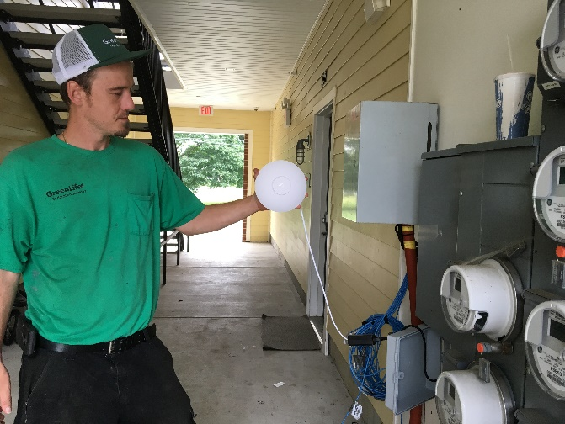
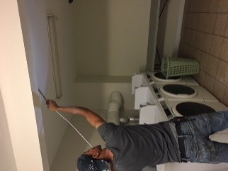
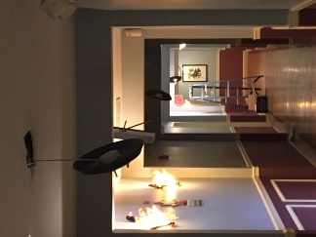
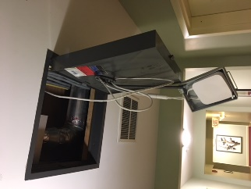
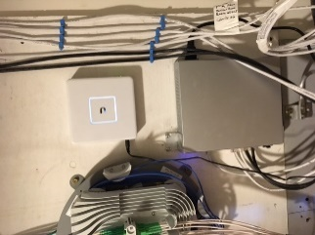
Network Installation
Notes:
Why is connectivity important? Because if set-up and control through a smart phone is going to be integral to the energy savings strategy, the thermostat itself needs to be connected to the internet. Many lower income households rely entirely on their smart phone for all of their internet access, but if the thermostat is not online, using the phone to interact with it is not an option.
It turns out we are now at a point where there is a connectivity solution available for most multifamily building configurations, though budget limitations determined which were the most practical. Working with our connectivity partner STRATIS IoT we installed a network in 9 of the 17 properties you saw listed earlier – through some combination of wired and broadcast approaches. In every case, any cabling or transmission equipment installed was invisible upon completion and tapped into the property's existing internet service at the leasing office somewhere on the property.

Slide 13
Connectivity Solutions Deployed
5 Projects (259 units) Nest E with STRATIS Wi-Fi
3 Projects (238 units) Honeywell T6 Z-Wave w/STRATIS Mesh
1 Project (72 units) HW T6 Z-Wave w/STRATIS Mesh+LoRa WAN
5 Projects (231 units) Nest E with tenant Wi-Fi if present
3 Projects (226 units) Ecobee 3 with tenant WiFi if present
Notes:
You can see here the various combinations of connectivity approaches and devices deployed in 9 of the properties, with the remaining 8 properties dependent on their own wifi if present – and we'll be talking more about the implications of that coming up shortly.

Slide 14
The Resident Experience
Lifestyle
Complexity
Motivation
Notes:
So moving on from the technical aspects of getting the device installed and connected, let's focus on the smart features and resident education. Three recurring aspects of the customer experience came up repeatedly during both the implementation and the evaluation:
- Resident lifestyle, including how they use their heating and cooling today and demographics factors such as age
- The features and complexity of the new device
- And how residents reported their attitude and feelings toward the device both before and after installation

Slide 15
Prior Winter Setbacks When No One Home
Notes:
Absent other improvements to the structure (such as air sealing and insulation), the majority of energy savings potential from the thermostat alone comes from taking every possible opportunity to change the setpoint – lower in winter, higher in summer – whenever it will not negatively impact comfort. This is true regardless of whether the thermostat is "smart", a standard programmable, or simple manual. But since more than half of participants in the evaluation reported no energy saving behavior at all, this seems to confirm a real opportunity for a device that by its design is more likely to convert those opportunities into actions.

Slide 16
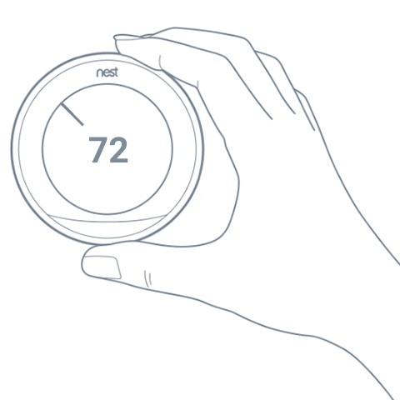
Being Smart About Smart Features
Online Scheduling
One-Tap Scenes
App Control
Geofencing
On-Board Occupancy Sensing
Offline Scheduling
Learning
Notes:
So how do Smart Thermostats do that? Different thermostats employ different strategies. The ENERGY STAR standard for smart thermostat certification doesn't define or dictate specific smart features beyond the requirement for connectivity – it's actually one of the first outcome based certification standards from ENERGY STAR versus the traditional specification based standards.
Generally all smart thermostats provide app control – which in theory at least makes it easier to program schedules or manually change setpoints – especially if you forgot to turn the thermostat up or down when you left the house, or if you're already in bed and don't want to get up again. Some apps make that even easier with "one-tap" controls to quickly toggle between energy saving and comfort settings for home, away or asleep.
Then there's automated setpoint changes based on the thermostat determining for itself that no one is home – either because resident phones have left the apartment (or geofencing), or from an occupancy sensor inside the thermostat or mounted separately elsewhere in the apartment. These automated Away settings are not comfort settings – they are typically deeper energy saving settings, or Eco-settings, that are set up once – often with visual feedback to confirm an energy saving choice of temperature – and then activated without conscious initiation by the resident.
And then there's the ability to schedule on the thermostat itself without going through a smartphone – or better yet, to convert patterns of behavior into automated schedules – or "learning".
But what we quickly learned is that enabling too many features can create too much complexity – potentially undoing the benefits in terms of the customer experience and ultimately the impacts.

Slide 17
Smart Phone Users Who Set Up the App
Notes:
But it turns out that in this customer segment, not all households have smartphones, or they choose not to install and activate the app even when they do have a smartphone.
Also not entirely surprisingly, this varies significantly by age demographic – seniors are simply less likely to engage through this technology, presumably because they are less comfortable with it.

Slide 18
Essential for Non-Smartphone Users/Activators
Online Scheduling
One-Tap Scenes
App Control
Geofencing
On-Board Occupancy Sensing
Offline Scheduling
Learning
Notes:
So our first conclusion was that an ability to create schedules on the thermostat itself, without being dependent on a smart phone, is essential. There are smart thermostats that can only be scheduled through an app, but obviously that would eliminate this traditional approach to energy savings for about half of participating households.
If we want to implement an energy saving strategy with the least possible interaction from the resident, then only an onboard occupancy sensor can fulfil that function for the vast majority of all households regardless of whether they engage with a smartphone or not.

Slide 19
Essential for Smartphone Users
Online Scheduling
One-Tap Scenes
App Control
Geofencing
On-Board Occupancy Sensing
Offline Scheduling
Learning
Notes:
For those who do have smartphones in the household, we want to help them engage through the app interface – at least for simple setpoint control – and if they're going to set up a schedule it's probably easier to do it through the app so let's make sure we have that capability as well.

Slide 20
Optional for Smartphone Users (Not enabled by default)
Online Scheduling
One-Tap Scenes
App Control
Geofencing
On-Board Occupancy Sensing
Offline Scheduling
Learning
Notes:
For smartphone users we found that any additional functionality also added a degree of complexity that required an additional level of engagement to a) determine that these functions – when available – would add value for this customer and b) the customer could be engaged sufficiently to ensure they were comfortable with both the setup and the operation – so we're going to call those "optional".

Slide 21
Optional for Smartphone Users (Not enabled by default)
Online Scheduling
One-Tap Scenes
App Control
Geofencing
On-Board Occupancy Sensing
Offline Scheduling
Learning
Notes:
Finally, while scheduled and occupancy based settings are complimentary – in other words they can be layered on each other without negative effects – we found that enabling the learning function became a complicating feature.
In fact we found it to be the biggest source of confusion for many households, especially those with multiple users in the home – otherwise known as families with kids – but also for many seniors and others who became frustrated with the setpoint changes that appeared to give the thermostat a mind of its own – and in many cases we had to help them undo this feature.

Slide 22
Lessons Learned… Keep it Simple*
Day/night (2-period) schedule
On-Board Occupancy Awareness
Resident Optional App Control
Program Optional Connectivity
Notes:
So our conclusion was to keep it simple...
For the default set-up, start with a basic 2-period schedule: Slightly cooler at night, slightly warmer during the day, summer and winter. Our observation is that most people like to sleep cooler, so contrary to the default programming from some manufacturers, the energy savings periods are really at night during the winter and during the day in the summer.
Add in occupancy awareness to trigger a deeper energy saving temperature when no-one is home – preferably using an occupancy sensor integrated into the thermostat itself.
By the way – property managers specifically requested that we not use remote sensors.
Then activate the app either with the customer in person or through instructions left behind if they're not home or not ready to engage at the time.
And since many low income customers use their smart phones for all their internet access and do not have access to wifi for the thermostat to connect to, if the program can support property level connectivity it dramatically improves the opportunity for engagement through app based features. By the way, even when the customer does have their own wifi AND they are home, we were very often not able to connect simply because they could not remember their own password.

Slide 23
*Resident Specific On-Site Setup
Home at time of install
Not home at time of install
Seniors
Smart phones
Language
Notes:
So that was the basic, default setup – but we also found it necessary to create a protocol for the specific scenarios encountered in the field.
Engaging directly and in person with the customer at the time of install is the most effective way to ensure the set-up is taking advantage of the features that will work best for them.
We employed a number of strategies to compliment this approach in each of these scenarios [read]

Slide 24
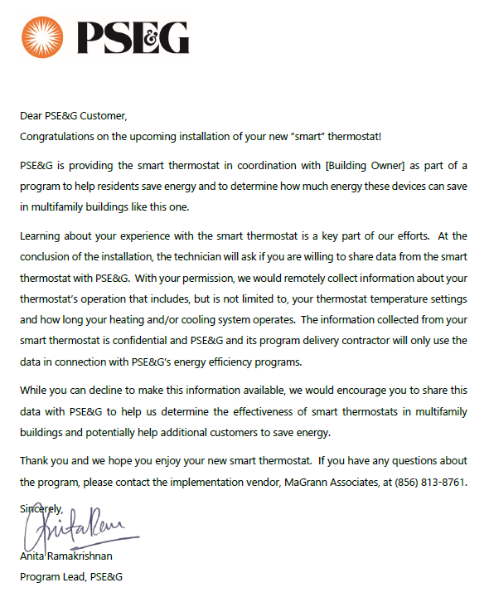
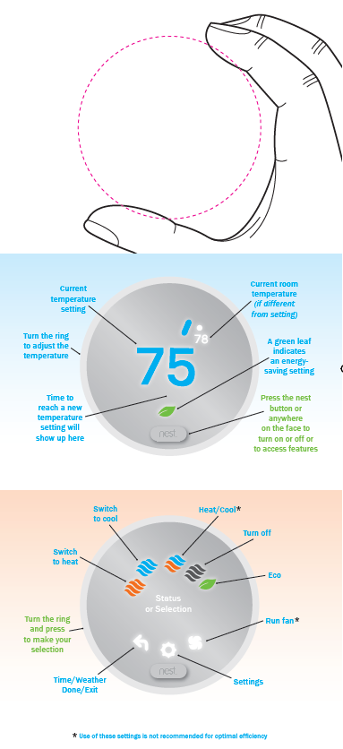
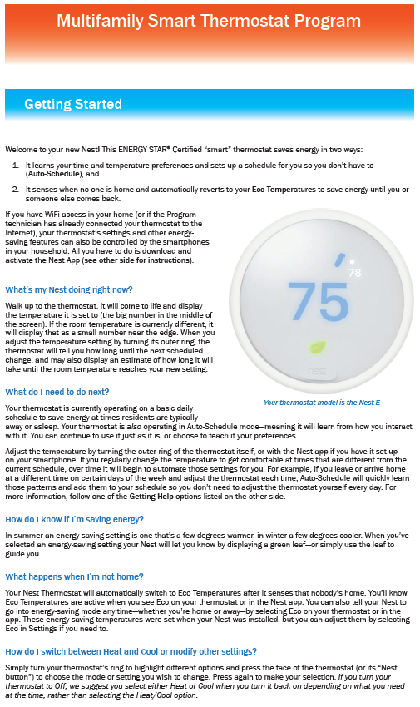
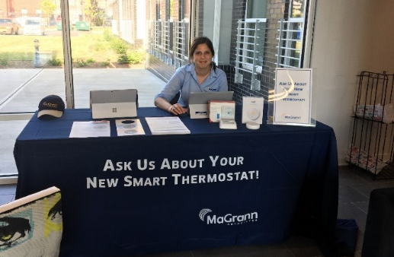
Resident Engagement
Advance notice
Installer-Educator
Leave-behind education materials
On-site “help desk” during installs
Multiple support options
Post installation workshops
Seasonal tip cards
“Embedded champions”
Notes:
[Read]
So what do we know about the effectiveness of this approach – Jackie is going to walk through the evaluation results for one of the utility programs represented here...

Slide 25
EE Meets IoT in MF Smart Thermostats & Connectivity Networks in Multifamily Buildings
Jackie Berger
President
APPRISE
Jackie-berger@appriseinc.org
Evaluation

Slide 26
Evaluation Overview
Customer Feedback
Energy Impacts
Market Analysis
Notes:
The evaluation had three components – a participant survey, assessment of the impacts of the smart thermostats on electric and gas usage through a billing analysis, and a market analysis to assess the potential for installation of smart thermostats and the potential energy savings from smart thermostat installation across the utility's service territory. This presentation reviews the participant survey findings and the energy impacts.

Slide 27
CUSTOMER FEEDBACK

Slide 28
Survey Methodology
Survey Sample
942 customers received smart thermostats
468 had complete contact information, all 468 targeted for survey
Advance Letters
Sent to 468 participants
Explained the purpose of the survey
Provided call-in option
Interviews
10-minute telephone interview
Calls made day, evening, and weekends
199 interviews completed
Notes:
Customers within several multi-family buildings received installation of smart thermostats. Complete contact information was only available for 468 of the 942 participants. All 468 participants with complete contact information were targeted for the survey.
An advance letter that explained the survey purpose and provided a toll-free number for the participant to call in if preferred.
The survey was a 10-minute telephone interview. Outbound calls were made during the day, evening, and weekend.
Surveys were completed with 199 of the 468 participants who were included in the survey sample.

Slide 29
Cooperation and Response Rate
Notes:
The overall participant survey response rate was 57 percent. 84 percent of those who we reached agreed to complete the survey. Response and cooperation rates varied somewhat by thermostat type, related to demographics of those who received different thermostat types.

Slide 30
Participant Characteristics - Demographics
Notes:
Thermostat models were selected based on the building characteristics. Demographics varied across thermostat types. The Nest was the most likely to have elderly recipients and the HW was most likely to have households with children. Therefore, it can be difficult to compare results and satisfaction across thermostat types.

Slide 31
Participant Characteristics – Computer Use
Notes:
We asked participants about computer use to assess their potential ability to use the smart thermostat features. We found that more than half said they used computers multiple times per day, but almost one third said they used a computer less than once per week. The Nest participants, most likely to be elderly, had 37 percent who used a computer less frequently than once per week.

Slide 32
Participant Characteristics Smart Phone or Tablet Used to Access the Internet
Notes:
We also asked about smart phone or tablet use. While 77 reported that they used these devices multiple times per day, 17 percent said they used the devices less than once per week. Again, the Nest participants were most likely to be infrequent users of the devices.

Slide 33
Participant Characteristics Reported Wi-Fi Connection in the Home
Note: Participants were more likely to report Wi-Fi connection than actual incidence rate.
Notes:
Overall, 83 percent reported that they had a wi-fi connection in their home. However, based on the incidence seen during installation, it appeared that a wi-fi connection was frequently reported when it was not present in the home.

Slide 34
Smart Thermostat Knowledge
Notes:
Most of the participants, 88 percent, reported that they were aware of the thermostat prior to the installation. All participants received letters notifying them of the smart thermostat installation.
However, only 24 percent said they had previously been aware of smart thermostats.

Slide 35
Initial Attitude Toward Smart Thermostat By Elderly Household Member
Question: How did you feel about receiving the smart thermostat when you first learned about the installation?
Notes:
Overall, 48 percent said they were happy to receive a smart thermostat, 36 percent said they were indifferent, and 16 percent said they did not want to receive a smart thermostat. Elderly households were much more likely to state that they did not want the smart thermostat.

Slide 36
Smart Thermostat Information Sources By Elderly Household Member
Notes:
The Program provided many opportunities for participants to learn about how to use the smart thermostats. While 26 percent requested information from building staff, 24 percent requested information from the installation company, 16 percent attended an information session that MaGrann held in the building,16 percent visited the manufacturer's website, 9 percent called the manufacturer, and 8 percent visited the help desk that was staffed in the building. Elderly were more likely to undertake most of these methods except visiting the manufacturer's website and the help desk.

Slide 37
Number of Smart Thermostat Information Sources By Elderly Household Member
Notes:
44% did not use any information sources, 31 percent used one source, 14 percent used two sources, 9 percent used three sources, and 3 percent used four or more information sources. Elderly participants used more information sources.

Slide 38
Understanding of Smart Thermostat
Question: How would you rate your current understanding or
lack of understanding of how to use the thermostat?
Notes:
39 percent reported that they had a very good understanding of the smart thermostat and only eight percent said they did not understand how to use it. Nest recipients were less likely to state they had a very good understanding of how of use the thermostat, but they were comprised of more elderly households.

Slide 39
Ease of Smart Thermostat Use
Notes:
Half of the participants said the smart thermostat was easier to use than their previous thermostat and 25 percent said it was harder to use.

Slide 40
Ease of Smart Thermostat Use By Elderly Member
Notes:
Elderly households were less likely to say the smart thermostat was easier to use. Only 37 percent of elderly households said the smart thermostat was easier to use, compared to 55 percent of non-elderly households.

Slide 41
Comfort Level
Question: Do you feel that your home is more comfortable, about the same, or less comfortable with the new smart thermostat as compared to your old thermostat?
Notes:
47 percent said that their home was more comfortable following installation of the smart thermostat and 13 percent said it was less comfortable.

Slide 42
Satisfaction with Smart Thermostat By Elderly Member
Notes:
58 percent said they were very satisfied with the smart thermostat and 24 percent said they were somewhat satisfied. While 44 percent of elderly households said they were very satisfied, 64 percent of non-elderly households said they were very satisfied.

Slide 43
Satisfaction with Smart Thermostat By Initial Attitude Toward Smart Thermostats
Notes:
Those who were initially happy to receive the smart thermostat were much more likely to be very satisfied. While 78 percent of those who were happy to receive the smart thermostat were very satisfied, 16 percent who did not want the smart thermostat were very satisfied.

Slide 44
Participant Feedback - Key Findings
Elderly were less receptive and satisfied.
High likelihood of computer, smart phone, and tablet use. But a minority set up the app.
Participants took advantage of many opportunities to learn about smart thermostats but still said more education is needed.
Most reported very good or good understanding of the thermostat.
Pre-installation, majority did not use programmed or manual setback when away.
Most were very or somewhat satisfied with the installation crew, temperature settings, thermostat, and program.
Energy Saving Opportunity
Demographic Impact
Technological Preparation
Thermostat Education
Thermostat Understanding
Satisfaction

Slide 45
ENERGY IMPACTS

Slide 46
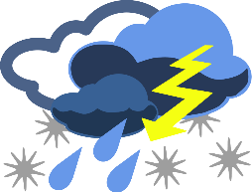
Energy Impacts - Methodology
Analysis Groups
552 of 942 participants with electric accounts included in the analysis (59%)
472 of 818 participants with gas accounts included in the analysis (58%)
Primary attrition reasons
No usage data (13-17%)
Not enough usage data (20%)
No Comparison Group available
Weather Normalization
Two weather normalization procedures used
Degree-day normalization process and PRISM analysis
Notes:
59 percent of electric accounts and 58 percent of gas accounts were included in the usage impact analysis. Accounts were most likely to be excluded because there was no usage data or not enough pre or post-treatment usage data. There was no comparison group available for use. We present weather normalized savings results.

Slide 47
Energy Impacts – Potential Factors
Building Type
Year Built
HVAC Type
Resident Type
Thermostat Installed
Connectivity
Common Entrance Low-Rise
Common Entrance Mid-Rise
Garden Style
Town/Row Homes
1971-2017
Conventional Furnace/ Condenser
2-Stage Conventional Furnace/ Condenser
Electric Resistance, Split System A/C
Hydronic Forced Air, Split System A/C
Families
Mixed
Senior
Nest
Ecobee
HW-T6
STRATIS
Individual Wi-Fi
None
Notes:
There are many potential factors that could impact energy savings. These include the building type, the year built, the HVAC type, the resident type, the type of thermostat, and the connectivity solution. Given the diversity and the potential interaction of these factors and the sample size, it is not possible to determine which are causal factors for higher or lower energy savings.

Slide 48
Total Electric Savings
Notes:
Weather-normalized electric savings averaged 196 kWh and 3.2 percent of total pre-treatment usage. Pre-treatment usage for these customers was relative low, averging only 6,053 kWh.

Slide 49
Electric Savings – Heating & Cooling Period
Notes:
Participants saved 9.7 percent of heating usage and 8.8 percent of cooling usage.

Slide 50
Total Gas Savings
Notes:
Gas savings were 5 therms or 1.6 percent of pre-treatment usage.

Slide 51
Final Thoughts… Resident Behavior
Devices
People
SMART
Notes:
Bringing it back together, our first conclusion is that smart thermostats are still not so smart that we can ignore the people and how they interact with them – the magic happens when we are smart about how we engage with both.

Slide 52
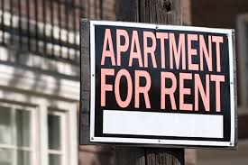
Final Thoughts… Property Participation
Could connectivity help address the split incentive problem?

Slide 53
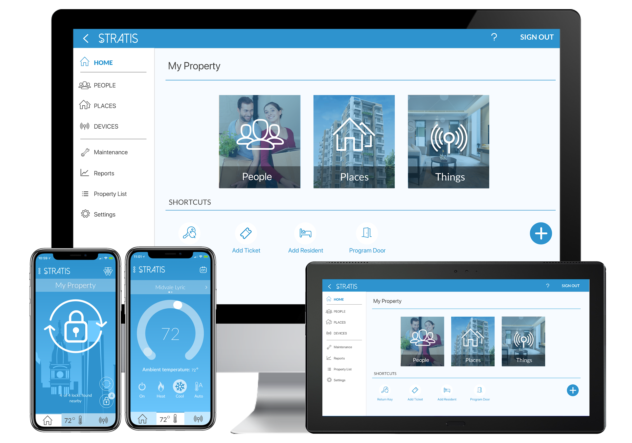
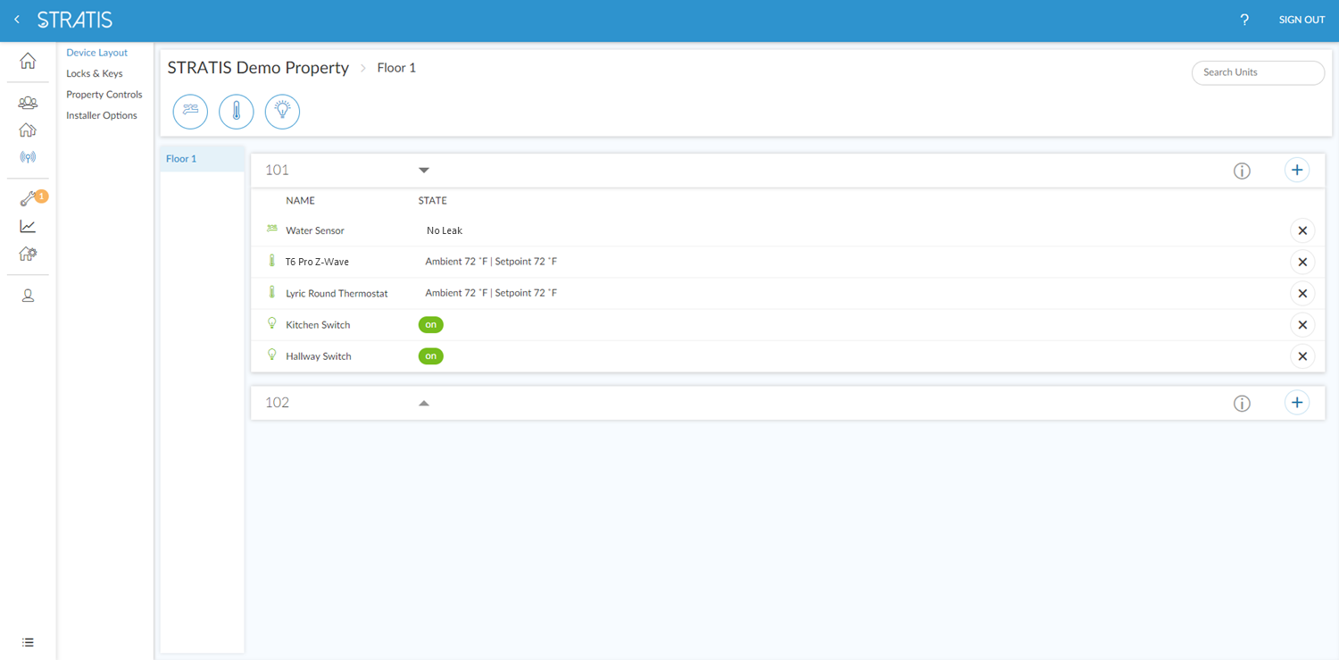
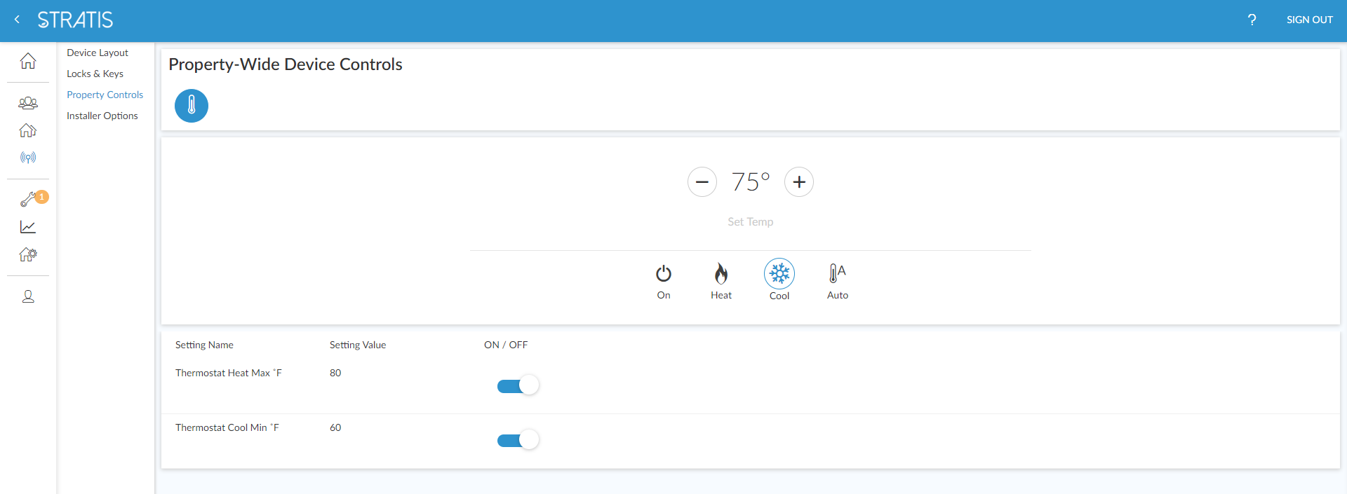
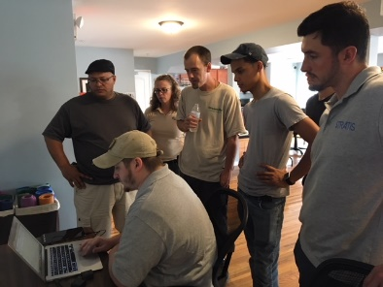
Where Are We Now?
Notes:
And it turns out the answer may be yes – if it provides value to the property owner. For example, when property wide connectivity comes with a platform that:
Provides insight into unit statuses
Allows property wide limits
Gives vacant unit control
Keeps account ownership with the property
Enables easy, remote on/off-boarding
Helps maintenance staff with resident messaging
This in turn may increase program participation – and provide addition Demand Response opportunities for the utility as well.
Participation
Not dependent on resident’s own connectivity
Building level DR deployment
Security & cost effectiveness
Lower cost compared to “Hub per unit” deployments
Firewalled network infrastructure
Property benefits may help address the Split Incentive
Enables dashboard level monitoring & settings
Facilitates vacant unit, common area and tenant turnover control
Can support other device and resident internet access

Slide 54
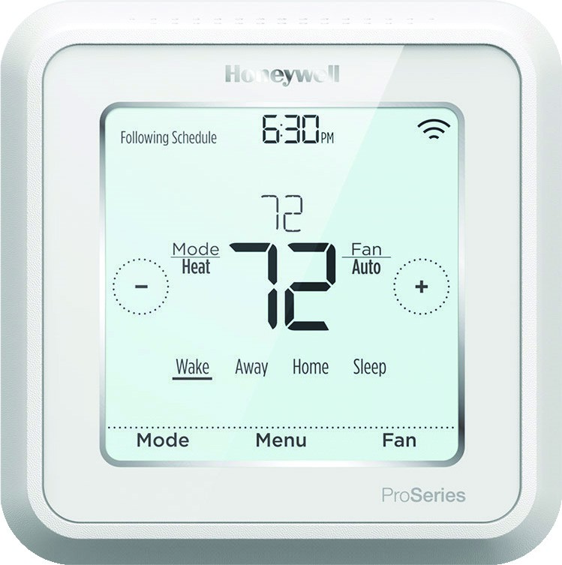
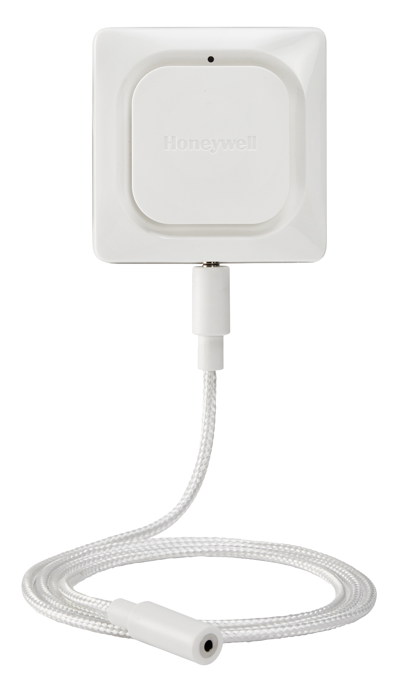
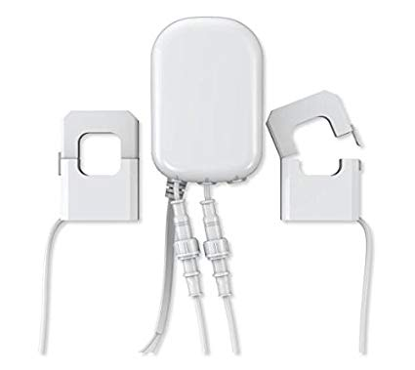
Where Are We Going?
Smart Systems
Building Diagnostics…
Temperature
Humidity
HVAC Data
Temperature
Humidity
Energy Consumption
Operating Condition
Routine & urgent alerts
Notes:
And that network can also help provide insight into how the building and systems are performing – and not just energy – the money saved from early detection of catastrophic water leaks can easily pay for the entire system with one avoided event!

Slide 55
Where Are We Going?
Make Actionable Analytics Possible
Common areas
Resident units
Interstitial space
Environmental
Dew point detection
High/low set points
Out of range temp & humidity
Cycle times & run times
Ambient & outdoor temp & humidity
Temp differentials (esp. multi-story)
Alerts on critical issues e.g. Bulk condensation
Identify systemic issues e.g. HVAC performance
Early warning on maintenance & durability issues
e.g. Imminent comfort & energy impacts
Notes:
Which ultimately leads to analytics to drive better building performance, for a more comfortable, more durable and healthier indoor environment that benefits the property owner far in excess of resident energy savings alone.
If this potential has value for the building owner, it seems reasonable to expect that they will be more likely to engage in a program where the energy saving benefit accrues primarily to the residents.

Slide 56
Ben Adams
VP Program & Strategic Development
benadams@magrann.com
(609) 760-1184
Jackie Berger
President
Jackie-berger@appriseinc.org
(609) 252-8009

