Slide 1
Analysis and Assessment of Non-Energy Impact Calculations September 1, 2020
Jackie Berger
APPRISE

Slide 2
Overview
What are Non-Energy Impacts (NEIs)?
Why are NEI’s Important to Study?
Challenges in the NEI Literature
Assessing NEI Calculations
Recommendations for NEI Research

Slide 3
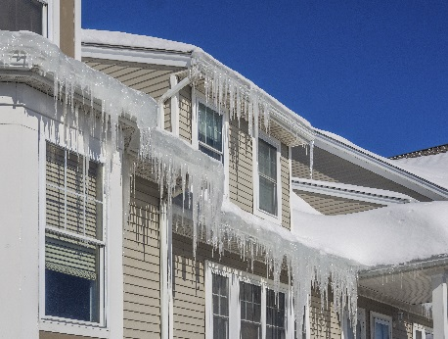
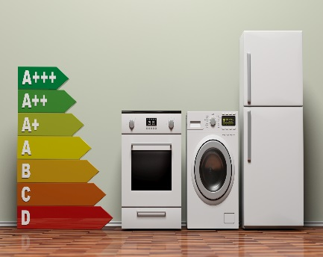
What are Non-Energy Impacts?
Energy Efficiency Evaluation Typical Assessments
Annual Energy Savings (kWh, ccf)
Demand Reduction (kW)
Measure-Level Savings
Cost-Effectiveness
Additional Impacts
Environmental Impacts
Economic Impacts
Comfort Impacts
…and many more!!

Slide 4
What are Non-Energy Impacts?
Benefit Level | Societal | Household
Benefits To | General Population | Ratepayer | Participant
Economic | ✓
Environmental | ✓
Health & Safety | ✓ |  | ✓
Affordability |  | ✓ | ✓
Collection Costs |  | ✓
System Reliability |  | ✓
Indoor Air Quality |  |  | ✓
Noise |  |  | ✓
Water Usage |  |  | ✓
Maintenance |  |  | ✓

Slide 5
What are Non-Energy Impacts?
Ratepayer Benefit Examples
Air sealing increases comfort
Reduced usage improves affordability and may reduce collections costs
Societal Benefit Examples
Reduced emissions positively impact the environment
Household Benefit Examples

Slide 6
What are Non-Energy Impacts?
Household level benefits may result in benefits to society
Program participant affordability improvements
Household level benefits may result in benefits to ratepayers
Program participant health improvements
May lead to reductions in Medicaid or Medicare costs
Benefits accrue to taxpayers
May lead to reductions in the cost of bill payment subsidy
Benefits accrue to ratepayers

Slide 7
Why Study Non-Energy Impacts?
Various Motivations for EE Participation
Monetary
Program Marketing
Comfort
Health & Safety
Environmental
Non-Energy Benefits Increase SIR
Greater Investment in Measures
Cost-Effectiveness Testing
Increased Energy Savings

Slide 8
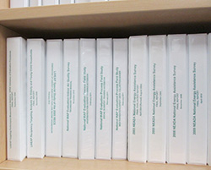
Challenges in the NEI Literature
Review Past Studies
Select Particular Benefits for Inclusion
Take Average of Past Study Impacts
Common Approach to NEI Estimation

Slide 9
Challenges in the NEI Literature
Utilizes Past Estimates
Lack of Documentation
Research Quality Not Assessed
Methodology
Assumptions
Robustness of Approach
Sample Size
Statistical Significance
Not Applicable to Current Study
Limitations
Out of Date

Slide 10
Challenges in the NEI Literature
Important Questions
Methodology
Robustness
Factors
Design
Sample Size
Statistical Significance
Calculations Performed
Causality
Response Rate
Impact of Attrition
Comparison Group Quality
Population Served
Program Design
Program Delivery
Weather
Fuels
Baseline
Other Services Available

Slide 11
Challenges in the NEI Literature
Important Questions
Economic Benefits
Net Benefit
What would the funds be used for in the absence of the program?
Other Influencing Factors
Energy Assistance
When households sign up for WAP, are they enrolled in LIHEAP?
Double
Counting
Health Impacts
Is the same benefit counted more than once when valuing the impact of increased prescription adherence, health status, colds, allergies, etc.?

Slide 12
Designing NEI Study Example
WAP Non-Energy Impact Measurement Framework
Treatment Group
Comparison Group
Baseline Survey
Households scheduled for a WAP audit.
Treated by WAP one year prior to survey.
In summer 2011 collected client self-reports of housing unit conditions and health status.
Follow-Up Survey
In summer 2013 asked the same survey questions on housing unit conditions and health status.
Analysis
Restricted to homes that were weatherized and still occupying weatherized home in 2013.
Compared changes for Treatment Group to changes for Comparison Group.

Slide 13
Assessing NEI Calculations Example
Two Non-Energy Impact Estimates from the Same Survey
Benefit | Reduction Estimate |  | Per Job Monetization First Year Benefit
 | Estimate 1 | Estimate 2 | Estimate 1 | Estimate 2
CO Poisoning | 0% | No Report | $0 | $31.43
Home Fires | 0% | 0% | $0 | $84
Cold-Related Illness/Death | 1% | 1% | $0 | $393.26
Heat-Related Illness/Death | 0% | 1% | $0 | $87.45
Asthma Emergency Dept. Visits | 1% | 12% | $0 | $202.00
Sleep Problems/Work Productivity | 1% | 21% | $0 | $182.33
Sleep Problems/Housework Productivity | 1% | 21% | $0 | $133.67
Missed Days of Work | .49 | .52 | $0 | $20.25
Short-Term Loans | 2% | 9% | $0 | $7.12
Prescriptions Affordability | 10%*** | 10% | $43 | $193.98
Food Affordability | 4% | 16% | $0 | $19.92
Food Assistance | 3% | 6% | $0 | $84
Total Benefit |  |  | $43 | $1,439

Slide 14
Assessing NEI Calculations Example
Why Did the Results Differ?
Estimate 1
Estimate 2
Longitudinal Framework
Same Participants in Pre and Post Periods
Unmatched Samples
Comparison
Net Change = (Pre-Treatment–Post-Treatment) –
(Pre-Comparison–Post-Comparison)
Gross Change = Pre-Treatment – Post-Treatment
Additional Measure = Pre-Treatment – Pre-Comparison
Statistical Significance
At Least 90 Percent Confidence Level
No Requirement
External Data
Only Data from Referenced Survey
External Data Used when Survey Found Small NEI

Slide 15
Assessing NEI Calculations Example
Average Low-Income Arrearage
Impact of Energy Efficiency Program on Arrearages
Interest Rate
Reduction in Arrearage Carrying Costs
*
*
$5.58
$218
32%
8%
Assessment
The referenced energy efficiency program reduced arrearages by 32%.
How much energy did that referenced program save?
What bill reduction did that translate into?
What $ amount of arrearage reduction did that translate into?
Should arrearage reduction be a % of average arrearages or a % of bill reduction?

Slide 16
Assessing NEI Calculations Example
Referenced Program
Program Studied
Referenced Program
Program Studied
Arrearage Reduction
32%
32%
Starting Arrearages
?
$218
Arrearage Reduction
?
$70
Bill Reduction
$200
$40
Arrearage Reduction
40% of bill reduction
40% of bill reduction
$ in Reduced Arrearages
$80
$16

Slide 17
Recommendations for NEI Research
Review Referenced Studies
Understand Methodologies and Limitations
Assess Applicability to Evaluated Program

Slide 18
Summary
Current literature on NEIs has many challenges
Additional research is needed
Difficult to apply findings from previous studies
Factors specific to programs, jurisdictions, participants, and implementation can impact the NEIs
Methodologies have been developed to measure NEIs
Additional challenges relate to valuing benefits relating to health, comfort, and safety

Slide 19
Contact
Jackie Berger
APPRISE
32 Nassau Street, Suite 200
Princeton, NJ 08540
609-252-8009
jackie-berger@appriseinc.org
www.appriseinc.org

