Slide 1
Program Impacts: How to Measure Program Success – Energy Assistance & Energy Efficiency Outcomes
Jackie Berger, APPRISE
Mykinna Howard, Ameren Missouri
Steven Jerue, Philadelphia Gas Works
Connie Taylor, Ameren Missouri

Slide 2
Agenda
Introduction
Ameren Keeping Current
PGW LIURP
Need for Evaluation
Evaluation Requirements
Program Design
Evaluation Examples
Summary
Program Design
Evaluation Examples
2

Slide 3
Why Evaluate?
“Measurement is the first step that leads to control and eventually to improvement. If you can’t measure something, you can’t understand it. If you can’t understand it, you can’t control it. If you can’t control it, you can’t improve it.”
― H. James Harrington
3

Slide 4
Why Evaluate?
Measure Program Impacts
Energy bill affordability
Economic impacts
Environmental impacts
Health, safety, and comfort
Cost benefit analysis
Energy usage
Assess Potential Improvements
Goals
Efficiency
Effectiveness
Equity
Targeting
Client Satisfaction
Meet Regulatory Requirements
State
PUC
Other
4

Slide 5
Ameren Keeping Current Evaluation Requirements
Keeping Current Objectives
Included assessment of
Consistent and timely payment patterns
Arrearage reduction and elimination
Uncollectible and collections cost impact
Cooling credit impact on hot weather safety
Keeping Current Tariff
Explicitly stated evaluation requirement
5

Slide 6
Pennsylvania Evaluation Requirements
Low-Income Usage Reduction Program Evaluation
Required Annually by Pennsylvania Public Utility Commission
Weather-Normalized Usage Impact Analysis
Payment Impact Analysis
Data Submitted to Penn State
Universal Service Program Evaluation
Required Every 6 Years by Pennsylvania Public Utility Commission
Evaluation of All Low-Income Programs
Focus on Bill Payment Assistance Program
6

Slide 7
Ameren keeping current
7

Slide 8
Ameren Missouri
Program Impacts: How to Measure Program Success: Energy Assistance and Energy Efficiency Outcomes
Connie Taylor, Manager Customer Advocacy and Energy Assistance
Mykinna Howard, Supervisor, Energy Assistance
August 5, 2020

Slide 9
Keeping Current
Past due forgiveness over 12 months and monthly bill credits of $35 – $90 with on-time payments
for 24 months
2 year enrollment period
Benefits:​
​
Increases affordability​
Supports habit of
on-time bill payments
Income Eligibility:
150% of FPL
Notes:
Micro

Slide 10
About Keeping Current
Funded 50% Shareholders, 50% customers (in rates)
Oversight provided by the Keeping Current Collaborative
Ameren Missouri
Missouri Public Service Commission
Consumer’s Council
Office of Public Council
AARP
Evaluations:
2013, 2015, 2019
Reports are published on the APPRISE website (www.appriseinc.org)
Notes:
Surveyed Energy Assistance Agencies to get recommendations on how to use the funds
Expansion of Heat Up St Louis to Heat Up Missouri
Weatherization and why it’ important

Slide 11
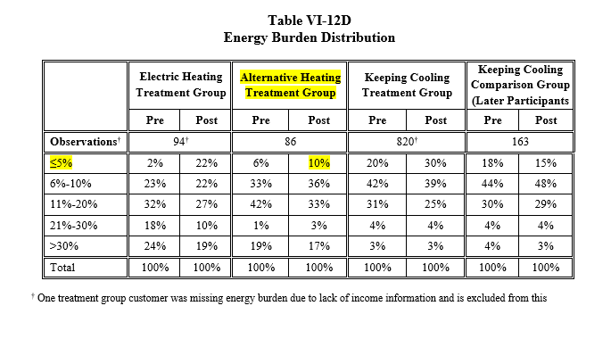
Keeping Current Evaluations
In 2016, 10% had an energy burden less than 5%
Notes:
Surveyed Energy Assistance Agencies to get recommendations on how to use the funds
Expansion of Heat Up St Louis to Heat Up Missouri
Weatherization and why it’ important

Slide 12
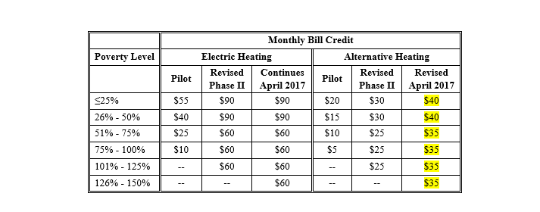
Keeping Current Evaluations
Action Taken – Ameren Missouri increased the income threshold from 125% to 150% FPL and increased the monthly bill credit from a range of $25 - $30 to a range of $35 to $40
Notes:
Surveyed Energy Assistance Agencies to get recommendations on how to use the funds
Expansion of Heat Up St Louis to Heat Up Missouri
Weatherization and why it’ important

Slide 13
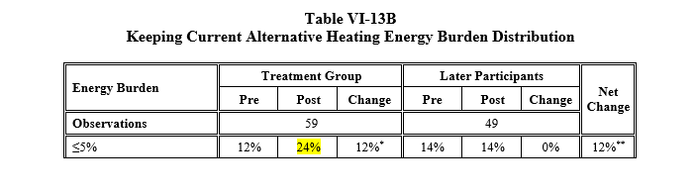
Keeping Current Evaluations
In 2019, the percent with low energy burden of 5% or less increased to 24%
Notes:
Surveyed Energy Assistance Agencies to get recommendations on how to use the funds
Expansion of Heat Up St Louis to Heat Up Missouri
Weatherization and why it’ important

Slide 14
Data Driven Changes and Improvements
Eligibility
Previous
Heating – 125% FPL
Cooling – 135% FPL
2017- Present
Heating –150% FPL
Cooling – 150% FPL
Flexibility
Previous
No flexibility
2017- Present
Participants may miss one payment, receive credit, still current
Payment Due Date
Previous
Date assigned by Ameren
2017- Present
Participants may choose date

Slide 15
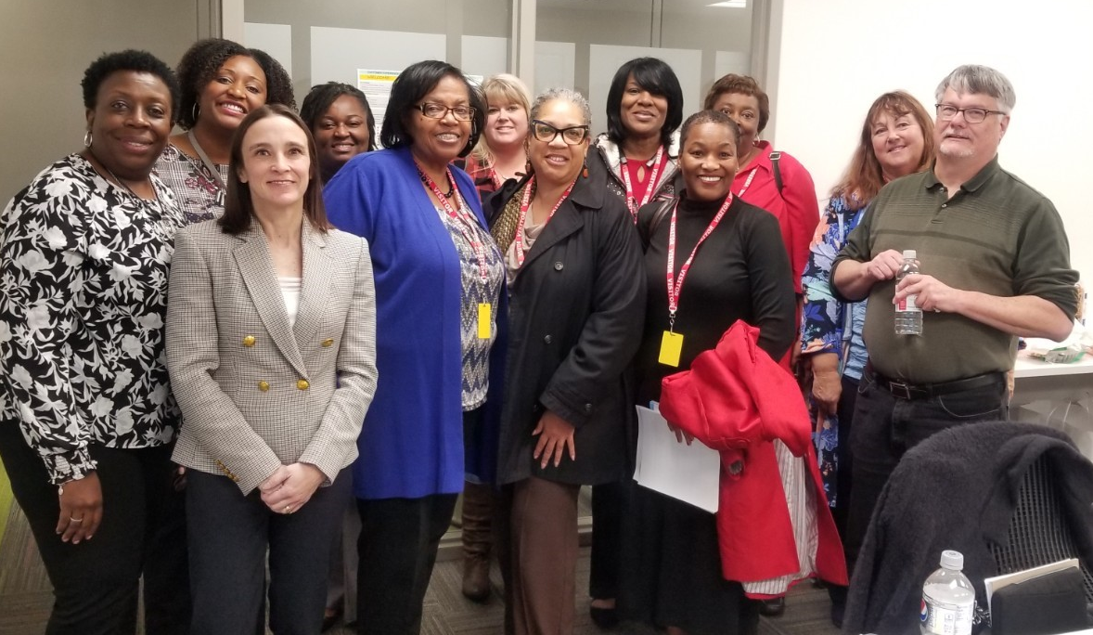
Evaluation and Collaboration: Review Meeting with Keeping Current Agencies
Representatives from 7 agencies attended
APPRISE presented evaluation findings and recommendations
Agencies provided recommendations, shared best practices and asked questions

Slide 16
Keeping Current/Keeping Cool Success
Bill Payment Improved after KC Enrollment
The percentage of Electric Heat participants who paid at least 90 percent of their full bill increased from 56 percent in the year prior to program enrollment to 68 percent in the year following enrollment, an increase of 12 percentage points.
Alternative Heat participants also had a large improvement in their coverage rates. While 43 percent paid the full bill in the year prior to enrollment, 70 percent paid the full bill in the year following enrollment.
Missed Payments
While 46 percent of Electric Heat participants had no missed payments in the year prior to enrollment, 58 percent had no missed payments in the year following enrollment.
The percentage of Alternative Heating participants with no missed payments increased from 57 to 74 percent
Balances
Electric Heat participants reduced their balances by an average of $213.
Alternative Heat participants reduced their balances by an average of $182.
Collections Actions
Electric Heat participants reduced notices, payment arrangements, and service disconnections. Disconnections declined from 30% to 16%.
Alternative Heat participants reduced notices and payment arrangements.

Slide 17
Customer Quotes – Reasons for Success
“When they are paying part of my electric bill for me, and making it cheaper, that is really all I need. As long as I can afford that bill and my other necessities, I am going to pay it in full every month.”
“Ameren sent us email reminders before the bill was due, which helped me make sure I never missed a payment. Mostly though, the program lowered the bill enough that I could manage it on my fixed income without other help.”
“I am on automatic bill pay so that I am able to make sure it gets paid. I would rather have an overdraft fee than lose Keeping Current. I try not to use too much electricity and stuff, but I am on oxygen. I try to keep the temperature reasonable. I try to be as energy efficient as possible.”
“I was successful because the program really helped me out with my overdue balance and made it so that my monthly amounts were manageable. The most important thing was knowing exactly how much I was going to have to pay every month.”

Slide 18
PGW Home Comfort Program

Slide 19
PGW Home Comfort
Program goals and workflow:
3 Contractors schedule audits, develop work scopes, and return to perform efficiency measures
Achieve deep cost-effective savings, based on TRC
$7.9 million annual budget
Over 24,000 homes treated since 2011
Prioritized based on highest usage

Slide 20
Energy Savings by Contractor

Slide 21
Realization Rates by Contractor

Slide 22
2016 Measure level savings
Measure | Obs. | Savings (ccf/yr) | Projected Savings (ccf/yr) | Realization Rate
Roof Insulation | 364 | 87±33*** | 133 | 65%
Heating System Replacement | 523 | 284±25*** | 409 | 69%
Air Sealing w/ Blower Door | 718 | 40±24*** | 112 | 36%
Air Sealing w/o Blower Door | 482 | 24±26* | 76 | 32%
Programmable Thermostat | 1,391 | 37±18*** | 64 | 57%
Water Heater Replacement | 60 | 71±66* | 38 | 184%
***Statistically significant at the 99 percent level; **95% level. *90% level.

Slide 23
Measure Savings by Contractor
 | Contractor A |  | Contractor B |  | Contractor C
# of Jobs | 1,928 |  | 320 |  | 1,050
Measure | Obs | Savings (ccf/yr) | Obs | Savings (ccf/yr) | Obs | Savings (ccf/yr)
Roof Insulation | 183 | 76±53*** | 75 | 77±137 | 106 | 56±48**
Heating System | 305 | 282±32*** | 165 | 257±69*** | 53 | 231±65***
Air Sealing w/ BD | 312 | 74±39*** | 63 | 59±133 | 343 | 14±36
Air Sealing w/o BD | 94 | 59±60* | 38 | 12±147 | 350 | 11±34
Programmable Therm | 811 | 29±24** | 255 | -5±84 | 325 | 31±30**
Water Heater | 19 | 3±118 | 22 | 185±136*** | 19 | 25±106
***Statistically significant at the 99 percent level; **95% level. *90% level.

Slide 24
Hypothesis
Not defining thermal envelope or using blower door properly
Unclear expectations and communication
Crews not encouraged to seek deep savings
“Quality” not defined
Fitting within limitations

Slide 25
Investigation
Evaluations and reports
Inspection reports
Measure and case data
Customer complaints
Contractor field visits

Slide 26
Contractor-Centric Training & Mentoring
On-site shadowing for all auditors and crews
Classroom trainings for all program staff
Web conferences & meetings at contractor offices
Availability for technical questions & QA report review

Slide 27
Program Manual
Define quality
Reduce communication issues
Provide inspector tool
Set clear expectations
Provide to field staff, management and administrators

Slide 28
Contractor Scorecard Updates
Projected savings & recent activity
BCR
% Savings
QA Scores
Post-usage realized savings
BCR
% Savings
Realization Rate

Slide 29
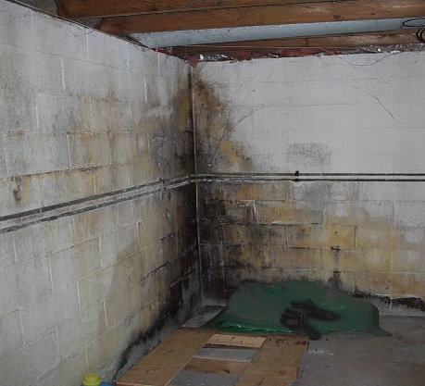
Health & Safety Pilot
Up to $2,000 can be spent on health and safety upgrades that will allow weatherization
Every dollar spent on health and safety has leveraged $3.41 in weatherization measures
Chimney liner, heater safety issues, attic rewire, bugs and pests, roof repair

Slide 30
SUMMARY
30

Slide 31
Measuring Program Impacts
Evaluation requirements needed for consistent evaluation.
Informs program managers of programs successes and areas for improvement.
Understand how to refine program.
31

Slide 32
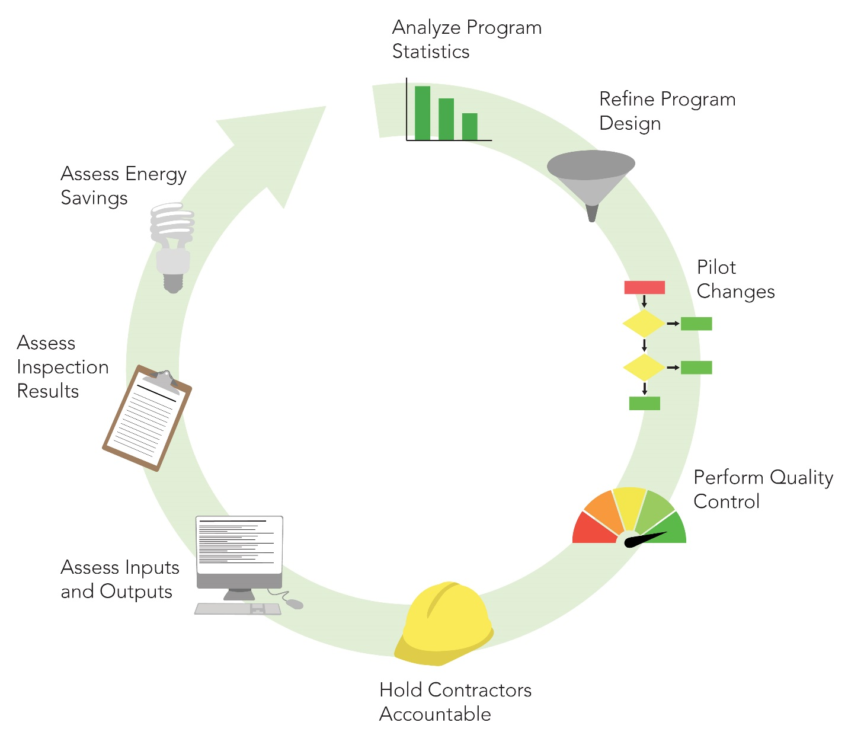
Performance Measurement
Notes:
Since APPRISE reviews our data for annual PUC reporting, we can review without requiring a full evaluation

Slide 33
Continuing the Learning
Jackie Berger
Jackie-berger@appriseinc.org
Mykinna Howard
Mhoward@Ameren.com
Steven Jerue
Steven.Jerue@pgworks.com
Connie Taylor
CTaylor4@Ameren.com

