Slide 1
Working Together for Low-Income Households
Jackie Berger
NEUAC Conference
June 3, 2019

Slide 2
Overview
Energy Burden
Affordability Challenges & Solutions
Bill Payment Assistance Programs
Low-Income Energy Efficiency
Performance Measurement
2

Slide 3
Energy Affordability Determinants
Income | Energy Costs | Other Expenses
Unemployment | Energy Efficiency | Housing Costs
Health/Disability | Shell | Medical Costs
Transportation | Heating System | Childcare
Family Care | Defacto Heating | Elder Care
Elderly Fixed Income | Appliances | Transportation to Work
 | Behavior
 | Vulnerable Individuals
 | Medical Equipment
3

Slide 4
Energy Burden
Energy Burden: Measure of energy affordability
Does not factor in variability of other expenses
Individual Energy Burden Average ($\frac{Energy Costs}{Income}$) | Group Energy Burden ($\frac{Average Energy Costs}{Average Income}$)
4

Slide 5
Energy Burden
2014 Residential Energy Burden
Main Heat Fuel | All Households |  | Non-Low-Income |  | Low-Income |  | LIHEAP-Recipient
 | Individual | Group | Individual | Group | Individual | Group | Individual | Group
Electric | 9.0% | 2.6% | 3.2% | 2.2% | 18.4% | 8.6% | 17.5% | 10.2%
Gas | 7.5% | 2.9% | 2.9% | 2.3% | 17.3% | 9.8% | 17.7% | 12.1%
All Fuels | 8.6% | 3.0% | 3.3% | 2.4% | 18.4% | 10.0% | 18.8% | 13.1%
Source: LIHEAP Home Energy Notebook, FY 2014.
5

Slide 6
Affordable Energy Burden
Moderate Shelter Burden
Median Low-Income Energy Costs
Affordable Residential Energy Burden
30% of Income
20% of Shelter Costs
30%*20%=6% of Income
6

Slide 7
Severe Energy Burden
Severe Shelter Burden
Median Low-Income Energy Costs
Severe Residential Energy Burden
50% of Income
20% of Shelter Costs
50%*20%=10% of Income
7

Slide 8
Solutions to Energy Affordability Challenges
High Energy Usage
Low Income
Other Challenges
Energy Efficiency
Bill Payment Assistance
Referrals
Housing, medical, etc.
8

Slide 9
Affordability Program Types
Gross Bill | PIPP |  | Fixed Credit |  | Discount
 | $10,000 income 9% = $900/12=$75 |  | $10,000 income 9%=$900 $1400 estimated bill $1400-$900=$500 $500/12=$42 |  | 60% discount
 | Bill | Subsidy | Bill | Subsidy | Bill | Subsidy
$300 | $75 | $225 | $258 | $42 | $120 | $180

Slide 10
Affordability Program Types
 | Gross Bill | PIPP |  | Fixed Credit |  | Discount
 |  | $10,000 income 9% = $900/12=$75 |  | $10,000 income 9%=$900 $1400 estimated bill $1400-$900=$500 $500/12=$42 |  | 60% discount
 |  | Bill | Subsidy | Bill | Subsidy | Bill | Subsidy
Initial | $300 | $75 | $225 | $258 | $42 | $120 | $180
Rate Increase | $360 | $75 | $285 | $318 | $42 | $144 | $216
Usage Reduction | $240 | $75 | $165 | $198 | $42 | $96 | $144

Slide 11
Affordability Programs Comparison
Discount
PIPP
Fixed Credit
Targets benefits to level of need
Implementation challenges
Percentage of Income Program
Administrative simplicity
Higher benefits may go to higher income households
Burden shared between customer and ratepayer
Targets benefit to level of need
Does not achieve exact burden target
Implementation challenges
Fixed monthly bill
Cannot target final energy burden
11

Slide 12
LIHEAP Impact
 |  | Annual Household Income |  | 6% Energy Costs |  | LIHEAP Heating Grant |  | Net Energy Cost |  | Net Energy Burden
Pov. Level | HH Size | Min | Max | Min | Max | Min Income | Max Income | Min | Max | Min | Max
<50% | 1 | $0 | $6,030 | $0 | $362 | $907 | $377 | ($907) | ($15) | 0% | 0%
 | 2 | $0 | $8,120 | $0 | $487 | $918 | $290 | ($918) | $197 | 0% | 2%
 | 3 | $0 | $10,210 | $0 | $613 | $928 | $224 | ($928) | $389 | 0% | 4%
 | 4 | $0 | $12,300 | $0 | $738 | $939 | $200 | ($939) | $538 | 0% | 4%
 | 5 | $0 | $14,390 | $0 | $863 | $949 | $200 | ($949) | $663 | 0% | 5%
51%-100% | 1 | $6,031 | $12,060 | $362 | $724 | $377 | $200 | ($15) | $524 | 0% | 4%
 | 2 | $8,121 | $16,240 | $487 | $974 | $290 | $200 | $197 | $774 | 2% | 5%
 | 3 | $10,211 | $20,420 | $613 | $1,225 | $224 | $200 | $389 | $1,025 | 4% | 5%
 | 4 | $12,301 | $24,600 | $738 | $1,476 | $200 | $200 | $538 | $1,276 | 4% | 5%
 | 5 | $14,391 | $28,780 | $863 | $1,727 | $200 | $200 | $663 | $1,527 | 5% | 5%
101%-150% | 1 | $12,061 | $18,090 | $724 | $1,085 | $200 | $200 | $524 | $885 | 4% | 5%
 | 2 | $16,241 | $24,360 | $974 | $1,462 | $200 | $200 | $774 | $1,262 | 5% | 5%
 | 3 | $20,421 | $30,630 | $1,225 | $1,838 | $200 | $200 | $1,025 | $1,638 | 5% | 5%
 | 4 | $24,601 | $36,900 | $1,476 | $2,214 | $200 | $200 | $1,276 | $2,014 | 5% | 5%
 | 5 | $28,781 | $43,170 | $1,727 | $2,590 | $200 | $200 | $1,527 | $2,390 | 5% | 6%
12

Slide 13
Arrearage Forgiveness
Reduction of past due arrearages over time
Often full, on-time payments are required
May promote bill payment
Customer understanding?
13

Slide 14
Low-Income Energy Efficiency Increase Savings by …
Target high usage homes that need major measures
Identify, prioritize, and install appropriate measures
Ensure that weatherization staff do high quality work
14

Slide 15
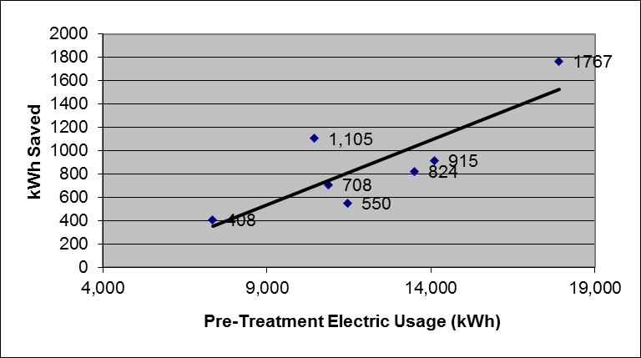
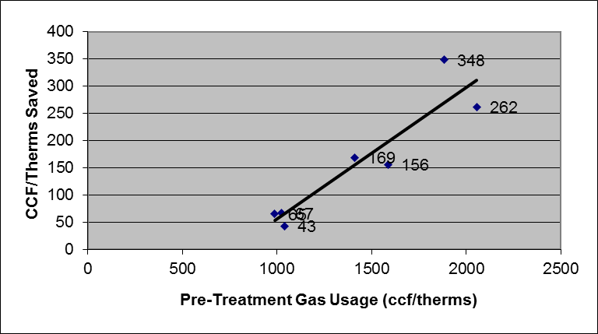
Treating High Usage Across Program Analysis
Seven low-income electric efficiency program evaluations over past eight years.
Seven low-income gas efficiency program evaluations over past four years.
15

Slide 16
Savings by Pre-Treatment Usage
16

Slide 17
Install Major Measures
17

Slide 18
Installation Quality
18

Slide 19
Performance Measurement Steps
How do you write a policy that:
Targets households with high energy usage,
Ensures that the program installs major measures,
AND puts a high premium on installation quality?
How do you write a policy that:
Targets the most affordable energy burden with available funding,
Takes account of the LIHEAP interaction,
AND incentivizes customers to pay remaining bill?
The answer is …
19

Slide 20
Performance Measurement Steps
Program Statistics
Refine
Pilot Changes
Quality Control
Hold Contractors Accountable
Assess Inputs and Outputs
Assess Inspection Results
Assess Energy Savings
20

Slide 21
Types of Measures
More difficult to obtain data
Inputs
Outputs
Outcomes
Impacts
Staff Hours
Equipment
Supplies
# Applied
# Enrolled
% Vulnerable
$ in Benefits
# Referred
Bill Reduction
Burden Reduction
Technical Reference Manual Savings Estimate
% Paid Bill
% Terminated
% Energy Saved
More powerful information
21

Slide 22
Performance Measurement Repeat
Compare Results Over Time
Assess What is Working
Refine Program
22

Slide 23
Recommendations
Energy Burden
Target Solutions to Specific Problems
Consider LIHEAP Impact
Low-Income Energy Efficiency
Performance Measurement
Measure of Affordability
Income
Energy Usage
Other
May Skew Targeted Outcomes
Target High Users
Install Major Measures
Assess Installation Quality
Assess Inputs and Outputs
Refine Programs
Repeat Over Time
Other Factors to Consider
Need to Consider LIHEAP for Equitable Outcomes
23

Slide 24
Contact
Jackie Berger
APPRISE
32 Nassau Street, Suite 200
Princeton, NJ 08540
609-252-8009
jackie-berger@appriseinc.org
www.appriseinc.org
24

