Slide 1
Understanding the Low-Income Market to Improve Energy Programs
Paula Carmody, MD Office of People’s Counsel
Matthew Lyons, APPRISE

Slide 2
Presentation Overview
Office of People’s Counsel Background
Market Characterization Results
Findings and Recommendations
Using Data for Program Improvement
Market Characterization Research Plan
Questions and Answers
2

Slide 3
Office of People’s Counsel Background
3

Slide 4
Agency Mission
Represent interests of all State residential utility customers
Electric, Gas, Private Water, Telecom Services
Special focus on low-income and vulnerable customers
Energy affordability and energy efficiency
4

Slide 5
Where We Act
Public Service Commission (PSC)
Federal Agencies and PJM
State Legislature
Advisory Boards, Government, and Non-Profit Collaborations
NASUCA
5

Slide 6
Policy Areas – Energy Affordability
1999 Retail Competition Law
Electric deregulation and Electric Universal Service Program
Termination and arrearage investigations
Consumer protections and PSC regulations
Assessment of energy assistance programs
Office of Home Energy Programs (OHEP)
PSC energy affordability docket (PC27)
Retail suppliers
Founder of Critical Medical Needs program
Training and information for agency network
Energy affordability targets for low-income households
Impact of high prices on low-income households
Protecting medically vulnerable households from loss of energy service
Energy assistance, energy efficiency, and community service providers
6

Slide 7
Policy Areas – Energy Efficiency
EmPower Maryland
Portfolio of ratepayer-funded programs intended to reduce electricity usage
Low-Income Energy Efficiency
State Department of Housing & Community Development (DHCD) administers DOE Weatherization and low-income EmPower programs for single family and multifamily buildings
7

Slide 8
Low-Income Energy Issues
Energy affordability
Utility bill assistance
Arrearage forgiveness
Single family energy efficiency
Service terminations
Critical medical needs
Alternative energy suppliers
Community solar
Data-Driven Advocacy
Multifamily energy efficiency
8

Slide 9
Low-Income Energy Programs
Maryland Energy Assistance Program (MEAP)
Heating assistance benefits
Electric Universal Service Program (EUSP)
Electric benefits
Arrearage Retirement Assistance (ARA)
Forgiveness of past due electric and gas bills
Weatherization Assistance Program (WAP)
Federally-funded single family weatherization
EmPower Limited Income Energy Efficiency Program (EmPower)
Ratepayer-funded single family energy efficiency
Multifamily Energy Efficiency and Housing Affordability Program (MEEHA)
Ratepayer-funded multifamily energy efficiency
9

Slide 10
Interest in Market Research
County and regional differences in low-income population
Gaps in utilization of bill assistance and energy efficiency programs
Inform data-driven local outreach strategies
Identify targeting opportunities for partners to improve affordability and increase participation
10

Slide 11
Market Characterization Report
http://opc.maryland.gov/RegulatoryActivities/Publications.aspx
11

Slide 12
Market Characterization Research Plan
12

Slide 13
APPRISE
Nonprofit Research Institute
Mission
Research Areas
Clients
Federal Government (DOE, HHS)
State Governments
Utility Companies
Nonprofits
Energy Efficiency
Energy Affordability
Princeton, NJ
Established in 2002
Analyze data and information to assess and improve public programs
13

Slide 14
Research Objectives
Document the Low-Income Market
Size and diversity
Assess Energy Programs Serving Low-Income Market
Energy assistance programs (175% FPL)
Identify Key Findings and Recommendations
Gaps in services
Program utilization
Targeting opportunities
Energy needs of market
Trends by income-level and geography
Energy efficiency programs (200% FPL)
14

Slide 15
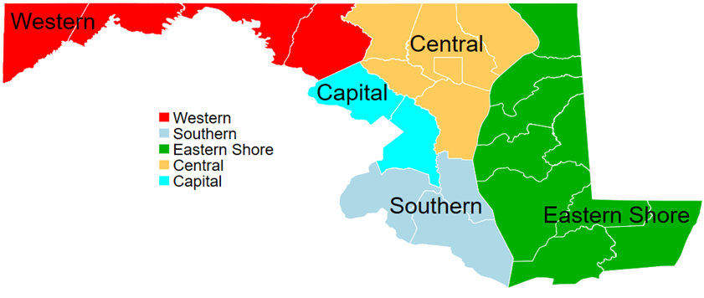
Utility Regions
15

Slide 16
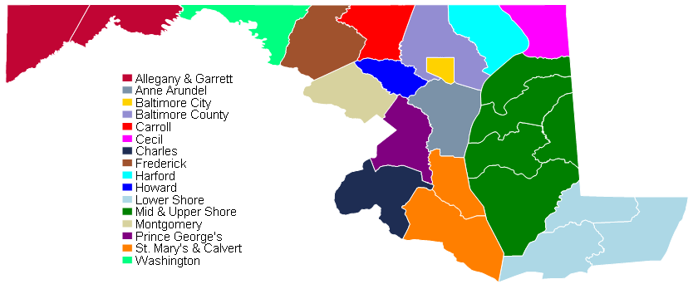
County Areas
16

Slide 17
Data Sources
Income-eligible population
2014 – 2016 American Community Survey (ACS)
2009 Residential Energy Consumption Survey (RECS)
Program recipient population
FY 2017 OHEP Data
FY 2010 – FY 2017 DHCD Data
17

Slide 18
Market Characterization Results
18

Slide 19
Income and Eligibility
How Can Market Analysis Inform Program Design
Population size
Market potential for program services
Households by income-level
Eligibility for low vs. moderate-income programs
Share of households in extreme poverty
Participation rates
Market saturation in local agency service areas
Differences in program utilization by income-level
Income Sources
Different intake and outreach strategies for working families and households with fixed income
19

Slide 20
Program Eligibility
Program Eligibility by State Region
State Region | Energy Efficiency (200% FPL) |  | Energy Assistance (175% FPL) |  | All Households
 | # | % | # | % | # | %
Capital | 113,699 | 17% | 96,274 | 14% | 676,345 | 100%
Central | 223,546 | 22% | 192,846 | 19% | 1,020,411 | 100%
Eastern Shore | 45,546 | 27% | 39,258 | 23% | 171,111 | 100%
Southern | 19,673 | 16% | 16,519 | 13% | 126,588 | 100%
Western | 45,400 | 25% | 38,096 | 21% | 184,889 | 100%
State Total | 447,863 | 21% | 382,993 | 18% | 2,179,344 | 100%
Source: ACS (2014 – 2016)
20

Slide 21
Federal Poverty Level
Source: ACS (2014 – 2016)
21

Slide 22
Sources of Income
Source: ACS (2014 – 2016)
22

Slide 23
Recertification Policy
In FY 2019, OHEP launched a streamlined recertification process for seniors and disabled households on fixed income
Source: ACS (2014 – 2016)
* Retirement benefits include social security income and retirement, survivor, and disability pensions
23

Slide 24
Heating Assistance
Source: ACS (2014 – 2016) / FY 2017 OHEP Data File
24

Slide 25
Heating Assistance
Source: ACS (2014 – 2016) / FY 2017 OHEP Data File
25

Slide 26
Weatherization Participation
Source: ACS (2014 – 2016) / FY 2010 - 2017 DHCD Data File
26

Slide 27
Demographics
How Can Market Analysis Inform Program Design
Household Composition
Tailoring application and outreach strategies to different household types
Vulnerable Households
Participation of households susceptible to temperature extremes
Race/Ethnicity and Language
Targeting opportunities in minority communities
Internet Access
Barriers to accessing online applications
Translation services to non-English speaking households
Local partnerships based on composition of vulnerable populations
Potential impact of internet-based outreach
27

Slide 28
Household Type
Head of Household Type | Number of Households | Percentage of Low-Income Households | Average Income
Elderly Individual | 109,911 | 25% | $12,828
Elderly Couple | 74,010 | 17% | $24,461
Older without Children (40-59) | 71,252 | 16% | $14,417
Older with Children (40-59) | 72,238 | 16% | $29,723
Younger without Children (<40) | 42,247 | 9% | $13,386
Younger with Children (<40) | 78,205 | 17% | $25,448
All Low-Income Households | 447,863 | 100% | $19,985
Source: ACS (2014 – 2016)
28

Slide 29
Vulnerable Households
Source: ACS (2014 – 2016)
29

Slide 30
Vulnerable Households
Source: ACS (2014 – 2016) / FY 2017 OHEP Data File / FY 2010 – FY 2017 DHCD Data File
30

Slide 31
Linguistic Isolation
Source: ACS (2014 – 2016)
31

Slide 32
Internet Access
Source: ACS (2014 – 2016)
32

Slide 33
Housing
How Can Market Analysis Inform Program Design
Owner/Renter
Landlord barriers to energy efficiency services
Housing Unit Type
Eligibility for single-family and multifamily energy efficiency services
Housing Age
Opportunity for energy efficiency savings
Mobility of low-income population
Differences in market potential by income-level and region
Likelihood of home repair, lead paint, and deferred maintenance issues
33

Slide 34
Home Ownership
Source: ACS (2014 – 2016)
34

Slide 35
Home Ownership
Source: ACS (2014 – 2016)
35

Slide 36
Home Ownership
Source: ACS (2014 – 2016) / FY 2017 OHEP Data File / FY 2010 – FY 2017 DHCD Data File
36

Slide 37
Housing Type
Source: ACS (2014 – 2016)
37

Slide 38
Housing Type and Ownership
Distribution of Low-Income Households
By Housing Unit Type and Ownership Status
Housing Unit Type | Own | Rent | All Households
Single Family Attached | 10% | 13% | 23%
Single Family Detached | 25% | 9% | 33%
Small Multifamily | 0% | 7% | 7%
Large Multifamily | 3% | 31% | 34%
Mobile Homes | 2% | 1% | 3%
All Housing Units | 40% | 60% | 100%
Source: ACS (2014 – 2016)
38

Slide 39
Housing Age
Source: ACS (2014 – 2016)
39

Slide 40
Energy and Utilities
How Can Market Analysis Inform Program Design
Heating and Cooling Sources
Customers impacted by winter utility service disconnection protections
Energy Usage
Targeting energy efficiency services to high usage households
Heat Included in Rent
Eligibility for bill assistance benefits
Market participation by fuel type
Opportunities for baseload electric reduction vs. whole house energy efficiency
Coordination with landlords for program enrollment
Water/Sewer
Impact of rising water bills on housing affordability
Coordination of water and energy assistance programs
40

Slide 41
Utility Heated Homes
Source: ACS (2014 – 2016)
41

Slide 42
Bulk Fuel Heated Homes
Source: ACS (2014 – 2016)
42

Slide 43
Main Heating Fuel
Source: ACS (2014 – 2016) / FY 2017 OHEP Data File
43

Slide 44
Electricity Usage
Source: RECS (2009)
Includes survey respondents from Maryland, Washington D.C., West Virginia, and Delaware
44

Slide 45
Heat Included in Rent
Source: ACS (2014 – 2016)
45

Slide 46
Water and Sewage Costs
Totals do not account for potential increase in costs in 2017 and 2018.
Source: ACS (2014 – 2016)
46

Slide 47
Energy and Shelter Burden
How Can Market Analysis Inform Program Design
Heating and Cooling Costs
Impact of heating vs electric costs on total energy bill
Energy Burden
Program impact on reaching energy affordability goals
Shelter Burden
Need for coordination of energy programs with housing affordability initiatives
Differences in energy costs by geography and fuel type
Targeting of benefits based on actual energy costs
Differences in gross and net energy burden among market segments
47

Slide 48
Energy Affordability
Energy Burden – percentage of income paid to energy bills
Gross: Prior to receipt of energy assistance
Annual Energy Bill / Annual Income
Net: After receipt of energy assistance
(Annual Energy Bill – Energy Assistance Benefit) / Annual Income
Average Energy Burden of Non-Low-Income Households: 2%
Office of People’s Counsel advocates for adoption of a 6% energy affordability target
48

Slide 49
Housing Affordability
Shelter Burden – percentage of income paid to housing costs
Owners: Mortgage, real estate taxes, insurance, utilities, fuels, mobile home costs, condo fees
Renters: rent, utilities, and fuels
The U.S. Department of Housing & Urban Development defines affordable housing costs as not exceeding 30% of income
49

Slide 50
Heating Expenditures
Source: ACS (2014 – 2016)
50

Slide 51
Energy Expenditures
Source: ACS (2014 – 2016)
Does not include fuel expenditures for fuel types other than primary heating source
51

Slide 52
Heating Assistance Benefits
Heating Bill Paid and Heating Assistance Benefits
By Main Heating Fuel
Main Heating Fuel | Main Heating Expenditures | Average Heating Benefit | % of Bill Covered
Electric | $523 | $367 | 70%
Natural Gas | $1,174 | $492 | 42%
Fuel Oil/Kerosene | $1,491 | $1,298 | 87%
Propane | $2,124 | $1,244 | 59%
All OHEP Income-Eligible Households | $873 | $538 | 62%
Source: ACS (2014 – 2016) / FY 2017 OHEP Data File
52

Slide 53
Energy Burden
6% OPC Target
Source: ACS (2014 – 2016)
53

Slide 54
Energy Burden
6% OPC Target
Source: ACS (2014 – 2016) / FY 2017 OHEP Data File
54

Slide 55
Energy Burden
6% OPC Target
Source: ACS (2014 – 2016) / FY 2017 OHEP Data File
55

Slide 56
Shelter Burden
30% OPC Target
Source: ACS (2014 – 2016)
56

Slide 57
Shelter Burden
30% OPC Target
Source: ACS (2014 – 2016)
57

Slide 58
Findings and Recommendations
58

Slide 59
Findings and Recommendations
Diversity in Low-Income Market
Define common set of performance measures to define program success
Affordability Gap
Develop strategies to equitably improve affordability and meet energy burden targets
Differences in Program Participation
Target outreach to populations underutilizing existing programs
Localized Needs of Populations
Provide tools and support for local agencies to customize intake and outreach strategies to meet the needs of their local population.
59

Slide 60
Using Data For Program Improvement
60

Slide 61
Low-Income Energy Efficiency
EmPower Low-Income Work Group using data to
Adopt low-income energy savings goals
Target outreach to households with low participation at county level
Partner with utilities and stakeholders to increase participation in utility programs
61

Slide 62
Energy Efficiency Findings of Interest
Geographic Representation
Significant variation in participation by county and local agencies
Barriers to Renters
60% of low-income households are renters but only 29% of participants rent.
Large low-income rental population (72%) in Baltimore City
Participation by Income-Level
Low participation among HHs between 150% and 200% FPL
Need for outreach to households over-income for energy assistance
Targeting Households with Bulk Fuels
HHs that heat with expensive bulk fuels are less likely to receive energy efficiency services
However, these households participate in energy assistance at higher rates
62

Slide 63
Low-Income Energy Assistance
Partnering with state and local agencies to
Target outreach to underrepresented populations
Evaluate barriers to participation within application processes
Increase overall participation levels
Address gap in energy affordability among current program recipients
63

Slide 64
Energy Assistance Findings of Interest
Geographic Representation
Significant variation in participation by county and local agencies
Meeting the Needs of Elderly Households
Average income among elderly individuals very low
Language Barriers
Language barriers differ significantly by county
Need for locally customized outreach and partnership strategies
Energy Burden
Significantly higher for very low-income households (42%) than households at upper income limits (9%)
Lower program participation relative to other household types
Greater barriers to utilizing web-based applications
64

Slide 65
Open Access Database (In Development)
Will make low-income market data available to the public through customizable, dynamic reports
Geographic Analysis
State, region, and county
Population Analysis
Income, demographics, housing, energy
Statistical Analysis
Energy and shelter costs and household burdens
Intended to help agencies understand the needs of their customers, improve outreach, and increase participation
65

Slide 66
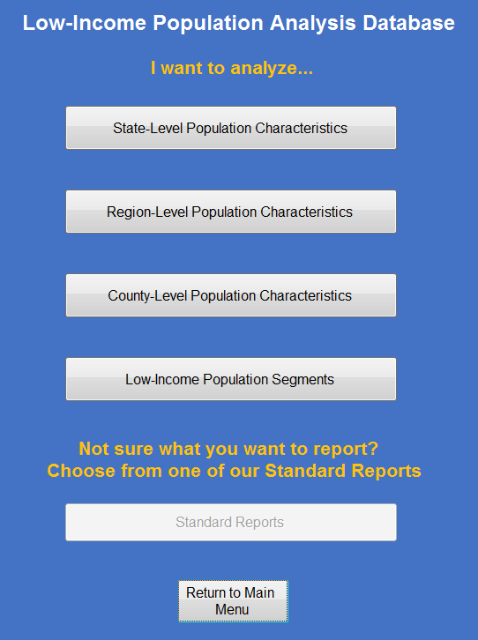
Open Access Database (In Development)
66

Slide 67
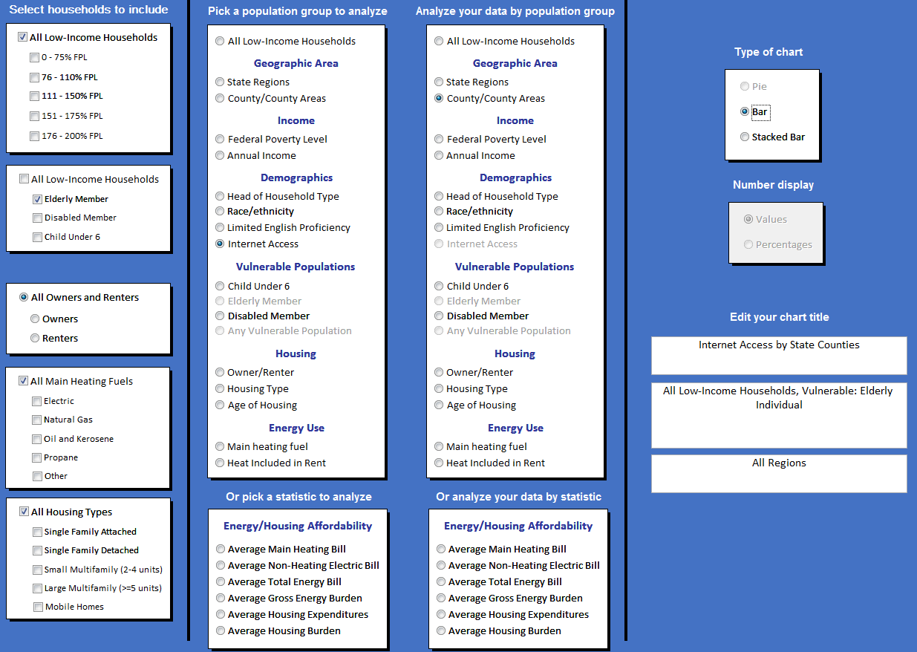
Open Access Database (In Development)
67

Slide 68
Discussion
Paula Carmody
People’s Counsel
Maryland Office of People’s Counsel
410-767-8150
Paula.Carmody@Maryland.gov
Matthew Lyons
Project Director
APPRISE
609-252-8014
Matthew-Lyons@appriseinc.org
68

