Slide 1
Princeton’s Energy Future
The Role of Energy Efficiency
Jackie Berger
October 17, 2018

Slide 2
Session Outline
Background
Why Energy Efficiency?
Where is Energy Used in the Home?
What to Do!
NJ Clean Energy Program
2

Slide 3
APPRISE
Nonprofit Research Institute
Mission
Research Areas
Clients
Federal Government (DOE, HHS)
State Governments
Utility Companies
Nonprofits
Energy Efficiency
Energy Affordability
Princeton, NJ
Established in 2002
Analyze data and information to assess and improve public programs
3

Slide 4
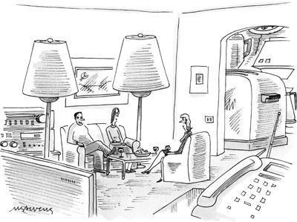
Why Energy Efficiency?
4

Slide 5
Energy Efficiency “The Invisible Fuel”
What is the cheapest and cleanest approach?
5

Slide 6
Energy Efficiency “The Invisible Fuel”
Reduce waste!
6

Slide 7
Energy Efficiency “The Invisible Fuel”
Source: ACEEE
7

Slide 8
Home Comfort
Drafts
Humidity
Cold/Hot Rooms
Noise
8

Slide 9
Health & Safety
Mold
Air Quality
Carbon Monoxide
Asbestos
Pests
9

Slide 10
How is Energy Used in the Home?
10

Slide 11
Major Energy Users
Percent of Residential Energy Usage – All Fuels
Percent of Residential Energy Usage – Electricity
Source: 2015 Residential Energy Consumption Survey. Data for Mid-Atlantic Region (NJ, NY, PA).
11

Slide 12
Your Home
Where is energy used in your home?
Measure it!
12

Slide 13
How to Do It?
13

Slide 14
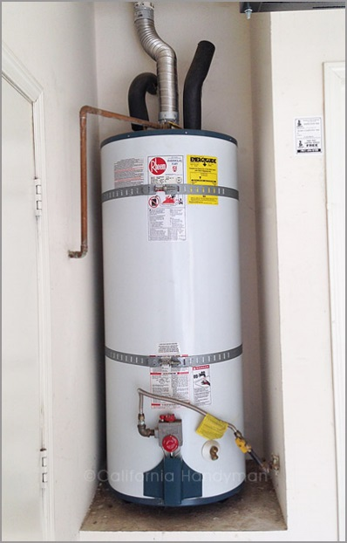
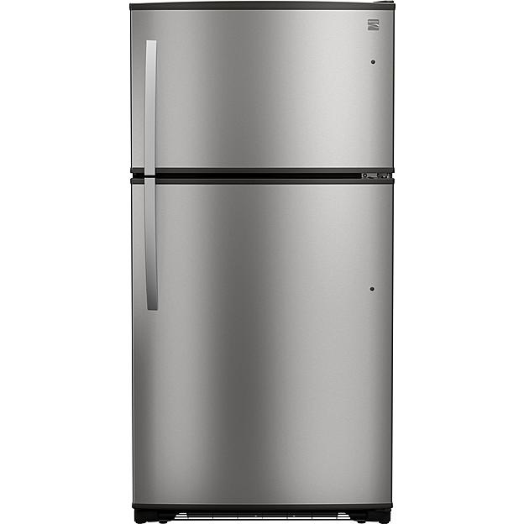
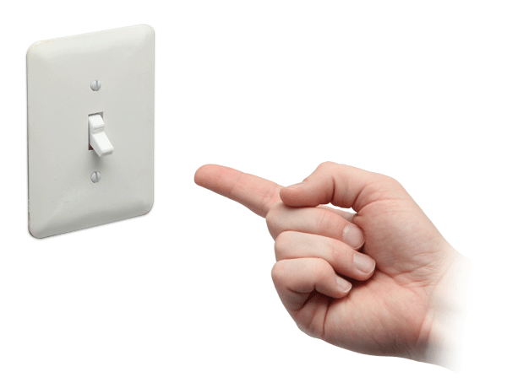
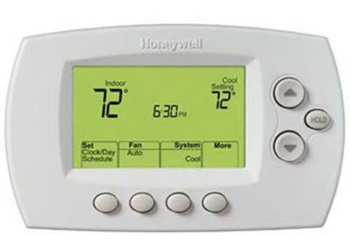
Behavior Change
Heat & AC
Reduce setting
Turn down when away
Water Heat
Turn down temperature
Turn down when away on vacation
Other
Turn off anything when not in use
Turn down at night
Shorter showers
Cold water laundry
Eliminate second refrigerator/freezer
14

Slide 15
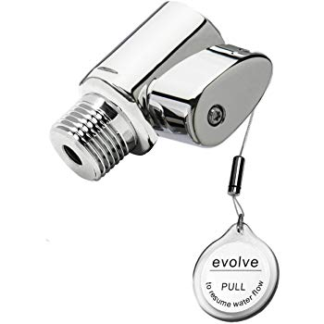
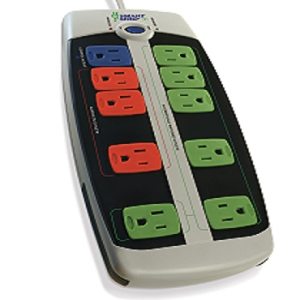
Low-Cost Measures
Heat & AC
Programmable Thermostat
Smart Thermostat
Hot Water
Electric Water Heater Timer
Other
LEDs
Smart Strips
Shower Sensor
Low-flow Showerhead
15

Slide 16
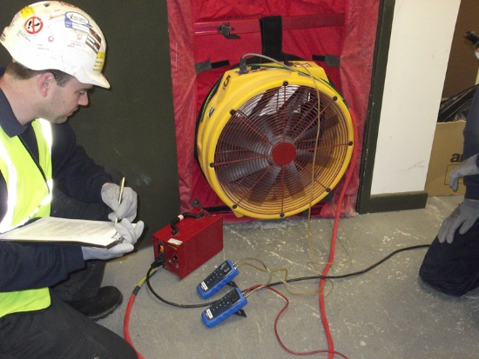
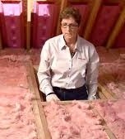
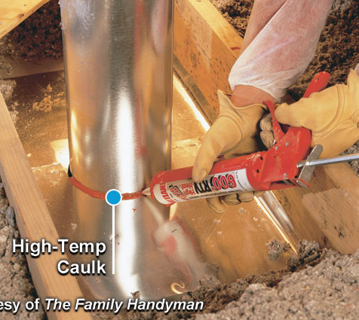
Home Performance
Step 1: Home Energy Assessment
Step 2: Review Results
Step 3: Install Measures
16

Slide 17
Home Performance
Heat & AC
High-Efficiency Systems
Hot Water
High-Efficiency Water Heater
New Technologies
Other
Ventilation
Air Sealing
Insulation
Duct Sealing
Appliances
17

Slide 18
New Jersey Clean Energy Program
18

Slide 19
Comfort Partners Program
No-cost energy efficiency services.
Measures determined by what is needed in home.
1-14 unit buildings
Primary residence
Separately metered electric or gas account
Eligibility
225% Federal Poverty Guidelines
2018 Income Guidelines (225% of the Federal Poverty Guidelines)
Size of Family | Yearly Income
1 | $27,315
2 | $37,035
3 | $46,755
4 | $56,475
5 | $66,195
6 | $75,915
7 | $85,635
8 | $95,355
19

Slide 20
Home Performance with Energy Star
Rebate up to $4,000
Up to 50% of cost of improvements
To achieve highest $4,000 rebate
25% energy savings
Air sealing
Insulation added if below required level
Financing
0% interest for 7-year term on up to $10,000
4.99% interest for 10-year term on up to $15,000
Eligibility
Residential building 3 stories or less
1-4 dwelling units
Townhouse
Multifamily >= 5 units addressed as whole building
20

Slide 21
Residential Equipment Rebates
Appliances
Clothes Washers – Up to $75
Clothes Dryers – Up to $300
Refrigerator – Up to $75
Recycle Refrigerator - $50
Recycle Room AC - $25
Recycle Dehumidifier - $25
WarmAdvantage
Gas Furnaces – up to $500
CoolAdvantage
Air Conditioner – up to $500
Boilers - $300
Furnace & Water Heater – up to $950
Boiler & Water Heater – $700
Water Heater – up to $500
21

Slide 22
Commercial & Industrial Programs
Direct Install
Turnkey process
Free energy assessment
Combined Heat & Power and Fuel Cells
Financial incentives
Covers up to 70% of energy efficiency upgrade costs
Lighting, HVAC, refrigeration, and other equipment
NJ SmartStart Buildings – Equipment Rebates
Heating & cooling systems
Pay for Performance
Whole building approach
Water heating
Lighting & controls
Refrigeration
ECM motors
Work with program partner on energy reduction plan
Custom measures
Save 15% or more
Existing buildings and new construction
22

Slide 23
summary
23

Slide 24
Summary
Energy efficiency is the least cost and cleanest fuel
Scales of commitment and investment
NJ Clean Energy Programs can cover some or all of the cost
Energy usage practices
Low-cost measures
Home performance
Identify where your home is wasting energy
24

Slide 25
Contact Information
Jackie Berger
President
jackie-berger@
appriseinc.org
609-252-8009
APPRISE
32 Nassau Street
Suite 200
Princeton, NJ 08542
25

