Slide 1
Coordinating Healthy Homes with Energy Programs Program Design and Performance Measurement Considerations
Matthew Lyons
APPRISE Incorporated
Notes:
Today, I will be discussing how energy programs that serve low-income populations can work with healthy homes partners to provide more comprehensive services and improve outcomes for clients.

Slide 2
Presentation Objectives
Understand potential benefits of healthy homes coordination
Review steps to consider when planning a healthy homes coordination project
See an example of the evolution of a healthy homes coordination project
Identify lessons learned to design, track, and evaluate healthy homes outcomes in an energy program
2
Notes:
This presentation is intended to provide program implementers practical information for how they can design their own energy plus health initiative. While it is helpful to see what a fully operational energy plus health collaborative looks like, we’ll spend time looking at how a coordinated service delivery model evolves from the planning phase, to early implementation, through more advanced implementation. First, we will

Slide 3
Reasons to Invest in an Energy Plus Health Model
Reduce energy efficiency deferrals
Generate referral sources
Leverage additional funding streams
Resolve inefficiencies in service delivery
Provide more comprehensive service delivery
Improve energy and non-energy participant outcomes
3
Notes:
Reduce energy efficiency deferrals – leverage funding streams that can fix issues in homes that would otherwise result in WAP deferrals
Referral sources – programs with similar eligibility requirements can be great access points to enroll households
Comprehensive service delivery – the needs of low-income households are quite complicated and we often find that to get at the core issues

Slide 4
Energy Plus Health – Process Improvements
Fragmented Programs
Jane Applicant:
High Energy Bills
Roof Leak
Chipping/Peeling Paint
Heating System Broken
Schedule Home Repair Audit
Reapply for Weatherization
Select / Assign Contractor
Complete Lead Abatement
Apply for Weatherization
Submit CDBG Documentation
Complete Loan Closing
Select / Assign Contractor
Submit WAP Documentation
Apply for CDBG Home Repair
Complete Roof / Heating Repairs
Conduct Audit & XRF Testing
Schedule Energy Audit
Defer Applicant Repair Issues
Apply for Lead Abatement
Submit Lead Documentation
4
Notes:
Jane is someone that has multiple, critical needs, who we would want to serve as quickly and efficiently as possible.

Slide 5
Energy Plus Health – Process Improvements
Coordinated Programs
Jane Applicant:
High Energy Bills
Roof Leak
Chipping/Peeling Paint
Heating System Broken
Integrated Home Retrofit Plan
Contractor Assignment
Apply for Housing Services
Comprehensive Home Audit
Loan Closing*
Submit Unified Application
Submit Required Documentation
Home Retrofit
5
Notes:
Jane Applicant is someone that has immediate

Slide 6
Energy Plus Health – Process Outcomes
Leveraging
Increased investment in households served
Deferral rates
Less households denied weatherization services
Lower energy auditing costs
Time efficiencies
Reduced staff hours on duplicative activities
Reduced processing time to receive program services
Increased organizational resources
6

Slide 7
Energy Plus Health – Client Outcomes
Higher energy savings
Repairs that reduce air infiltration
Improvements that facilitate effective weatherization
Improved health and safety
Mitigating lead paint hazards
Reducing home asthma triggers
Reducing home falls/injuries
Reduced expenses
Lower energy bills
Emergency room visits, hospitalizations, and nursing home placements
Improved home comfort
Activities of Daily Living
Home heating/cooling temperature
Physical and mental health
7
Notes:
High customer transaction costs

Slide 8
Energy Plus Health Objectives
Maximize Health Impacts
Target populations with health problems
Target interventions that address health outcomes
Comprehensive Service Delivery
Address barriers to weatherization
Facilitate improved energy savings
Reduce participant transaction costs
8
Notes:
High program transaction costs

Slide 9
Challenges Creating an Energy Plus Health Model
Restrictions in uses of energy efficiency funding
Lack of alignment between funding streams
Lack of alignment between agencies
Separate intake, assessment, and contracting
Data tracking limitations
9
Notes:
High program transaction costs

Slide 10
Energy/Healthy Housing Design Framework
Planning Steps | Design Questions
Needs Assessment | What are the needs of the eligible and participant populations?
Funding Research | What funding sources are available that serve the needs of the population?
Resource Analysis | How does available funding meet the needs of the population?
Organizational Management | What are the roles, rules, and relationships for resource coordination?
Low-Risk/High Yield Opportunities | What are near-term, mutually-beneficial opportunities for service coordination?
System Building Strategies | What are long-term opportunities to improve the efficiency and effectiveness of energy/health interventions
10

Slide 11
Energy/Healthy Housing Needs Assessment
Housing
Energy
Demographics
Own / rent
Single family / multi-family
Housing age
Heating fuel type
Energy usage
Energy burden
Financial capacity
Income
Vulnerable populations
Health
Critical Needs
Energy Efficiency Deferrals
Asthma
Home energy service
Mold and moisture
Falls/injuries
Lead paint poisoning
Structural problems
Water leaks
Housing affordability
Health costs
11
Notes:
Importance of understanding community needs and the relationship between population characteristics

Slide 12
Funding Research
Funder | Descriptions
Department of Energy | Weatherization Assistance Program Energy Efficiency and Conservation Block Grant
Housing and Urban Development | Healthy Homes Demonstration Grant Lead-Based Paint and Lead Hazard Reduction Demonstration Grant HOME Community Development Block Grant Choice Neighborhood Grants
Health and Human Services | Low Income Home Energy Assistance Program CDC Lead Poisoning Prevention
USDA | Rural Repair and Rehabilitation Loans and Grants
Utilities, State and Local Government, Philanthropy | Ratepayer-funded low-income programs State housing trust funds Non-profits Municipal bonds Foundations
12

Slide 13
Resource Analysis
Resource Assessment | Area of Analysis
Funding Rules | Income limits Allowable activities Block grant vs. categorical grant Loans vs. grants
Funding Implementation | Fed vs. state vs. local vs. non-profit vs. utility Application and documentation requirements Underwriting guidelines Contractor assignment/selection
Gap Analysis | Are funding sources sufficient to meet the needs of the population? What additional funding is needed? What changes in how funding is administered are needed?
13

Slide 14
Case Study: City of Baltimore
Summer 2009 - $15.7 million ARRA weatherization award to Baltimore City
Increased production goals from 100-200 units/year to 2,400 units over 3 years
In the first year of ARRA implementation, 64% of households were deferred from weatherization due to health and safety issues.
14

Slide 15
Baltimore City Housing Quality Issues
15

Slide 16
Managing Baltimore’s Energy Plus Health Initiative
Leadership Team
Core city health and housing agencies
Non-profit healthy housing leader
Management Network
Philanthropic convener
Partner and funding identification
Policy and system change
Operating Network
Referral processes
Case tracking
Audit/scope coordination
Partners and Stakeholders
External collaborators
Intersection of energy/healthy housing with other program services
16

Slide 17
Low-Risk/High Yield Coordination Opportunities – Baltimore City
CDBG Renovated Homes + Weatherization
Leverage recently renovated homes likely eligible for weatherization
Weatherized Homes + Lead Hazard Reduction
Leverage WAP data to target lead paint home visits and abatement
Senior Home Repair Services + Weatherization
Leverage community organizations to coordinate senior home repairs and weatherization
17

Slide 18
Service Coordination Components – Baltimore City
Referral Form
Standardized method for agencies to refer clients to partnering agencies
Screening Tool
Assessment tool for identifying needs and eligibility for households with complex needs
LIGHT Team
Network of agencies that meet regularly to manage interagency coordination opportunities
LIGHT Database
Database to track client information across multiple agencies
18

Slide 19
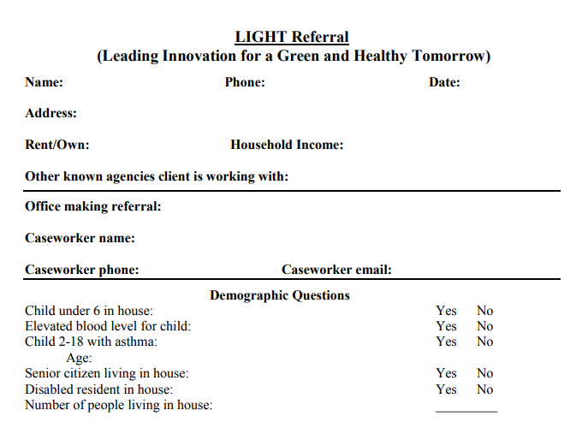
Referral Form
Client Priorities
19

Slide 20
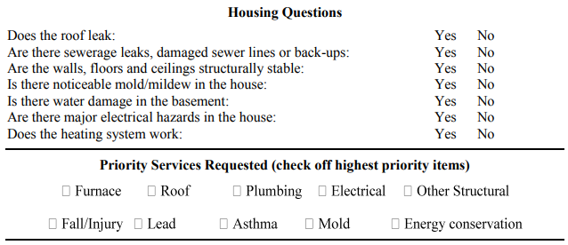
Referral Form
Housing Priorities
20

Slide 21
Screening Tool – Assessing Housing Needs
Housing
Building Structure
Plumbing/Sewerage
Mold/Moisture
Energy
Usage
Out of fuel/Utility disconnect
Heating system broken
Asthma
Child with asthma / Adult with respiratory problems
Pest infestation
ER visits, school/work days missed, hospitalizations
Lead Paint
Child blood lead level testing
Housing age
Chipping/peeling paint
Aging in Place
Trip/fall hazards in home
History of falls / hospitalizations / ambulatory aid
Activities of Daily Living
21

Slide 22
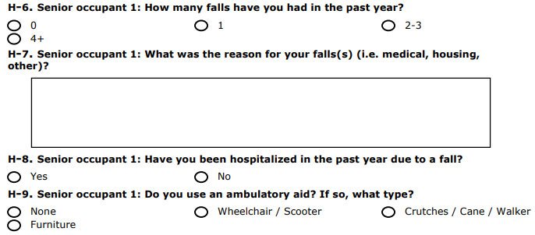
Screening Tool – Examples
Client Prioritization
22

Slide 23
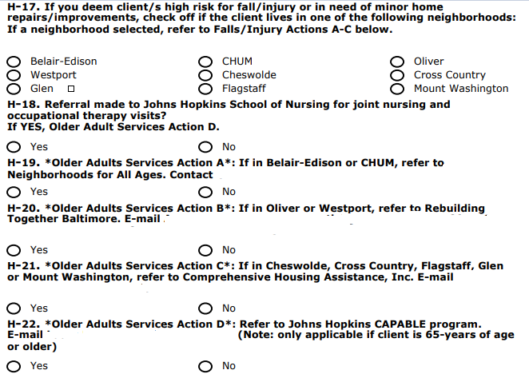
Screening Tool – Examples
Available Programs
23

Slide 24
LIGHT Team Members
Housing Rehabilitation
Baltimore Housing Office of Rehabilitation
Neighborhood Housing Services of Baltimore
Park Heights Renaissance
Energy
Weatherization Assistance Program
Fuel Fund of Maryland
Baltimore Energy Challenge
Health
Green and Healthy Homes Initiative
Baltimore City Health Department
Healthcare Access Maryland
Older Adult Services
Comprehensive Housing Assistance
Civic Works
Johns Hopkins School of Nursing
Tax/Financial/Legal Services
Baltimore CASH Campaign
Bar Association of Baltimore
Public Justice Center
24

Slide 25
Shifting from Coordination to Integration
2009
Testing referrals with core stakeholders
2010
Standardized referral form; expand partners
2011
Merge Wx/Lead/Rehab under single agency
2012
Integrate application processing functions
25

Slide 26
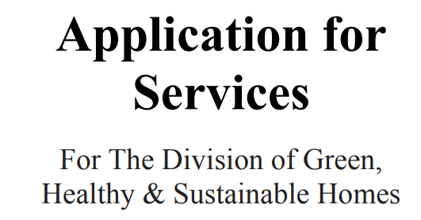
Integrated Application – Apply for Services, Not Programs
Housing Rehab
Health/Safety
Energy
Roof
Plumbing
Structural
Water/Sewer
Electrical
Lead Hazards
Heating System
Accessibility Modifications
Energy efficiency
26

Slide 27
Comprehensive Home Assessment & Contracting
Client Interview
Inspection
Demographic information
Lead hazards
Asthma
Indoor pollutants
Indoor hazards management
Safety & injury prevention
Energy Audit
Lead paint
CO / Smoke / Fire Safety
Mold / Moisture
Electrical / Structural Hazard
Child Safety
Stairs / Railing Safety
27

Slide 28
Coordinated vs Integrated Interventions
Jane Applicant:
High Energy Bills
Roof Leak
Chipping/Peeling Paint
Heating System Broken
Coordinated Services
Integrated Services
Home Repair Contractor
Single Contractor
Roof Replacement
Lead Abatement
Heating System Replacement
Weatherization
Lead Abatement Contractor
Weatherization Contractor
28

Slide 29
Lessons Learned – Energy Plus Health Planning
Balance community needs and program resources
Geographic targeting
Find Mutually Beneficial Partnerships
Start with easy wins
Positive branding encourages agency participation
Create venues to resolve policy and operating issues
Population targeting
29

Slide 30
Lessons Learned – Energy Plus Health Data Tracking
Identify priority populations for healthy homes enhancements
Asthma – school days missed, emergency room visits, hospitalizations
Fall/Injury – Activities of Daily Living, number of past falls
Lead Paint – age of housing, children in home, blood lead levels
Triage client needs
Weatherization only
Weatherization plus healthy homes enhancements
Resolve housing repair needs prior to weatherization
Establish method for evaluating pre- and post-outcomes
Updates to data tracking system
Methods for capturing energy, health, and housing data
Controlling for exogenous influences
30

Slide 31
Lessons Learned – Energy Plus Health Process Changes
Service Coordination
Identify funding to support interagency coordination
Develop standardized referral processes
System Changes
Consider long-term strategies to align application and documentation processes
Assess procurement and training opportunities to facilitate integrated home assessments and retrofits
Establish assessment tools and data tracking that make coordination more efficient
31

Slide 32
Lessons Learned – Energy Plus Health Performance Measures
Reduction in deferrals
Pre-/post- health outcomes
Energy savings
Financial benefits
Staff time/cost savings
Customer processing times
Leveraged funding for comprehensive services
32

Slide 33
Matthew Lyons APPRISE Incorporated Matthew-Lyons@appriseinc.org 609-252-8014
33

