Slide 1
Understanding & Improving Energy Affordability in New Jersey
Matthew Lyons
Atlantic City Electric
Energy Assistance Summit
August 31, 2016

Slide 2
Overview
Energy Affordability Measurement & Factors
Improving Energy Affordability
Targeting Energy Affordability Solutions
Energy Efficiency Issues
Energy Assistance Issues
2

Slide 3
APPRISE Background
Nonprofit Research Institute
Founded in 2002
Energy Program Research and Evaluation
Low-Income Energy Bill Payment Assistance
Low-Income Energy Efficiency
Residential Energy Efficiency
Commercial and Industrial Energy Efficiency
Our Clients
Federal government
State government offices
Utility companies
Nonprofits
Princeton, NJ
Research conducted across the U.S.
3

Slide 4
Energy affordability measurement and factors
And what are the different energy affordability needs of New Jersey low-income households?
4

Slide 5
Energy Affordability
Household Energy Burden
Total Energy Cost
Household Income
=
Data from FY 2014 LIHEAP Home Energy Notebook
5

Slide 6
Energy Affordability Factors
Factors that influence energy affordability
Income
Energy Efficiency
Housing Quality
Vulnerable Household Temperature Needs
Medical Device Energy Usage
De Facto Space Heating
6

Slide 7
Impact of Income
Affordability is driven by income
Energy Costs | Income | Energy Burden
$1,200 | $10,000 | 12%
$1,200 | $20,000 | 6%
$1,200 | $30,000 | 4%
7

Slide 8
Impact of Energy Costs
Example: Very low income
Efficiency will not solve affordability issue
Energy Costs (Pre-Wx) | Wx Impact | Energy Costs (Post-Wx) | Household Income | Energy Burden
$1,200 | None | $1,200 | $10,000 | 12%
$1,200 | 10% | $1,080 | $10,000 | 10.8%
$1,200 | 30% | $840 | $10,000 | 8.4%
8

Slide 9
Impact of LIHEAP
Low energy costs
Income is key factor
Energy assistance has greater impact
No USF benefit
Electric burden is <3%
Heating fuel is fuel oil
Energy Costs (Pre-LIHEAP) | LIHEAP Benefit | Energy Costs (Post-LIHEAP) | Income | Energy Burden
$1,200 | $0 | $1,200 | $10,000 | 12%
$1,200 | $410 | $790 | $10,000 | 7.9%
$1,200 | $600 | $600 | $10,000 | 6%
Note: $410 is the estimated average LIHEAP benefit in NJ for FY 2016
9

Slide 10
Impact of LIHEAP And USF
Customer receives USF
Electric burden is > 3%
Household heats with electric
Limits energy burden to 6%
Energy Costs (Pre-LIHEAP) | Energy Costs (Post-LIHEAP) | Income | Energy Burden | USF | Energy Costs (Post-USF) | Energy Burden (Post-USF)
$1,200 | $1,200 | $10,000 | 12% | $600 | $600 | 6%
$1,200 | $790 | $10,000 | 7.9% | $190 | $600 | 6%
$1,200 | $600 | $10,000 | 6% | $0 | $600 | 6%
Note: $410 is the estimated average LIHEAP benefit in NJ for FY 2016
10

Slide 11
High Energy User
More Expensive Fuel
Larger Home
Inefficient Home
High Energy Burden
Energy Costs | Income | Energy Burden
$1,500 | $30,000 | 5%
$3,000 | $30,000 | 10%
$4,500 | $30,000 | 15%
11

Slide 12
High Energy User Weatherization Impact
High Energy Costs
High Energy Efficiency Potential
Also Need Energy Assistance
Energy Costs (Pre-Wx) | Wx Impact | Energy Costs (Post-Wx) | Household Income | Energy Burden
$4,500 | None | $4,500 | $30,000 | 15%
$4,500 | 10% | $4,050 | $30,000 | 13.5%
$4,500 | 30% | $3,150 | $30,000 | 10.5%
12

Slide 13
High Energy User LIHEAP Impact
High Energy Costs
LIHEAP is not Enough
No USF Benefit
Also need energy efficiency
Energy Costs (Pre-LIHEAP) | LIHEAP Benefit | Energy Costs (Post-LIHEAP) | Income | Energy Burden
$4,500 | $0 | $4,500 | $30,000 | 15%
$4,500 | $410 | $4,090 | $30,000 | 13.6%
$4,500 | $600 | $3,900 | $30,000 | 13%
13

Slide 14
High Energy User LIHEAP Impact
USF further reduces burden
Still good opportunity for energy efficiency
Further reduce burden
Reduce ratepayer subsidy
Also need energy efficiency
Energy Costs (Pre-LIHEAP) | Energy Costs (Post-LIHEAP) | Income | Energy Burden | USF | Energy Costs (Post-USF) | Energy Burden (Post-USF)
$4,500 | $4,500 | $30,000 | 15% | $1,800 | $2,700 | 9%
$4,500 | $4,090 | $30,000 | 13.6% | $1,800 | $2,290 | 7.6%
$4,500 | $3,900 | $30,000 | 13% | $1,800 | $2,100 | 7%
14

Slide 15
Tools to Reduce Energy Burden
Energy Costs
Household Income
Energy efficiency improvements
Behavior change to lower energy costs
LIHEAP
USF
Access to non-energy benefits (e.g. EITC)
Self-sufficiency services (long-term strategy)
15

Slide 16
Energy assistance issues
16

Slide 17
Demand for Energy Assistance in New Jersey
Households | Households
LIHEAP Income-Eligible | 761,203
LIHEAP Recipients | 273,336
Percentage Receiving LIHEAP | 36%
Significant number qualify but do not receive benefits
Income-eligible households taken from FY 2014 LIHEAP Home Energy Notebook; households receiving LIHEAP taken from FY 2016 New Jersey LIHEAP Model Plan
17

Slide 18
Receipt of LIHEAP By Poverty Level
Federal Poverty Level (FPL) | # Households | % Households
< 75% FPL | 66,891 | 25.7%
75% - 100% FPL | 67,968 | 26.2%
101% - 125% FPL | 46,464 | 17.9%
126% - 150% FPL | 37,832 | 14.5%
151% - 200% FPL | 40,732 | 15.7%
Over 50% of households receiving energy assistance are below the federal poverty line
Data based on households receiving heating assistance reported in the FY 2016 New Jersey Household Report – Long Form
18

Slide 19
Vulnerable Populations Receiving LIHEAP
Vulnerable Population | # Households | % Households
Elderly (60 Years or Older) | 104,848 | 40.3%
Disabled | 62,447 | 24.0%
Child Age 5 or Under | 45,550 | 17.5%
Elderly, Disabled or Young Child | 177,765 | 68.4%
Total Households | 259,887 | 100%
Over two-thirds of households receiving energy assistance have at least one household member that is a vulnerable population
Data based on households receiving heating assistance reported in the FY 2016 New Jersey Household Report – Long Form
19

Slide 20
Targeting Energy Assistance
Considerations for targeting energy assistance benefits
Poverty Level
Energy Usage
Fuel Type
Heat Included in Rent
New LIHEAP performance measures
Track energy burden
Refine how benefits are calculated
20

Slide 21
Energy efficiency issues
21

Slide 22
Low-Income Energy Efficiency Programs
NJ Comfort Partners
NJ Dept Community Affairs
Overseen by NJ Board of Public Utilities
Free installation of energy efficiency measures, energy education, and counseling
Utility administration
Electric & Gas Heaters
Overseen by NJ Dept. of Community Affairs
Free installation of energy efficiency measures, energy education, and counseling
Local weatherization agency service delivery
22

Slide 23
NJ Comfort Partners
Fiscal Year | Households Served | Expenditures
2001 | 5,848 | $10,354,000
2002 | 5,937 | $13,268,000
2003 | 6,661 | $15,435,000
2004 | 6,706 | $14,266,000
2005 | 6,403 | $15,467,000
2006 | 8,552 | $18,209,000
2007 | 8,484 | $26,170,000
2008 | 7,239 | $20,655,000
2009 | 7,779 | $30,741,450.93
2010 | 6,814 | $31,377,188.90
2011 | 7,054 | $28,405,762
2012 | 11,760 | $48,397,526.80
2013
2014 | 6,054 | $31,739,536.69
2015 | 5,188 | $27,510,017.07
2016 | 4,612 | $29,266,520.14
TOTAL | 105,091 | $361,262,003
23

Slide 24
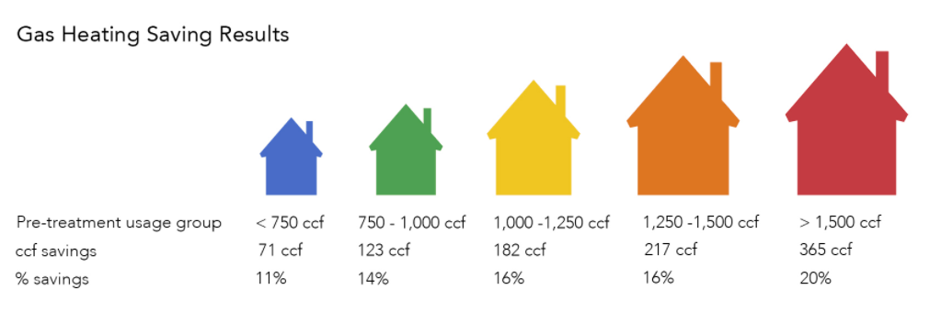
Targeting Energy Efficiency by Usage
Households with higher usage realize greater savings
24

Slide 25
Non-Energy Benefits of Weatherization
Comfort
Regulating indoor air temperature
Reduced drafts
Health
Reduced asthma triggers
Identification of lead paint hazards
Safety
Testing for carbon monoxide hazards
Repair of heating systems
Improved ventilation and indoor air quality
25

Slide 26
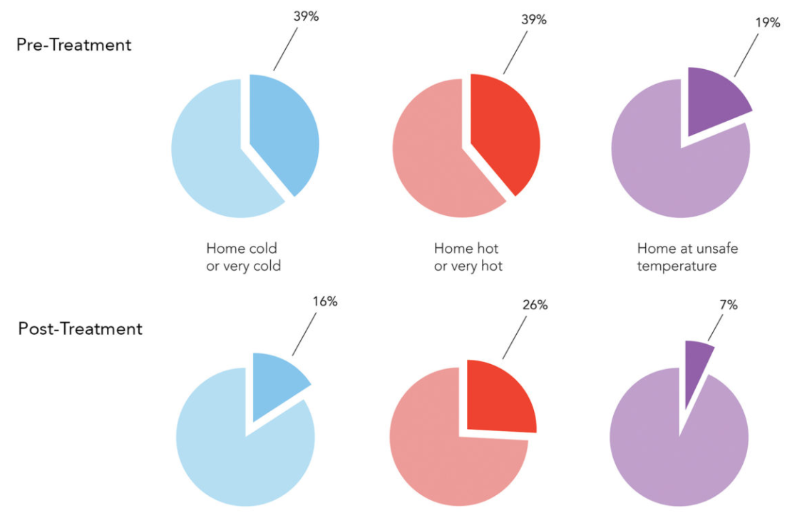
Non-Energy Benefits Home Comfort
26

Slide 27
Barriers to Accessing Weatherization
23% of households that receive an energy audit are deferred service
Deferrals are higher for vulnerable populations
Elderly 43%
Children 36%
Disabled 36%
Data from Oak Ridge National Laboratory, Rose 2015
27

Slide 28
Deferral Reasons Health & Safety
Excessive mold/moisture
Asbestos
Knob/tube wiring
Unsanitary conditions
Excessive repairs
Roof leaks
Unsafe equipment
Pest infestations
Structural disrepair
28

Slide 29
Removing Barriers to Weatherization
Programs and resources that address common deferral issues:
Community Development Block Grant
Lead Hazard Reduction Program
State housing programs
Private/non-profit home repair resources
Align energy efficiency, housing, and healthy homes services
Screen customers into the right programs
29

Slide 30
targeting energy affordability solutions
Triaging, aligning and coordinating resources
30

Slide 31
Targeting to Achieve Energy Affordability
Energy Plus Health
Energy Efficiency
Energy Assistance
31

Slide 32
Triaging Customers’ Needs
Factors to consider
Household income
Energy usage
Home repair issues
Fuel type
Health needs
What else?
32

Slide 33
Client-Centered Service Coordination
Questions to consider
Energy crisis that requires immediate attention?
Previously received weatherization?
Home repair issues that could defer weatherization?
Expected impact on energy affordability?
Screening tools to determine household needs and eligibility?
33

Slide 34
SUMMARY
34

Slide 35
Treat Clients Individually
Assess Needs
Examine Source of Problem
Review Important Household Factors
Understand Potential Impact of Services
Review Additional Program Eligibility
Provide Comprehensive Solution
35

Slide 36
Contact
Matthew Lyons
Project Director
APPRISE
32 Nassau Street, Suite 200
Princeton, NJ 08542
609-252-8009
Matthew-Lyons@appriseinc.org
www.appriseinc.org
36

