Slide 1
WAP Warm Climate Weatherization: Opportunities for Energy Savings
Kevin McGrath and Dan Bausch
NASCSP Winter Training Conference
March 1, 2018

Slide 2
Outline
Needs Assessment – What is the level of need for low-income weatherization in warm climates?
WAP Performance in Warm Climates – What can results from the National ARRA-period Evaluation tell us about WAP success in warm climates?
New LIHEAP Performance Measures – What can the new data that states are collecting for LIHEAP reporting tell us about opportunities in warm states?
2

Slide 3
Needs Assessment for Low-Income Weatherization in Warm Climates
3

Slide 4
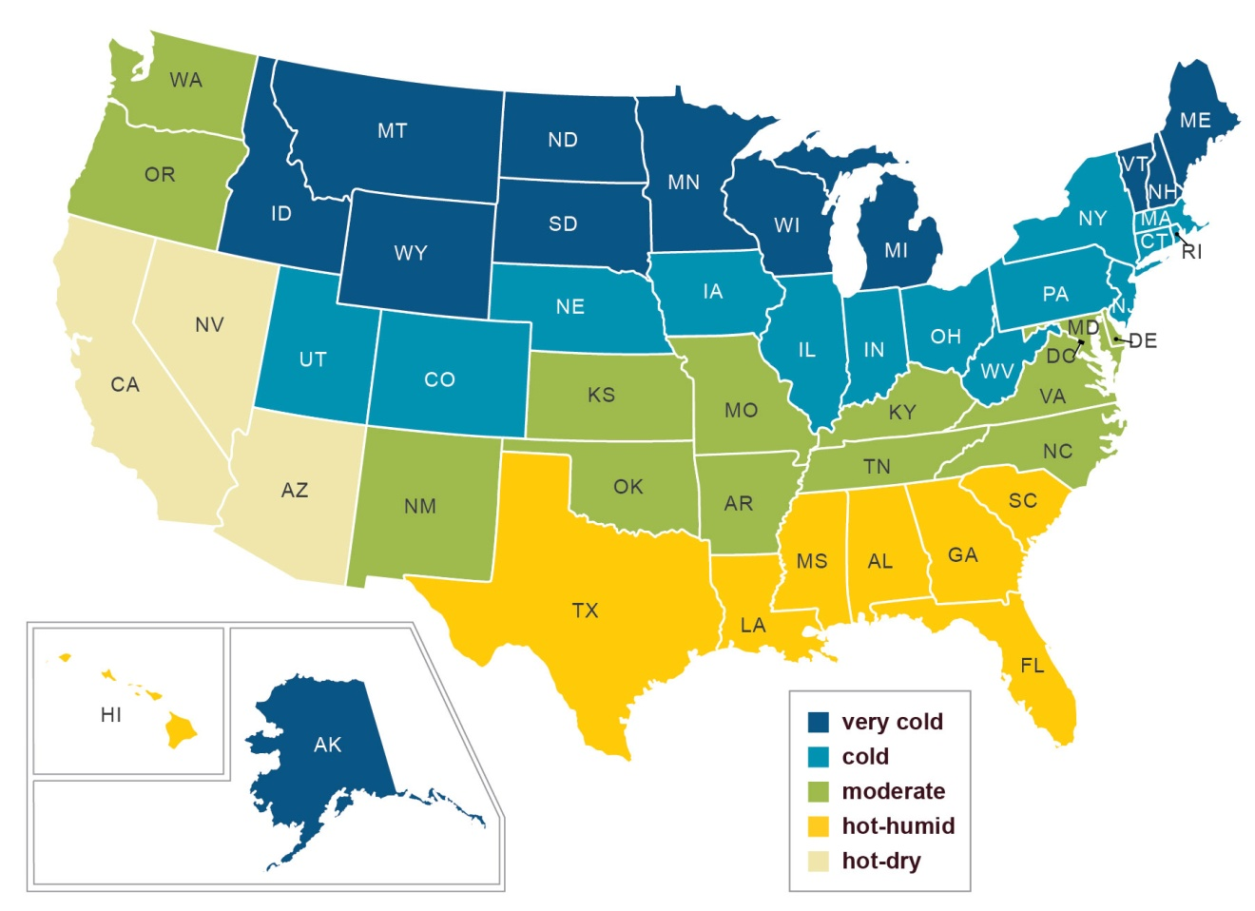
Climate Zones
4

Slide 5
WAP Eligible Population
Zone | Total Households | WAP Eligible Households | % Eligible for WAP
Very Cold | 11,815,195 | 3,496,585 | 29.6%
Cold | 37,436,040 | 11,089,262 | 29.6%
Moderate | 25,296,900 | 8,068,110 | 31.9%
Hot-Humid | 27,793,529 | 9,753,464 | 35.1%
Hot-Dry | 16,518,389 | 5,224,098 | 31.6%
United States | 118,860,053 | 37,631,519 | 31.7%
Source: 2016 American Community Survey (ACS)
5

Slide 6
WAP Population Served
Zone | WAP Eligible Households | Total Funding Last 10 Years (Billions) | Total Units Served Last 10 Years | % Served Last 10 Years
Very Cold | 3,496,585 | $2.420 | 261,995 | 7.5%
Cold | 11,089,262 | $3.898 | 732,939 | 6.6%
Moderate | 8,068,110 | $1.587 | 256,488 | 3.2%
Hot-Humid | 9,753,464 | $0.787 | 102,019 | 1.0%
Hot-Dry | 5,224,098 | $1.026 | 197,038 | 3.8%
United States | 37,631,519 | $9.719 | 1,550,479 | 4.1%
Source: 2016 ACS, WAPTAC Funding Survey (PY2006-PY2015)
6

Slide 7
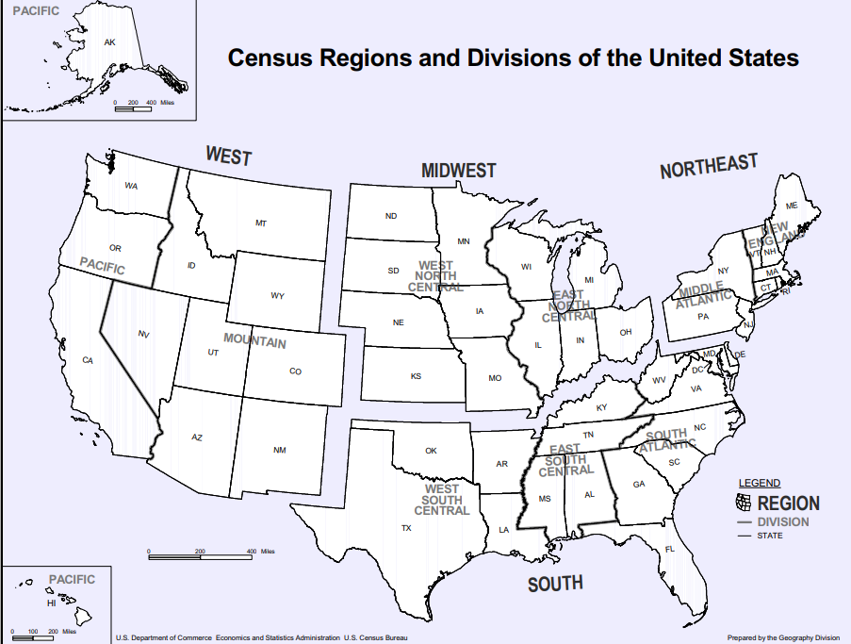
Census Regions
7

Slide 8
Average Annual Consumption (MMBtus) Low-Income Households
Census Region | Total Residential Energy | Home Heating | Home Cooling
Northeast | 99.0 | 58.3 | 1.7
Midwest | 107.7 | 59.3 | 2.3
South | 66.0 | 19.7 | 7.3
West | 60.3 | 18.7 | 3.3
United States | 80.7 | 35.9 | 4.4
Source: FY 2014 LIHEAP Home Energy Notebook Estimates
Low-income = households income-eligible for LIHEAP under federal guidelines
8

Slide 9
Source Energy
EPA recommends using source energy when comparing across different fuel mixes.
“EPA has determined that source energy is the most equitable unit of evaluation. Source energy represents the total amount of raw fuel that is required to operate the building. It incorporates all transmission, delivery, and production losses. By taking all energy use into account, the score provides a complete assessment of energy efficiency in a building.”
Source: https://portfoliomanager.energystar.gov/pdf/reference/Source%20Energy.pdf
9

Slide 10
Average Annual Consumption (MMBtus) Low-Income Households – Source Energy
Census Region | Total Residential Energy | Home Heating | Home Cooling
Northeast | 150.2 | 64.4 | 5.2
Midwest | 180.8 | 69.9 | 7.1
South | 160.3 | 32.9 | 23.0
West | 121.9 | 26.7 | 10.4
United States | 155.2 | 46.1 | 13.9
Source: FY 2014 LIHEAP Home Energy Notebook Estimates Converted to Source Energy
Low-income = households income-eligible for LIHEAP under federal guidelines
10

Slide 11
Average Annual Expenditures Low-Income Households
Census Region | Home Heating | Home Cooling | Total Residential Energy
Northeast | $1,130 | $85 | $2,520
Midwest | $759 | $75 | $1,935
South | $415 | $266 | $1,859
West | $279 | $128 | $1,342
United States | $601 | $164 | $1,894
Source: FY 2014 LIHEAP Home Energy Notebook
Low-income = households income-eligible for LIHEAP under federal guidelines
11

Slide 12
Average Annual Energy Burden Low-Income Households
Census Region | Home Heating |  | Home Cooling |  | Total Residential Energy
 | Mean | Median | Mean | Median | Mean | Median
Northeast | 11.6% | 4.6% | 0.9% | 0.3% | 20.8% | 11.1%
Midwest | 9.6% | 3.4% | 0.9% | 0.3% | 18.9% | 9.2%
South | 5.9% | 2.1% | 3.7% | 1.2% | 20.5% | 9.9%
West | 3.3% | 0.9% | 1.2% | 0.3% | 11.8% | 5.5%
United States | 7.3% | 2.4% | 1.3% | 0.5% | 18.4% | 9.5%
Source: FY 2014 LIHEAP Home Energy Notebook
Low-income = households income-eligible for LIHEAP under federal guidelines
12

Slide 13
WAP Eligible Population: Main Heating Fuel
Zone | EL | NG | FO/KER | LPG | Other
Very Cold | 22% | 56% | 7% | 9% | 6%
Cold | 24% | 59% | 9% | 4% | 4%
Moderate | 56% | 31% | 3% | 5% | 5%
Hot-Humid | 73% | 21% | 0% | 3% | 3%
Hot-Dry | 38% | 52% | 0% | 3% | 7%
United States | 45% | 42% | 4% | 4% | 4%
Source: 2016 ACS
13

Slide 14
WAP Eligible Population: Owner/Renter Status
Zone | Own | Rent | Other
Very Cold | 49% | 48% | 3%
Cold | 42% | 56% | 3%
Moderate | 46% | 50% | 4%
Hot-Humid | 48% | 48% | 4%
Hot-Dry | 37% | 60% | 3%
United States | 44% | 52% | 3%
Source: 2016 ACS
14

Slide 15
WAP Eligible Population: Housing Unit Type
Zone | Single Family | Small Multifamily (2-4 units) | Large Multifamily (5+ units) | Mobile Homes
Very Cold | 58% | 11% | 24% | 8%
Cold | 50% | 16% | 29% | 5%
Moderate | 57% | 9% | 21% | 13%
Hot-Humid | 56% | 9% | 22% | 13%
Hot-Dry | 52% | 10% | 30% | 7%
United States | 54% | 12% | 25% | 9%
Source: 2016 ACS
15

Slide 16
WAP Eligible Population: Housing Age
Zone | Before 1980 | 1980-1999 | 2000-Present
Very Cold | 65% | 23% | 12%
Cold | 73% | 18% | 9%
Moderate | 55% | 29% | 15%
Hot-Humid | 48% | 33% | 19%
Hot-Dry | 59% | 28% | 14%
United States | 60% | 26% | 14%
Source: 2016 ACS
16

Slide 17
WAP Eligible Population in Hot-Humid Zone: Deeper Look
What are some of the household and housing unit characteristics that are important when considering how to target the population?
Owner/renter status
Housing unit type
Main heating fuel
Age of housing stock
17

Slide 18
WAP Eligible Population: Owner/Renter by Housing Unit Type for Hot-Humid Zone
Owner/Renter Status | Single Family | Small Multifamily (2-4 units) | Large Multifamily (5+ units) | Mobile Homes
Own | 77% | 1% | 4% | 18%
Rent | 34% | 17% | 41% | 9%
Other | 65% | 5% | 9% | 20%
Total | 56% | 9% | 22% | 13%
Source: 2016 ACS
18

Slide 19
WAP Eligible Population: Housing Unit Type by Heating Fuel for Hot-Humid Zone
Housing Unit Type | EL | NG | FO/KER | LPG | Other
SFA/SFD | 63% | 30% | 0% | 4% | 3%
SMF (2-4 units) | 80% | 17% | 0% | 1% | 2%
LMF (5+ units) | 88% | 9% | 0% | 0% | 3%
MH | 83% | 6% | 1% | 8% | 2%
Total | 73% | 21% | 0% | 3% | 3%
Source: 2016 ACS
19

Slide 20
WAP Eligible Population: Housing Unit Type by Housing Age for Hot Humid Zone
Housing Unit Type | Before 1980 | 1980-1999 | 2000-Present
SFA/SFD | 57% | 26% | 17%
SMF (2-4 units) | 50% | 35% | 16%
LMF (5+ units) | 42% | 37% | 21%
MH | 24% | 55% | 21%
Total | 48% | 33% | 19%
Source: 2016 ACS
20

Slide 21
Targeting WAP Eligible Population in Hot-Humid Zone
Mainly electric heat, equal proportions owner/renter, mainly SF homes but greater proportion of MH than other zones
If targeting owners, looking at SFA/SFD with some more gas opportunities and older buildings
If able to reach renters, looking at SMF/LMF with mostly electric opportunities in slightly newer buildings
21

Slide 22
Other Demographic and Regional Changes
Dramatic population increase
Increase in Air Conditioning
Since 1993, electricity consumed for air conditioning in the South has increased 43% (EIA, 2009 RECS).
Increase in the number of hot days above 95 degrees in the Southeast since 1970 and expected to increase in the coming decades (National Climate Assessment).
22

Slide 23
WAP Performance in Warm Climates:
Findings from the National WAP ARRA Evaluation
23

Slide 24
National WAP Evaluation
Comprehensive, peer-reviewed evaluation efforts examining WAP during two distinct periods to produce national and regional climate zone results.
PY 2010 ARRA Evaluation
Assess program during ARRA period
Client data collected for ~35,000 WAP households
Energy usage data collected from ~400 utilities
24

Slide 25
WAP During ARRA
National WAP Statistics | PY 2010 (ARRA)
Total DOE Funds | $2 billion
Total Leveraged Funds | $317 million
Total Housing Units Served | 340,158
Average Cost per Housing Unit | $6,812
Income Limit | 200% of Poverty
# of State Sub-grantees | 928
25

Slide 26
Climate Zones
26

Slide 27
WAP Single Family Homes By Climate, PY 2010
Zone | PY10 Units | Percent
Very Cold | 40,870 | 19%
Cold | 78,381 | 36%
Moderate | 40,459 | 19%
Hot-Humid | 36,047 | 17%
Hot-Dry | 19,688 | 9%
27

Slide 28
Home Characteristics
Zone | Central AC | Electric Suppl. Heat | Mean CFM50
Very Cold | 15% | 10% | 2,789
Cold | 30% | 12% | 3,227
Moderate | 59% | 20% | 3,489
Hot-Humid | 62% | 21% | 3,429
Hot-Dry | 52% | 12% | 1,948
28

Slide 29
Home Characteristics in Warm Climates
Central AC used by 60% of WAP households in warm zones compared to 30% in the cold zone and 15% in the very cold zone
Electric supplemental heat use is 2 times as much as in colder climates
Air leakage rates highest at more than 3,400 CFM50.
29

Slide 30
Gas Savings by Climate, 2010
Zone | Sample Size | Pre-WAP Therms | Net Savings Therms | Percent
Very Cold | 2,149 | 1,040 | 157 (+/-13) | 15.1%
Cold | 2,990 | 1,091 | 188 (+/-13) | 17.2%
Moderate | 792 | 828 | 125 (+/-24) | 15.1%
Hot-Humid | 368 | 558 | 81 (+/-23) | 14.6%
Hot-Dry | 293 | 545 | 12 (+/-17) | 2.1%
30

Slide 31
Electric Savings for Gas-Heated Homes by Climate, 2010
Zone | Sample Size | Pre-WAP kWh | Net Savings kWh | Percent
Very Cold | 1,878 | 8,594 | 560 (+/-102) | 6.5%
Cold | 3,518 | 8,673 | 632 (+/-104) | 7.3%
Moderate | 943 | 11,315 | 937 (+/-270) | 8.3%
Hot-Humid | 526 | 11,537 | 1,302 (+/-270) | 11.3%
Hot-Dry | 406 | 8,440 | 686 (+/-217) | 8.1%
31

Slide 32
Gas + Electric MMBtus for Gas Heated Homes (Source Energy Comparison)
Zone | Sample Size | Pre-WAP Source MMBtus | Net Savings Source MMBtus | Percent
Very Cold | 2,149 | 201.3 | 22.5 | 11.2%
Cold | 2,990 | 207.5 | 26.5 | 12.8%
Moderate | 792 | 208.2 | 23.2 | 11.1%
Hot-Humid | 368 | 182.2 | 22.5 | 12.3%
Hot-Dry | 293 | 147.7 | 8.6 | 5.8%
32

Slide 33
Savings for Gas-Heated Homes
Hot-Humid had lower gas savings amounts, but had comparable percentage savings to the Very Cold Region due to lower pre-WAP usage.
Hot-Humid and Moderate had the highest electric baseload savings for gas-heated homes.
When combining results and looking at source energy, Moderate does better in overall savings than Very Cold and Hot-Humid has approximately the same as Very Cold.
33

Slide 34
What about Electric Main Heat Households?
Zone | Sample Size | Pre-WAP kWh | Net Savings kWh | Percent
Warm | 689 | 18,577 | 1,837 (+/-375) | 9.9%
Cold | 603 | 21,410 | 2,021 (+/-392) | 9.4%
Warm: <3,500 HDD65
Cold: =>3,500 HDD65
34

Slide 35
Measures Installed
Zone | Any Air Sealing | Attic Insulation | Wall Insulation
Very Cold | 76% | 67% | 32%
Cold | 96% | 64% | 32%
Moderate | 88% | 62% | 14%
Hot-Humid | 97% | 67% | 17%
Hot-Dry | 70% | 19% | <1%
35

Slide 36
Measures Installed (Cont.)
Zone | Mechanical Ventilation | AC | Refrigerator
Very Cold | 19% | 1% | 27%
Cold | 16% | 1% | 18%
Moderate | 17% | 13% | 16%
Hot-Humid | 32% | 23% | 24%
Hot-Dry | 5% | 9% | 14%
36

Slide 37
Job Costs
Zone | Mean Cost | Mean ECM Costs | Mean # of Major Measures
Very Cold | $5,543 | $4,790 | 1.6
Cold | $4,242 | $3,582 | 1.6
Moderate | $4,308 | $3,677 | 1.4
Hot-Humid | $5,421 | $4,696 | 1.5
Hot-Dry | $2,482 | $2,052 | 0.5
37

Slide 38
Summary of Findings
WAP can produce strong savings in warm climates, as shown in the ARRA period
Savings for gas-heated home in Hot-Humid and Moderate climate zones comparable to Very Cold.
Savings for electric-heated homes in warm climates comparable to cold climates.
Measure installation rates show room for improvement
Analysis across climate zones points to the need to prioritize high usage and major measures
38

Slide 39
New LIHEAP Performance Measures Data
39

Slide 40
LIHEAP Performance Measures
Beginning with FY 2016, HHS required all states to submit data for four new LIHEAP Performance Measures
The Benefit Targeting Index
The Burden Reduction Targeting Index
The Restoration of Home Energy Service
The Prevention of Loss of Home Energy Service
40

Slide 41
Data Collected
States are collecting valuable information about the low-income households from utilities and energy vendors in support of this reporting requirement
Annual Main Heat Expenditures
Annual Electricity Expenditures
Annual Main Heat Usage [Optional]
Annual Electricity Usage [Optional]
Use of Supplemental Heat (electric, wood, other) [Optional]
Use of Air Conditioning (central AC, wall/room) [Optional]
41

Slide 42
Valuable Results
Average annual energy expenses by fuel type
Average energy burden by fuel type
Statistics for all LIHEAP households versus top 25% based on energy burden
42

Slide 43
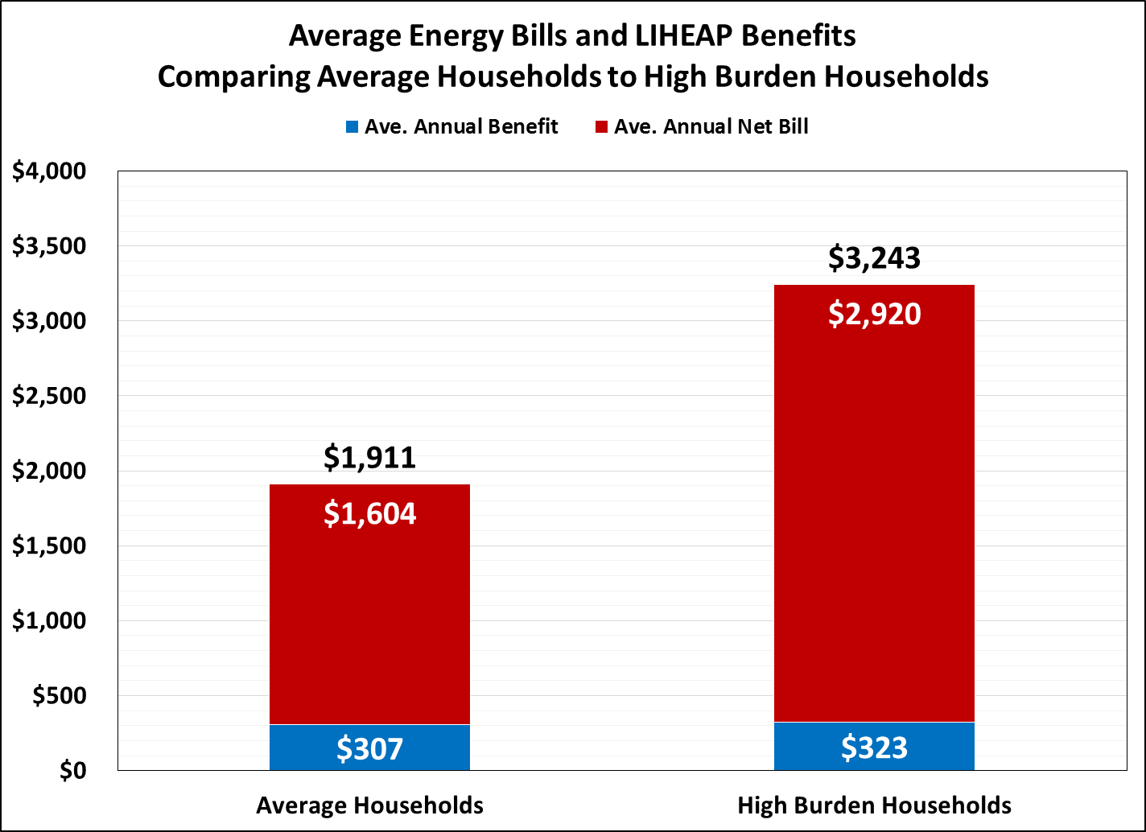
Example #1 – Expenditures
The data show that some recipients have very high energy bills – average for high burden recipients is >$3,000
43

Slide 44
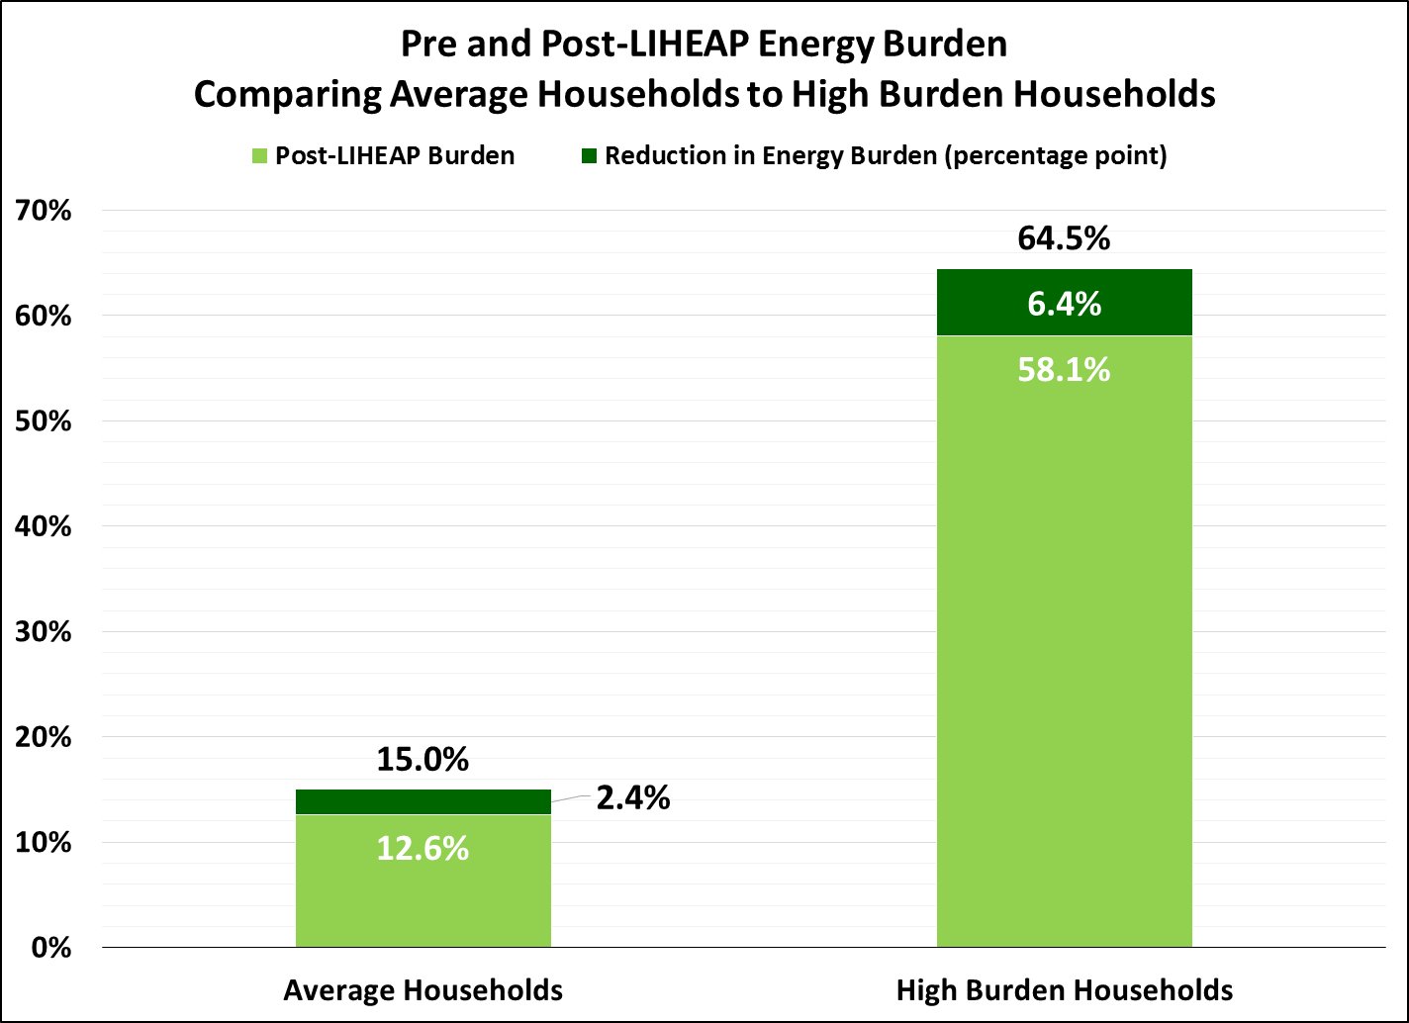
Example #2 – Energy Burden
The data show that some recipients have very high energy burden – average for high burden recipients is 4x greater than all recipients
44

Slide 45
Example #3 – Equipment Use
Supplemental Heating Use – 4% of all LIHEAP recipients in state
16% of LIHEAP recipients using natural gas main heat use a supplemental heating source
10% of LIHEAP recipients using fuel oil main heat use a supplemental heating source
Window/Wall AC Use – 18% of all LIHEAP recipients in state
45

Slide 46
How can the data help warm weather states?
The Performance Measures provide actual energy expenditure data documenting the need for additional ratepayer-funded energy efficiency programs
The data can help to identify subgroups with greater needs
Opportunity for referrals from LIHEAP to WAP for those with the highest usage
46

Slide 47
Conclusions
47

Slide 48
Conclusions
Need for Low-Income Weatherization in the Warm Climate States
Low-income households in warm southern climates have energy expenses and energy burdens comparable to the Midwest
Less of the income-eligible population in the warmer climate zones served, but also less funding available
Comparatively few ratepayer programs targeted at low-income households in the South
48

Slide 49
Conclusions
WAP Performance in Warm Climates
Combined gas/electric savings for gas-heated homes in the Hot-Humid and Moderate zones was comparable to the Very Cold zone.
Electric main heat savings in warm regions similar to cold regions.
Measure installation rates show room for improvement.
Analysis across climate zones points to the need to prioritize high usage and major measures
49

Slide 50
Conclusions
New LIHEAP Performance Measures
The warm weather state LIHEAP offices are collecting energy expenditure data that can help to document the need for additional ratepayer funded energy efficiency programs in those states.
WAP offices can coordinate with LIHEAP to review the data and discuss ways to target high usage LIHEAP recipients.
Example = Minnesota
50

Slide 51
Conclusions
Continued opportunity for WAP to maximize energy savings in warm climates
Target high usage customers
Identify opportunities for major measure installations
Conduct performance management to assess work quality
Conduct evaluations to assess if goals are achieved
51

Slide 52
Contact
Kevin McGrath, 609-252-2081
Kevin-McGrath@appriseinc.org
Dan Bausch, 609-252-9050
Daniel-Bausch@appriseinc.org
APPRISE
32 Nassau Street, Suite 200
Princeton, NJ 08540
52

