Slide 1
Best Practices in Residential Energy Efficiency
NJ Clean Energy Learning Center Conference
September 12, 2017
Jackie Berger
APPRISE

Slide 2
APPRISE
Nonprofit Research Institute
Established in 2002
Princeton, NJ
Mission
Analyze data and information to assess and improve public programs
Research Areas
Energy Efficiency
Energy Affordability
Clients
Federal Government (DOE, HHS)
State Governments
Utility Companies
Nonprofits

Slide 3
Achieving High Savings
Introduction
Evaluation findings
Using information to improve outcomes
Maximizing Energy Savings
Target high energy users
Install major measures where cost-effective
Provide effective service delivery
Performance Measurement
System to measure and improve outcomes
Systematically measure quality of service delivery
Summary & Recommendations
Key data to assess the program
Building on program success

Slide 4
INTRODUCTION

Slide 5
Energy Efficiency Program Goals
Energy Savings
Cost-Effectiveness
Bill Reduction
Health and Safety Improvement
Environmental Impact
Economic Impact
Delivery to Vulnerable Households

Slide 6
Energy Efficiency Program Effectiveness
Energy efficiency programs have many different goals
Evaluations need to assess accomplishments with respect to those goals
Program managers need to refine program based on goal prioritization
This session focuses on one goal – energy savings
Savings and cost-effectiveness is a key performance measure for energy programs

Slide 7
Session Objectives
Energy Efficiency Programs have Great Potential for
Saving Energy
Improving Lives of Participants
Research Shows
Differences in Energy Savings
BETWEEN and WITHIN Programs
Discuss Factors Associated with Higher Savings
Recommendations
Ongoing Performance Measurement

Slide 8
Information Sources
National WAP Evaluation
6 Ratepayer HPwES & High- Efficiency HVAC
2008 Program
2010 Program
10 State-Level WAP Evaluations
Over last 5 years
By APPRISE and others
10 State and Utility Ratepayer Low-Income Evaluations
Over last 5 years
By APPRISE
Over last 5 years
By APPRISE

Slide 9
CONCEPTS

Slide 10
Natural Gas Usage
Definition of high usage varies by geography
Mountain North
Census Division
950 Therms
Midwest
Census Region
950 Therms
Northeast
Census
Region
900 Therms
Pacific
Census
Division
450 Therms
Average gas usage per low-income household
Mountain South
Census Division
450 Therms
South
Census
Region
600 Therms
10

Slide 11
Energy Program Savings Estimates
Energy Savings based on billing analysis
Use of utility data
Weather normalization
Comparison group
NOT projections of energy savings

Slide 12
Energy Savings
A
B
12 Months Pre-Wx
Energy Usage
Weather Normalize
12 Months Post-Wx
Energy Usage
Weather Normalize
Wx
Gross Energy Savings
A-B
1-12 Mnth Pre-Wx
Energy Usage
Weather Normalize
Comp.
Group
Wx
C-D
13-24 Mnth Pre-Wx
Energy Usage
Weather Normalize
Comp. Group Savings
C
D
Net Savings
Gross Energy Savings
Comparison Group Savings
A-B
C-D
12

Slide 13
Major Measures
Measures for single family homes
In order of average impacts in comprehensive program
Furnace Replacement
70-150 Therms
Wall Insulation
60-120 Therms
Attic Insulation
50-100 Therms
Major Air Sealing
Duct Sealing
Thermostats
Foundation/Rim/Floor Insulation
50-100 Therms
10-30 Therms
10-30 Therms
10-30 Therms
13

Slide 14
CONSISTENT FINDINGS FROM PROGRAM EVALUATIONS

Slide 15
Increase Savings by…
Identify, prioritize, and install appropriate measures
Ensure high quality work
Target high usage homes that need major measures

Slide 16
Intersection of…
Policies
Target homes with highest potential
Prioritize measures with greatest impact
Furnish providers with right incentives
Practices
Ensure staff have needed skills and tools
Use best practices for measure selection
Complete high quality installation
Identify problems, give feedback, resolve issues
SUCCESS

Slide 17
FACTORS ASSOCIATED WITH HIGH SAVINGS: Targeting High Usage

Slide 18
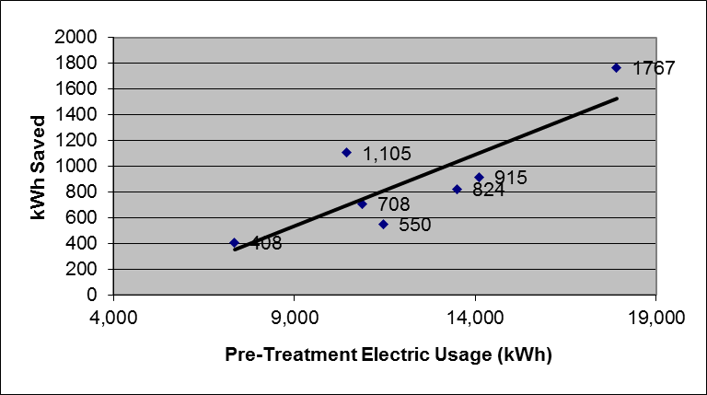
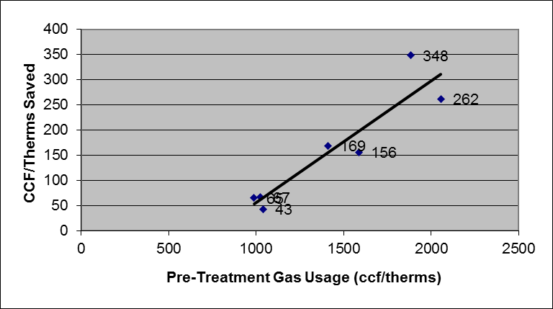
Treating High Usage Across Program Analysis
Seven low-income electric efficiency program evaluations over past ten years.
Seven low-income gas efficiency program evaluations over past five years.
18

Slide 19
Usage Impact Analysis
National Weatherization Program
Single Family Homes – Gas Savings
Pre-Treatment Usage | PY 2008 |  |  |  | PY 2010
 | Obs | Therms |  | % Save | Obs | Therms |  | % Save
 |  | Pre Use | Net Save |  |  | Pre Use | Net Save
<750 therm/yr. | 858 | 571 | 67 | 11.8% | 2,181 | 557 | 64 | 11.5%
750-1000 | 963 | 875 | 133 | 15.2% | 1,723 | 873 | 126 | 14.4%
1000-1250 | 726 | 1,120 | 206 | 18.4% | 1,227 | 1,111 | 199 | 17.9%
1250-1500 | 472 | 1,367 | 271 | 19.8% | 683 | 1,362 | 237 | 17.4%
>=1500 therm/yr. | 479 | 1,879 | 414 | 22.1% | 778 | 1,921 | 345 | 17.9%

Slide 20
Usage Impact Analysis
South Jersey Gas
Home Performance with Energy Star

Slide 21
Usage Impact Analysis
New Jersey Natural Gas
Home Performance with Energy Star

Slide 22
FACTORS ASSOCIATED WITH HIGH SAVINGS: Install Major Measures

Slide 23
Usage Impact Analysis
National Weatherization Program
Single Family Homes – Gas Savings
Major Measures | PY 2008 |  |  |  | PY 2010
 | Obs | Therms |  | % Save | Obs | Therms |  | % Save
 |  | Pre Use | Net Save |  |  | Pre Use | Net Save
None | 342 | 866 | 59 | 6.8% | 733 | 823 | 37 | 4.5%
One | 983 | 989 | 118 | 12.0% | 1,811 | 928 | 103 | 11.1%
Two | 973 | 1,035 | 181 | 17.5% | 1,916 | 1,005 | 168 | 16.7%
Three | 619 | 1,146 | 286 | 25.0% | 1,031 | 1,070 | 256 | 24.0%
Four | 192 | 1,220 | 414 | 33.9% | 304 | 1,124 | 369 | 32.8%

Slide 24
Usage Impact Analysis
NJ Comfort Partners
ELECTRIC HEATING SAVINGS
Number of Major Measures | Air Sealing, Attic Insulation, Other Insulation, HVAC Replace, Duct Sealing, Refrigerators
 | Obs. | % | Net Savings
 |  |  | kWh | %
None | 102 | 20% | -29 | -0.3%
1 Measure | 121 | 24% | 564* | 4.5%
2 Measures | 137 | 27% | 1,223** | 9.6%
3 Measures | 97 | 19% | 1,982** | 13.2%
4-5 Measures | 42 | 8% | 2,934** | 19.0%
GAS HEATING SAVINGS
Number of Major Measures | Air Seal, Attic Insul, Floor Insul, Sidewall Insul, Wall/Perimeter Insul, HVAC Replace, Duct Seal
 | Obs. | % | Net Savings
 |  |  | ccf | %
None | 1,365 | 28% | 11 | 1.1%
1 Measure | 1,066 | 22% | 35** | 3.9%
2 Measures | 1,284 | 27% | 34** | 3.5%
3 Measures | 792 | 16% | 97** | 8.8%
4 Measures | 260 | 5% | 150** | 12.4%
5-6 Measures | 57 | 1% | 218** | 15.9%

Slide 25
FACTORS ASSOCIATED WITH HIGH SAVINGS: Contractor Performance

Slide 26
Contractor Performance
National Weatherization Program
Single Family Homes – Gas Savings
Agency ID | Gas Use Pre-WAP | Net Savings | % of Pre | # of Measures
A | 1,077 | 187 (± 21) | 17.3% (±1.9) | 2.2
B | 992 | 122 (± 32) | 12.3 % (±3.2) | 0.9
C | 1,028 | 119 (± 40) | 11.6% (±3.9) | 1.2
D | 948 | 118 (± 19) | 12.4% (±2.0) | 1.3
E | 1,012 | 113 (± 64) | 11.1% (±6.3) | 0.7
F | 937 | 109 (± 44) | 11.6% (±4.7) | 1.2
G | 945 | 107 (± 50) | 11.3% (±5.3) | 0.9
H | 875 | 94 (± 26) | 10.7% (±3.0) | 0.7
I | 929 | 94 (± 41) | 10.1% (±4.4) | 1.1
J | 889 | 58 (± 27) | 6.5% (±3.0) | 0.5
Total | 983 | 130 (±11) | 13.2% (±0.7) | 1.4

Slide 27
Contractor Performance
South Jersey Gas
Home Performance with Energy Star

Slide 28
Contractor Performance
South Jersey Gas
Home Performance with Energy Star
Contractor | Treatment |  |  |  |  | Matched Comparison Group |  |  |  |  | Net Savings |  | Average Project Cost
 | Obs | Pre | Post | Savings |  | Obs | Pre | Post | Savings
 |  |  |  | ccf | % |  |  |  | ccf | % | ccf | %
A | 281 | 890 | 678 | 211*** | 23.7% | 281 | 883 | 897 | -14** | -1.6% | 225*** | 25.3% | $14,756
B | 98 | 834 | 637 | 198*** | 23.7% | 98 | 806 | 812 | -6 | -0.7% | 204*** | 24.4% | $17,697
C | 50 | 746 | 615 | 131*** | 17.6% | 50 | 742 | 745 | -3 | -0.4% | 135*** | 18.0% | $14,839
D | 47 | 901 | 696 | 205*** | 22.7% | 47 | 882 | 898 | -16 | -1.9% | 221*** | 24.5% | $15,743
E | 34 | 872 | 694 | 178*** | 20.4% | 34 | 875 | 920 | -45* | -5.1% | 223*** | 25.5% | $15,698
F | 20 | 871 | 732 | 139*** | 16.0% | 20 | 864 | 869 | -5 | -0.5% | 144*** | 16.5% | $17,190
Other Contractors | 116 | 887 | 702 | 184*** | 20.8% | 116 | 879 | 890 | -11 | -1.2% | 195*** | 22.0% | $15,595
All | 646 | 859 | 675 | 194*** | 22.3% | 646 | 859 | 871 | -13*** | -1.5% | 206*** | 23.8% | $15,556

Slide 29
Improvement Opportunities
Use blower door while inspecting for leaks
Work with customer to understand behavior change opportunities
Use blower door to guide air sealing
Use energy bills to assess opportunities
Communicate findings from auditor to installers
Use zonal pressure diagnostics to affirm appropriate pressure boundaries
Seal all major opportunities

Slide 30
PERFORMANCE MEASUREMENT

Slide 31
Performance Measurement
Program Statistics
Refine
Pilot Changes
Quality Control
Hold Staff Accountable
Assess Inputs and Outputs
Assess Inspection Results
Assess Energy Savings

Slide 32
Performance Measurement
Self-Assessment Example
 | Baseline | Follow-up 1 | Follow-up 2
Pre-Usage>1,200 ccf | 25% | 35% | 40%
3 or 4 Major Measures | 15% | 25% | 35%
Wall Insulation | 10% | 15% | 25%
Attic Insulation | 50% | 55% | 60%
Major Air Sealing | 55% | 55% | 60%

Slide 33
Performance Measurement
Review rates of:
Comprehensive installation
High quality installations
Missed opportunities
Poor work quality
⇨Early indication of energy saving expectations.

Slide 34
Performance Measurement
Self-Assessment Example
 | Baseline | Follow-up 1 | Follow-up 2
Audit Observation
Identified Occupant Opportunities | 50% | 60% | 70%
Comprehensive Audit Diagnostics | 60% | 75% | 95%
Post Complete Inspection
All Major Sealing Opportunities Addressed | 55% | 75% | 90%
No Gaps or Voids in Attic Insulation | 75% | 90% | 95%
No Major Missed Opportunities | 70% | 80% | 95%

Slide 35
Performance Measurement
Conduct billing analysis on an annual basis
Needed to ensure expected results
Develop procedures to more easily extract data
Reduced evaluation cost

Slide 36
Performance Measurement
Compare Results Over Time
Assess What is Working
Refine Program

Slide 37
ACHIEVING HIGH SAVINGS
SUMMARY

Slide 38
Achieving High Savings Lessons Learned
It is challenging to meet savings expectations
Target high usage customers
Ensure major measures are installed where opportunities exist
Maximize use of proven home performance techniques
Conduct performance measurement

Slide 39
Jackie Berger
APPRISE
32 Nassau Street, Suite 200
Princeton, NJ 08540
609-252-8009
jackie-berger@appriseinc.org
www.appriseinc.org

