Slide 1
Improving, Expanding, and Evaluating Residential Energy Efficiency Services
Anne-Marie Peracchio, NJNG
Jacqueline Berger, APPRISE
February 15, 2017

Slide 2
Overview
New Jersey Natural Gas/SAVEGREEN
Participant Feedback
Contractor Feedback
Usage Impacts
Non-Energy Benefits
Key Findings and Recommendations

Slide 3
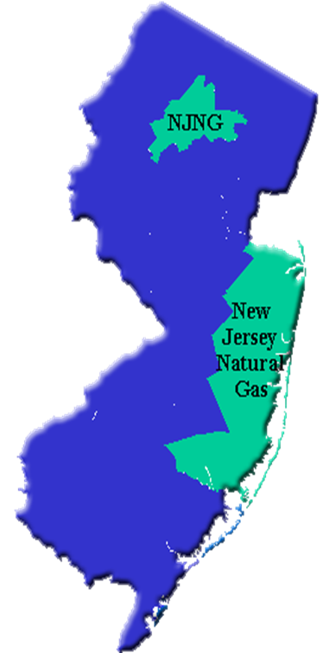
New Jersey Natural Gas
Established in 1952
Largest independent LDC in New Jersey
Provides safe, reliable service to over 520,000 customers
Primarily residential and small commercial customer base
Conserve to Preserve® launched in 2006 and separate EE programs launched in 2009 as
Notes:
Can speak to EE landscape in NJ , governor’s call to action, SAVEGREEN goals

Slide 4
The SAVEGREEN Project

Slide 5
SAVEGREEN Programs
Residential Enhanced Rebate
Residential HPwES On-Bill Financing and Rebate
Commercial Direct Install
OPower Pilot
High-efficiency gas furnace or boiler
Residential Non-HPwES On-Bill Repayment
SAVEGREEN rebate + NJCEP rebate
Participation in free NJNG audit required
High-efficiency heating and water heating system
SAVEGREEN On-Bill Financing + NJCEP rebate
Participation in free NJNG audit required
NJCEP HPwES participation
On-Bill Financing and rebate provided by NJNG
NJCEP Direct Install participation
On-Bill Financing + NJCEP 70% rebate
Mailings that compare usage to similar neighbors
Provide tips for saving energy
Notes:
Speak to volumes and transition over the years to less standalone and more comprehensive projects using financing

Slide 6
Contractor Outreach
Email blasts
Counter days at supply houses
Informational meetings
Free technical training sessions
Increased high-efficiency heating system rebate contractors to 2,100

Slide 7
Customer Outreach
Website banner advertisements
Targeting mailings to online audit participants
Marketing to customers who sent inquiries
Leverage support from municipalities and others
Presentations and workshops
Partnerships with the C&I Direct Install contractors

Slide 8
evaluation

Slide 9
Evaluation Overview
Background Research
Program Data Analysis
Participant Interviews
Contractor Interviews
Usage Impact Analysis
Non-Energy Benefits
Electric Data Collection

Slide 10
Participant feedback 50 In-depth Telephone Interviews

Slide 11
Participant Feedback Key Findings and Recommendations
Information Source
Include the benefits of saving money or energy, and SAVEGREEN financing options in the residential program marketing materials
Participation Reason
Continue focusing on the contractors while maintaining other outreach methods, including website
Changes to Homes
Many noticed changes in home comfort and gas bills, so these benefits should be included in marketing materials
Measure Installation
Contractors should be trained to clearly educate participants on installation options and how decisions affect program benefits.
Notes:
Key findings cover the points from the early slides. Could use a few of the compelling stats as talking points.

Slide 12
Contractor feedback 10 In-depth Telephone Interviews

Slide 13
Contractor Feedback Key Findings and Recommendations
Marketing
Continue contractor emails and training sessions
Continue customer-targeted print and web-based advertisements
Contractor Communication
Continue to provide trainings as they increase SAVEGREEN awareness and provide important information
Continue to update and maintain the SAVEGREEN Website and Portal
Send emails to alert contractors when program updates are posted
Contractor Satisfaction
Provide payments directly to contractors (change has been made)
Continue to use email as primary source of contractor communication

Slide 14
Usage impacts

Slide 15
Usage Impact Methodology
Treatment group
2013 participants
Participant comparison group
2014 participants
Matched comparison group
Matched nonparticipants

Slide 16
Gas Usage Impacts
Heating System Replacement Rebate
 | Treatment |  |  |  |  | Comparison Group |  |  |  |  | Net Savings
 | Obs | Pre | Post | Savings |  | Obs | Pre | Post | Savings
 |  |  |  | Therm | % |  |  |  | Therm | % | Therm | %
All HVAC Rebate | 3,168 | 1,102 | 1,026 | 75** | 6.8% | 3,168 | 1,098 | 1,098 | >-1 | >-0.1% | 76** | 6.9%
Home Performance Impact
 | Treatment |  |  |  |  | Matched Comparison |  |  |  |  | Net Savings
 | # | Therms |  | Savings |  | # | Therms |  | Savings |  | Therms | %
 |  | Pre | Post | Therms | % |  | Pre | Post | Therms | %
Degree Day | 1,156 | 1,048 | 849 | 199** | 19.0% | 1,156 | 1,050 | 1,072 | -22** | -2.1% | 221** | 21.1%

Slide 17
Non-energy benefits

Slide 18
Non-Energy Benefits
Environmental Benefits
(2013 Participants)
Economic Benefits
(2013 Participants)
Health & Safety Benefits
(2014 Participants)

Slide 19
Environmental Benefits Methodology
Energy Savings
Avoided Emissions
Value Avoided Emissions
Reduction in Natural Gas Usage
Tons of CO2, SO2, Nox, PM 2.5, and VOC
$ value using APEEP Model

Slide 20
Value of Avoided Emissions
 | Heating System Rebate |  |  | HPwES OBRP |  |  | Total Savings
 | Avoided Emissions (tons) | Marginal Value of Avoided Emissions ($ per ton) | Savings | Avoided Emissions (tons) | Marginal Value of Avoided Emissions ($ per ton) | Savings
CO2-eq | 3,139 | $41.4 | $129,945 | 2,356 | $41.4 | $97,547 | $227,492
SO2 | 0.015 | $111,573 | $1,654 | 0.011 | $111,573 | $1,242 | $2,896
NOx | 2.32 | $23,023 | $53,485 | 1.74 | $23,023 | $40,150 | $93,634
PM 2.5 | 0.047 | $468,563 | $22,002 | 0.035 | $468,563 | $16,516 | $38,518
VOC | 0.136 | $44,180 | $6,005 | 0.102 | $44,180 | $4,508 | $10,513
Annual |  |  | $213,091 |  | $159,963 |  | $373,054
Lifetime |  | $1,909,622 |  |  | $2,543,862 |  | $4,453,491

Slide 21
Economic Benefits Theory
SAVEGREEN spending replaces retail spending
Charge on energy bill would have been spent on retail goods
Retail spending replaces natural gas spending
Energy savings from program spent on retail goods
Increase in economic activity because replacement spending has
Higher labor intensity
Greater percentage spent in NJ

Slide 22
Economic Benefits Output Impact
Source of Economic Impact | Base Amount | Output Multiplier |  |  | Economic Impact ($)
 |  | With Program | Without Program | Change
NJNG Admin Spending
Labor: Admin, Prog Dev. | $251,346 | 1.9212 | 1.7112 | 0.2100 | $52,783
General: Sales, Marketing | $1,941,029 | 1.7661 | 1.7112 | 0.0549 | $106,562
Labor: Rebates, Inspect, QC | $1,224,056 | 1.9241 | 1.7112 | 0.2129 | $260,602
NJNG & NJCEP Incentives
NJNG HPwES Incentives | $23,694,720 | 1.7845 | 1.7112 | 0.0733 | $1,736,823
NJNG Enhanced Rebates | $4,804,500 | 1.7845 | 1.7112 | 0.0733 | $352,170
NJCEP Rebates | $2,178,460 | 1.7845 | 1.7112 | 0.0733 | $159,681
Customer Net Costs
HPwES Net Costs | $1,568,640 | 1.7845 | 1.7112 | 0.0733 | $114,981
Rebate Net Costs | $35,030,970 | 1.7845 | 1.7112 | 0.0733 | $2,567,770
Customer Total Savings
Natural Gas Savings | $10,086,713 | 1.7112 | 1.2638 | 0.4474 | $4,512,795
Total Economic Impact |  |  |  |  | $9,864,167

Slide 23
Health & Safety Issues Identified
 | Homes With Issue
 | Rebate |  | $6,500 OBRP
 | # | % | # | %
Improper Dryer Venting | 894 | 23% | 61 | 25%
Improper Bath Venting | 724 | 19% | 62 | 25%
Did Not Pass Oven Inspection | 189 | 5% | 6 | 2%
Moisture Issues | 132 | 3% | 10 | 4%
Gas Piping Leaks | 90 | 2% | 4 | 2%
Did Not Pass Depressurization Worst Case Test | 76 | 2% | -- | --
Did Not Pass Water Heater Draft (Worst Case) | 52 | 1% | -- | --
Gas Piping Leaks at Dryer | 28 | 1% | 0 | 0%
Did Not Pass Water Heater Draft (Natural) | 15 | <1% | -- | --
Asbestos Issues | 15 | <1% | 0 | 0%
CO ≥100ppm by Water Heater | 8 | <1% | -- | --
Structure Issues | 7 | <1% | 0 | 0%
CO ≥100ppm in CAZ | 0 | 0% | -- | --
ONE OR MORE ISSUES | 1,616 | 42% | 99 | 40%

Slide 24
Key findings & recommendations

Slide 25
Overview of Findings
Program Accomplishments
Customer Participation
Contractor Recruitment
Contractor Training
Importance of Program to Efficiency Work
High Customer and Contractor Satisfaction
Large Gas Usage Impacts
Non-Energy Benefits Achieved

Slide 26
Key SAVEGREEN Components
Contractor Development
Program Offerings
Marketing
Data Management
Home Energy Score
Safety and Quality
Recruiting and training
On-bill repayment improved affordability
Increased participation by customers at lower income levels
Extensive marketing with multiple methods
Multiple audiences – homeowners, contractors, realtors, businesses
Contracted with software developer
Improved efficiency and effectiveness of program administration and marketing
Early participant in DOE program, scored thousands of homes and worked with DOE to improve program
Promoted need for combination furnace and water heater replacement
Educated contractors to understand requirements for installing high-efficiency systems
Identify health & safety issues during home audits

Slide 27
Key Issues for Efficiency Programs
Program Stability
Policy
Marketing
Technology
Data
Energy efficiency programs need stability and consistency to obtain acceptance in the marketplace.
Ramifications of energy efficiency improvements in a home must be carefully considered before implementing new programs.
Energy efficiency programs need extensive and continuous marketing to gain awareness and acceptance.
Education and outreach are needed to help contractors understand the requirements of high-efficiency equipment. Without such outreach, unsafe installations such as orphaned water heaters can result.
Investment in data management is an important input to a successful energy efficiency program.

Slide 28
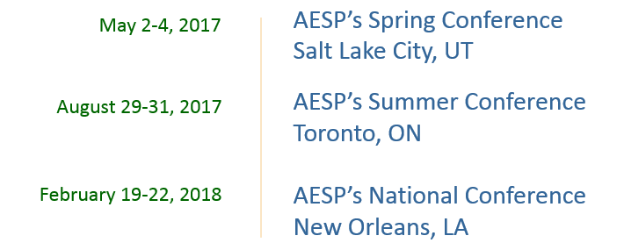
Save The Dates
For more information - www.aesp.org

